Slide 1
Birmingham Young Carers Unite
Schools Area Safeguarding Conferences
July 2017
Claire Toy

Slide 2
Spurgeons Birmingham Young Carers Unite
Who are we and who are spurgeons?
We are Compassionate
We demonstrate care and commitment in all our relationships even when that means making touch choices and going the extra mile.
We are Inclusive
We recognise each person as a unique individual, treating them with respect and celebrating our diversity.
We are Hopeful
We believe that positive change is possible for all people, so we maintain a hopeful attitude and do not easily give up.

Slide 3
Tier 3 - High Priority
Excessive or harmful levels of caring responsibility with high levels of unmet need requiring a co-ordinated multi-agency response, lead professional required linked to FCaf/ CIN Plan/ CP Plan. Time-limited holistic key worker support with young carer and their family will be provided. This tier level may also be appropriate for a life limiting diagnosis.
Tier 2 - Second Priority
Significant or regular caring role requiring additional support provided through group activities and a range of short break opportunities to develop peer support/enhance friendships/share experiences/ develop skills and confidence. May also include referrals or signposting to other relevant organisations.
Tier 1 - Third Priority
Low level / irregular caring role where needs can be met through universal provision e.g. access to mainstream services/ telephone support & advice/online information & support and referrals or signposting to other relevant organisations.

Slide 4
BYCU’S Offer
Regular young carers respite group
Confidential one-to-one support with a dedicated worker
Help to access other services
Training opportunities, e.g. first aid, fire awareness or building self esteem and confidence
Telephone Support
Issue based workshops
Access to our counselling service if needed
Transition into the adult carers service once you reach 18
Opportunity to take an activity break, make friends and have some fun!
Family Days
Information and Advice

Slide 5
The Numbers and Stats
At Birmingham Young Carers Unite we currently have 605 active Young Carers involved with the service.

Slide 6
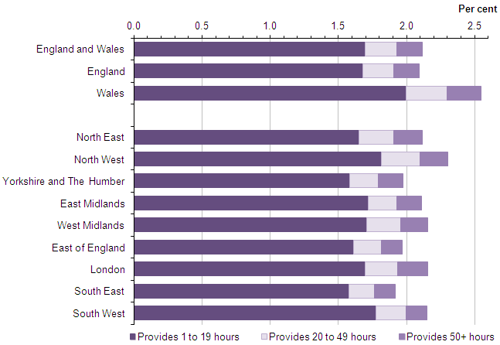
Country/Region | Proportion providing unpaid care |  | Number of young unpaid carers |  | Percentage increase between 2001 and 2011
 | 2001 (%) | 2011 (%) | 2001 | 2011
England and Wales | 1.7 | 2.1 | 149,929 | 177,918 | 18.7
England | 1.7 | 2.1 | 139,188 | 166,363 | 19.5
Wales | 2.2 | 2.6 | 10,741 | 11,555 | 7.6
North East | 1.8 | 2.1 | 7,808 | 7,943 | 1.7
North West | 2.0 | 2.3 | 22,917 | 24,561 | 7.2
Yorkshire and The Humber | 1.7 | 2.0 | 14,615 | 15,733 | 7.6
East Midlands | 1.8 | 2.1 | 12,603 | 14,327 | 13.7
West Midlands | 1.8 | 2.2 | 16,526 | 18,979 | 14.8
East of England | 1.5 | 2.0 | 13,100 | 17,497 | 33.6
London | 1.9 | 2.2 | 22,044 | 26,231 | 19.0
South East | 1.4 | 1.9 | 17,692 | 24,974 | 41.2
South West | 1.5 | 2.2 | 11,883 | 16,118 | 35.6
Table source: Office for National Statistics
Provision of unpaid care per week for 5 to 17-year-olds in England and Wales, 2011
Proportion, numbers and percentage increases of unpaid carers aged 5 to 17-years-old, between 2001 and 2011 in England and Wales
Office for National Statistics

Slide 7
1 in every 12 Pupils is a Young Carer
That’s at least 1 in every classroom
Carers Trust 2017

Slide 8
What’s the impact of caring?
Physical Health
Emotional Wellbeing
Isolation
Unstable environment
Ongoing impact

Slide 9
Identifying Young Carers
Identifying young carers is not always a simple task and there are lots of different way to ensure no young carer is missed.
Opportunity for self-identification
Everyones business
secure and safe environment for parents
secure and safe environment for young people
Good information sharing
Partnership with BYCU
Honesty and Openness

Slide 10
BYCU’S Schools Training Package
Training Level | Training length | Minimum no. of staff | Topics covered
Basic Young Carer Aware | 3hour session | 5 | Spurgeons Birmingham Young Carers Unite – Who are we and who are spurgeons? Who are young carers? Ofsted and the government Identifying young carers Transitioning
Active Young Carer Aware | Full day training or 2x 3hour session | 5 | In addition to the above topics: The impact of caring (their voice) Supporting young carers Steps your school can take Contract of commitment

Slide 12
Claire Toy,
Senior Young Carers Support Worker
Birmingham Young Carers Unite
Tel: 0121 227 7000
Mob: 07880383967
Birmingham Young Carers Unite
St George’s Community Hub
Great Hampton Row
Hockley
B19 3JG
www.spurgeons.org
www.facebook.com/spurgeons
www.twitter.com/SpurgeonsUK

