Slide 1


Keeping Children
Safe Online
The Safety Net Programme

Slide 2

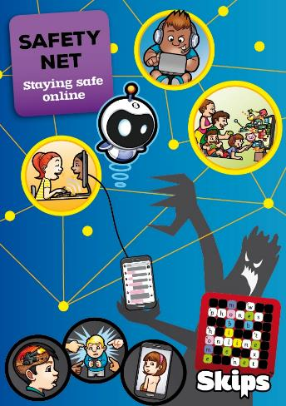
Introducing
Supporting:
Birmingham City Council’s Sustainable Schools Programme
Education Resilience team and Prevent Framework
Birmingham’s schools
Birmingham’s communities
Providing:
Training
Resources
Partnerships
Notes:
Split children up and ask them to collect the information from each other and write down the answers on a piece of paper.
Then collect them up ( you will need to read some of them out later on)

Slide 3
What is the problem?
The minimum official age for use of Facebook, WhatsApp, Instagram and Snapchat is 13, and yet 75% of 10 to 12 year-olds in the UK are said to have accounts.
2016 - the NSPCC and Children’s Commissioner found 13% of 11 to 16 year-olds reported that they had taken topless pictures of themselves and 3% had taken fully naked pictures of themselves.
2017 - More than one in 10 young people say they have been the victim of cyber bullying, and self-harm among children is on the rise amid evidence of a link between internet use and an increased risk of self harm.
2018 - Children’s Commissioner, Anne Longfield is calling on schools and parents to prepare children for the social media ‘cliff edge’ as they start secondary school. “We should teach kids how to use social media, not scare them off it.”

Slide 4
What is the answer?
2018 - Children’s Commissioner has called for compulsory digital literacy and online resilience lessons for Year 6s and 7s, so that they learn about the emotional side of social media and not just messages about safety.
It is increasingly clear that some behaviours which are unacceptable offline are being tolerated or even encouraged online – sometimes with devastating consequences. “We are determined to make Britain the safest place in the world to be online, and to help people protect themselves from the risks they might face. Karen Bradley, Secretary of State for Culture Media and Sport
The Department for Education’s (DfE) 2016 Keeping Children Safe in Education (KCSIE) statutory guidance states that “Governing bodies and proprietors should ensure there are appropriate procedures in place to safeguard and promote children’s welfare which should amongst other things include acceptable use of technologies and communications including the use of social media.”

Slide 5
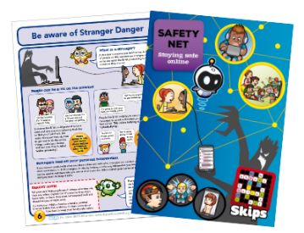
The SKIPS Safety Net Programme engages and empowers teachers, pupils and parents.
Schools that join the programme receive:
CPD training for teachers, equipping them with the skills, confidence, and resources they need to deliver effective lessons.
Class set of exercise books to capture the thinking and learning back in the classroom.
Class set of parental engagement books that act as a toolkit to take the messages from the classroom into the homes.
Certificates of achievement for pupils
Parental engagement workshops (optional)

Slide 6
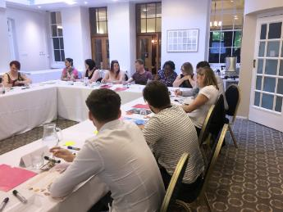
How is Skips different?
People focused
Scenario based
A supportive forum
We provide insight into the problems children can experience while online and discuss appropriate behaviour and improve emotional intelligence.
Our books provide technical hints and tips to help your children and their families stay safe online and also prompt some of the “difficult “conversations needed.
The training and resources we provide help you take what you learn back to school pass on your learning to your pupils and share best practice with other members of staff and provide parental workshops where required.

Slide 7

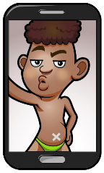
What topics do we explore?
Through social media
Through online gaming
Through chatting online
Notes:
The internet has risks

Slide 8
Why we know it works -
The Safety Net Pilot Experience
SKIPS had previously developed a draft Safety Net homework book and training material in line with programmes they had previously delivered in support of sustainable education and we wanted to test this out with the professionals who would be using it going forward.
The Pilot training day was structured to allow discussion, feedback and evaluation at every stage and to discuss how to use the books in a lesson and then send the books home for parents.
From the comments made and captured all through the training it became very clear that although teachers had previously attended training and gained some knowledge, they had not been given the skills and resources to teach their children only sign posting to what was available online.
The conclusion was that they wanted something ready to use including a framework of activities they could use in school to discuss online dangers. In the pilot participants collectively thought the draft version of the books and the training materials were excellent quality and easy to use.

Slide 9
Findings from Pilot –
Knowledge and behaviour before Safety Net
Nearly all children were unclear about what was personal information.
The majority of children ignorant of the dangers posed by the Internet, social media, and online gaming.
The majority of children had already had negative personal experiences online.
Most children said that their parents didn’t really check what they were doing online.
The Majority of children visit websites or play online games that are NOT age-appropriate.
GTA Warning Extreme Violence –
https://www.youtube.com/watch?v=yTzSuf3xqRM

Slide 10
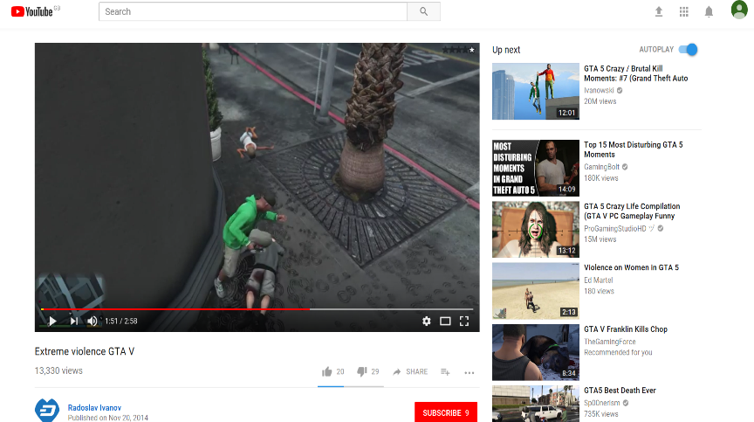
Most disturbing GTA Moments

Slide 11
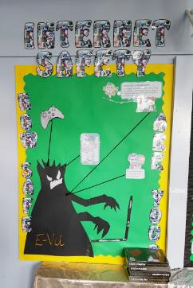
What changed after Safety Net?
Children now understand the dangers of strangers online, and playing age-inappropriate games.
Nearly all had a better understanding what personal information is, and how much to share online to keep safe.
They also have greater awareness of cyberbullying and sexting and knowledge that not everyone online is who they say they are
Pupils now know what ‘grooming’ is, and how online methods and fake news can be used to exploit people in relation to child abuse, gangs, and radicalisation.
Children are now aware who to speak to and trust without fear if they feel uncomfortable about something they have encountered online.

Slide 12
Feedback from parents
Parent workshops, July 2017.
All parents said they would have engaged more with their children’s online activities if they had the workshop at an earlier date.
95% of them admitted that they were not aware of the dangers of online use.
85% of them admitted knowing that their children play 18+ rated games, and will now take immediate action to stop them.
All parents said they would tell other parents to attend a Safety Net workshop.
Parents found the information regarding what their children might be witnessing online quite emotional and shocking, particularly the age inappropriate games and offensively corrupted child-oriented video programmes, which could so easily and innocently be accessed.
They said that the Safety Net programme should be made compulsory.
Caught in the Web – https://youtu.be/kgCNGvL0g1g
Safe Surfing on the Web – https://youtu.be/yrln8nyVBLU

Slide 13
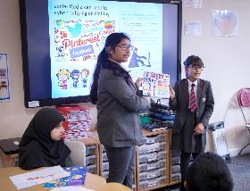
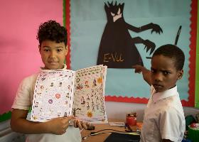
Further Evaluation – Programme Delivery
50 Birmingham Schools have engaged since the launch.
Feedback:
Unique approach.
Engaging quality resources.
Easily cascaded into the classroom.
Saves hours of preparation time.
Structured parental workshops.
Confidence in the programme changing behaviour impelling parents to take action.
Improved parental engagement with the school.
“The children were really engaged by the topics and resources.”
Angela Schofield, Ark Chamberlain Academy.

Slide 14
Case Study: St. Clements Academy
After completing the Safety Net programme
St Clements had two disclosures from pupils.
The teacher said following using Safety Net in the classroom the children now trust her enough to confide in her.
She added the programme had allowed them to intervene before the situation had got out of hand. Instead of matters escalating, Safety Net provided an outlet for a child to voice their concerns and articulate that they were disturbed by things they did not fully understand.
“The Internet safety training has given me the confidence to not only teach the children how to be safe, but also to run parent safety workshops. It has given me ideas of good quality resource use, ways of assessing the understanding of the usefulness and the impact of the booklet sent home.”
Terri Hall - Class Teacher, St. Clements Academy.

Slide 15
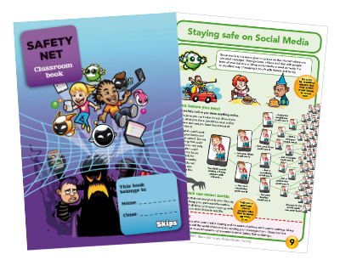
The Safety Net Programme
THREE YEARS TRAINING AND BOOKS FOR ONE CLASS
The cost, for each participating school, will be £249
For this one-off payment, you will receive the full programme for one teacher and one class.
‘Adopt a school’ scheme means two years further free funding.
The reason we are able to make this offer now is because of our new ‘Adopt a school’ campaign, which has been set up to fund your programme for the additional two years.

Slide 16

How to sign up for
the Safety Net Programme
Complete an expression of interest form and return to us today to find out more.
Make a booking with us today for our next training day.
Email ash.sharma@skipsed.com
www.skipseducational.org

