Slide 1
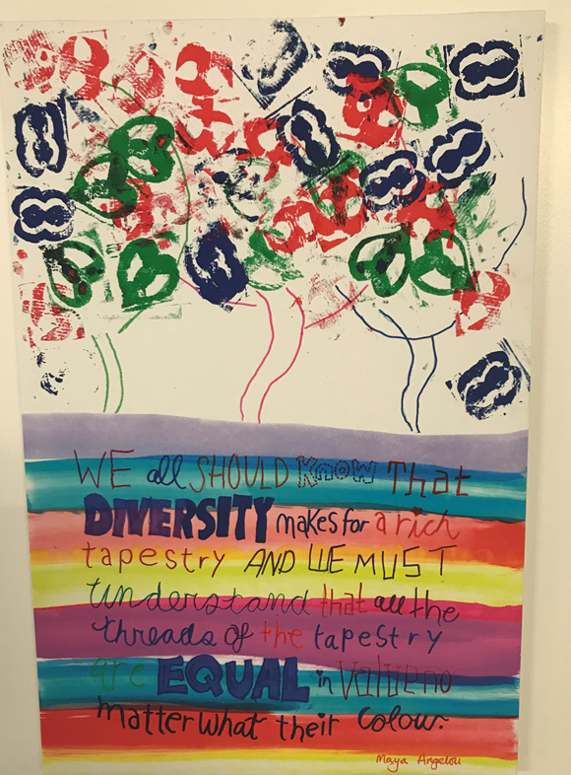
LOZELLS

Slide 2
CONTEXT

Slide 3
Early Identification

Slide 4
SCREENING TOOL

Slide 5
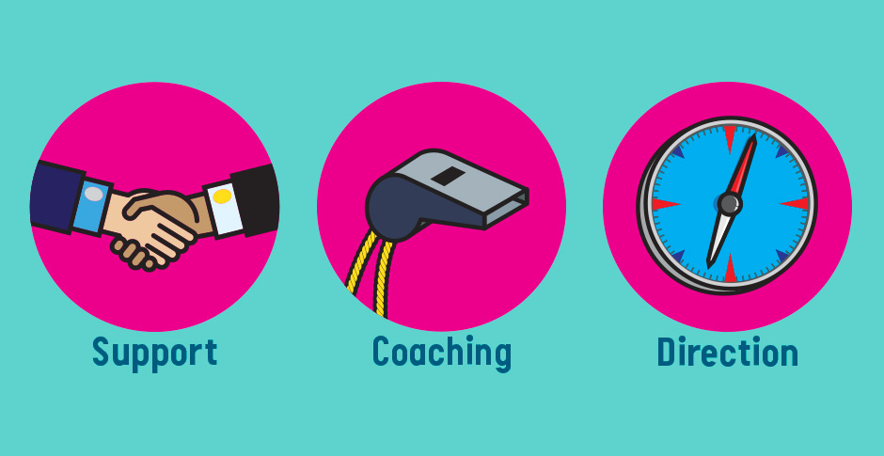
Interventions and support after id

Slide 6
Citizenship Day

Slide 7
Pilot Programme
Currently with one class
Programme overview
Challenges/Blockers
Parental involvement at the end of the project

Slide 8
4 Week Programme
Key Questions
Where might exploitation take place locally?
When does being kind and friendly cross over to exploitation?
What do the children understand by exploitation?
What might the warning signs be that a person is attempting to exploit
others?

Slide 9
Session 1
What do the children understand by exploitation?
Can they define it?
Do they understand that anyone can be exploited by different groups of people- friends, family, people unknown to them,
Have they got an understanding of why these different groups of people may exploit children?

Slide 10
Possible Learning Activities
Children write their own definition.
Children given different exploitation scenarios to discuss and explore.
Children to produce a sound bite/visual resource of their definition of exploitation.

Slide 11
Session 2
What is the children’s understanding of county lines?
Why might this happen?
When could it happen?
Why would people want to exploit children in this way?
Where is this happening in the UK currently?
What might the warning signs be that a person is attempting to exploit someone?

Slide 12
Possible Learning opportunities
Sorting activity; Children to have a true and false statements in relation to county lines and how people are exploited.
Children to be given a case study that presents different opportunities along a period of time for children to be exploited- can the children pin point where they could have got some help?
Children to use drama to think about why a person may exploit someone and look at the situation from a different point of view.
From this they would create a physical resource showing what they have to gain/what the person being exploited may have to lose. Visually powerful in that the person being exploited has lots to lose.

Slide 13
Session 3
Where can we find some real life incidents of county lines?- BBC news articles.
What is the children’s lived experience of this?
Are they aware of any incidents of people being exploited in their local community?
Where might exploitation take place locally?
What situations should they be mindful of?
When does “being kind and friendly” cross over to exploitation?

Slide 14
Possible learning activities
Read and discuss some real life examples of county lines cases from the news.
Mark on a map of the local area- where do children feel they are safe? Where do they feel vulnerable? What can they do about this?
Look at some scenarios and decide which are examples of people being exploited and which are not. How do we know? Are there some key facts/questions which determine this?

Slide 15
Session 4
Revisit the definitions of exploitation and County Lines-
What is the children’s understanding of this now?
Has it changed/deepened?
What actions can the children take if they are worried about exploitation or County Lines?
Who should they talk to or contact? Why is this so important for our community?
How can we raise awareness and spot the dangers of this happening?

Slide 16
Possible Learning opportunities
Children to rewrite their definitions.
Children to produce an action plan of what to do if……..
Children produce an information pack for the year group below warning children about this issue?

Slide 17
Future Planning

