Slide 1
Strategic approaches to Inclusion Katherine Marston, Head of School Sarah Crooks Assistant Principal, Behaviour and welfare
Saint John Wall Catholic School
Mission statement To educate each and every unique child in our care to hear and respond to what God calls them to be.

Slide 2
Saint John Wall Catholic School – The Journey
July 2012, Ofsted Good
August 2012, August 2013, August 2014 results declined to only 24% 5 A* - C including English and Maths
2014, Warning letter from the LA requiring improvements
Couldn’t recruit new Headteacher
September 2015, Tony Quinn seconded as Executive Principal
November 2015, Katherine Marston seconded as Head of School
Capacity to Improve Plan established
2015 – 2016, Re-structuring of SLT (new roles Jan 2016), Middle Leaders (new roles Sept 2016)
2016 – 2017, Support staff re-structuring (new roles Nov 2016)

Slide 3
Saint John Wall Catholic School – The Journey
April 2017, Ofsted Good
August 2017, P8 of +0.63 (+0.55 disadv.)
November 2017, Outstanding S48 grading
August 2018, P8 of +0.68 (+0.55 disadv.)

Slide 4
Headline figures and school context
621 pupils on roll
387 boys
243 girls
29 pupils current waiting list
33.01% FSM
65.85% EAL
41.83% PP
Current attendance 95.36%
FTE:
15/16: 69
16/17: 52
17/18: 38
PEX:
15/16: 1
16/17: 3
17/18: 0
Attendance:
15/16: 95.5%
16/17: 95%
17/18: 94.49%

Slide 5
Strategic Developments
Structures and procedures – ‘Bpro’ and staff routines
Provision – Saint Francis Centre and The Ark
Ethos – Restorative Justice and Emotional Coaching
Notes:
An eg Hedley Beare one
Military metaphors
Command and control, attention to detail on hair styles, counting ear-rings
Symbolic is bells and lockers
Bells used to ring in factories and prisons
Lockers lining corridors
Others are more guaranteed to impact on learning
Imagine are US teacher getting evaluated by his students (pace and engagement!)
Student feedback (just on lessons)
More structured ways on teaching and learning or the school in general
(eg of co-production of knowledge)
Longer lessons
We have 100 minute lessons – 3 a day
Dramatically improved planning and engagement
OK – so let’s say you’re a teacher and still sceptical
Working as a teacher in a factory school shortens your life expectancy
Let’s look again at the beach photo

Slide 6
1. Structures and Procedures – Clarifying a layered approach to behaviour management to empower and support everyone
Head of Year/ Senior Middle Leaders/ SLT
On call, higher level sanctions
Head of Department
Day to day routines, medium level sanctions, HOD/ subject report, temporary move out of class, HOD detention flow chart
Classroom/ Class teacher/ Form tutor
Daily routines, low level sanctions, rewards, class charts, EAR, Jesuit values, class/ tutor reports, staff buddies, procedures for dealing with
BPro
Exclusion
More serious
Less serious

Slide 7
Back to Basics expectations established
1. Structures and Procedures – Daily routines
Red jackets
Corridors and lesson transitions
Staff duties
Regular staff reminders in briefing, staff meetings, including follow up with individuals
All PowerPoints/ resources available on staff shared

Slide 8
Example of Daily routines (from Back to basics staff training)
3.10pm End of school
All pupils to leave the site via the side gate. One way system does not apply.
Duties in red/ orange jackets. (All other staff buffer time until 3.20pm)
Toilets
Monitor behaviour and safety, keep area calm and clear pupils outside Make way to bus stop after area is clear.
School lane/ car park gate/ entrance to school lane
Monitor behaviour, safety and traffic/ crossing the road. Encourage pupils to leave calmly and queue for the bus.
Bus stop
Monitor the bus queue, behaviour and safety. Ensure pupils get on the bus calmly.
Shops
Walk in pairs to shop, monitor behaviour and safety.
At the end of school all staff to sweep the playground/ corridors and ensure pupils move quickly and calmly off site.

Slide 9
Back to Basics
Example slide from Back to basics staff training
‘The standard you walk past is the standard you accept’.

Slide 10
1. Structures and Procedures – Procedures for dealing with..
Toolkit for classroom teachers
Starts with lowest level techniques
Includes Head of Department/ subject intervention before referring to pastoral
Reinforces layered approach

Slide 11
1. Structures and Procedures – BPro (Behaviour Process)

Slide 12
1. Structures and Procedures – Clarifying a layered approach to behaviour management to empower and support everyone
Head of Year/ Senior Middle Leaders/ SLT
On call, higher level sanctions
Head of Department
Day to day routines, medium level sanctions, HOD/ subject report, temporary move out of class, HOD detention flow chart
Classroom/ Class teacher/ Form tutor
Daily routines, low level sanctions, rewards, class charts, EAR, Jesuit values, class/ tutor reports, staff buddies, procedures for dealing with
BPro
Exclusion
More serious
Less serious

Slide 13
2. Provision – Saint Francis Centre and The Ark
Provision | Saint Francis Centre | The Ark
Hours | 8.55 am to 4.30 pm | 10.00am to 2.00pm
Staffing | Inclusion coordinator who is a senior middle leader, deputy DSL and deputy SPOC (full time teacher hours) | Inclusion coordinator who is a member of support staff (works 8.45 – 2.15, 27.5 hours per week)
Purpose | On-site inclusion room | On-site long term placement room
Why pupils are placed there | Day to day incidents, investigations, serious on call events, return from exclusion, awaiting parental interview, awaiting placement/short term placements (SJW pupils and other schools) ng managed move/ (+ if feeling ill) | Long term placements (SJW pupils and other schools) Return from managed move/ re-integration Key Stage 4 provision (early study leave!) Formal examinations
Who can place them there | Head of Year, on call staff, senior leaders | Assistant Principal, Inclusion coordinator
Work they complete | Pre-prepared folder work, examination homework, work set by teacher | Work for qualification subjects or set by teachers from timetabled lessons

Slide 14
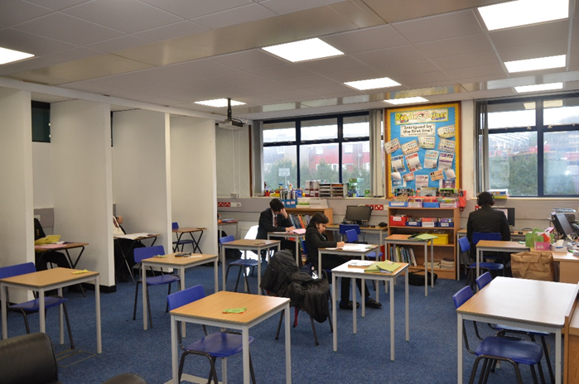
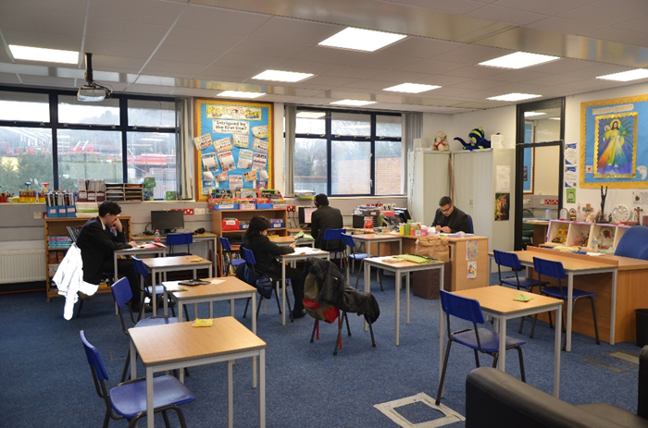
2. Provision – Saint Francis Centre
 | A typical day
Registration | Reading
Lesson 1 | Core subjects
Break | Arts and Crafts, word searches, cross stitch, knitting, puzzles
Lesson 2 | Core subjects
Lesson 3 | RS
Lunch | Arts and Crafts, word searches, cross stitch, knitting, puzzles
Lesson 4 | Ninja Maths

Slide 15
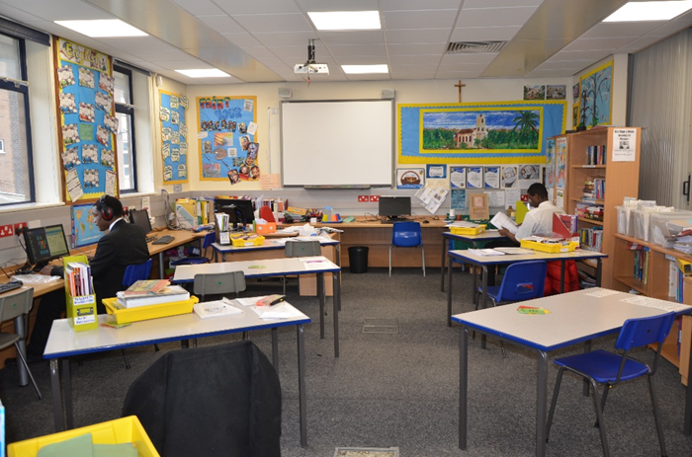
2. Provision – The Ark
 | A typical day
Arrive 10.00am
Lesson 1-3 | Personalised / flexible learning tasks set depending on the qualifications pupils are studying
 | 3 x 20 minutes of PE a week
Lunch | Arts and Crafts, word searches, cross stitch, knitting, puzzles
Depart 2.00pm

Slide 16
3. Ethos – Restorative Justice and Emotional Coaching
Pastoral ethos / mission statement
Jesuit Values words on reports, statements, classcharts
Staff Training
Questions prompt sheet

Slide 17
Strategic Developments
Structures and procedures – ‘Bpro’ and staff routines
Provision – Saint Francis Centre and The Ark
Ethos – Restorative Justice and Emotional Coaching
kmarston@sjw.bham.sch.uk
scrooks@sjw.bham.sch.uk
Any questions?
Notes:
An eg Hedley Beare one
Military metaphors
Command and control, attention to detail on hair styles, counting ear-rings
Symbolic is bells and lockers
Bells used to ring in factories and prisons
Lockers lining corridors
Others are more guaranteed to impact on learning
Imagine are US teacher getting evaluated by his students (pace and engagement!)
Student feedback (just on lessons)
More structured ways on teaching and learning or the school in general
(eg of co-production of knowledge)
Longer lessons
We have 100 minute lessons – 3 a day
Dramatically improved planning and engagement
OK – so let’s say you’re a teacher and still sceptical
Working as a teacher in a factory school shortens your life expectancy
Let’s look again at the beach photo

