Slide 1
Sustainable Approaches to Safeguarding and Supporting Vulnerable pupils at Bishop Challoner Catholic College
Eileen Breen
Kim Peckover

Slide 2
Whole school approach to safeguarding
Governors/Link governor – annual training, termly link governor meeting and report, termly reports to Principal, annual report to governing body
5 DSLs
Vice Principal/DSL/SENCO/LAC
Two Student Support Coordinators
Key staff have school mobile phones
HOY also attend DSL training to enhance and inform their role

Slide 3
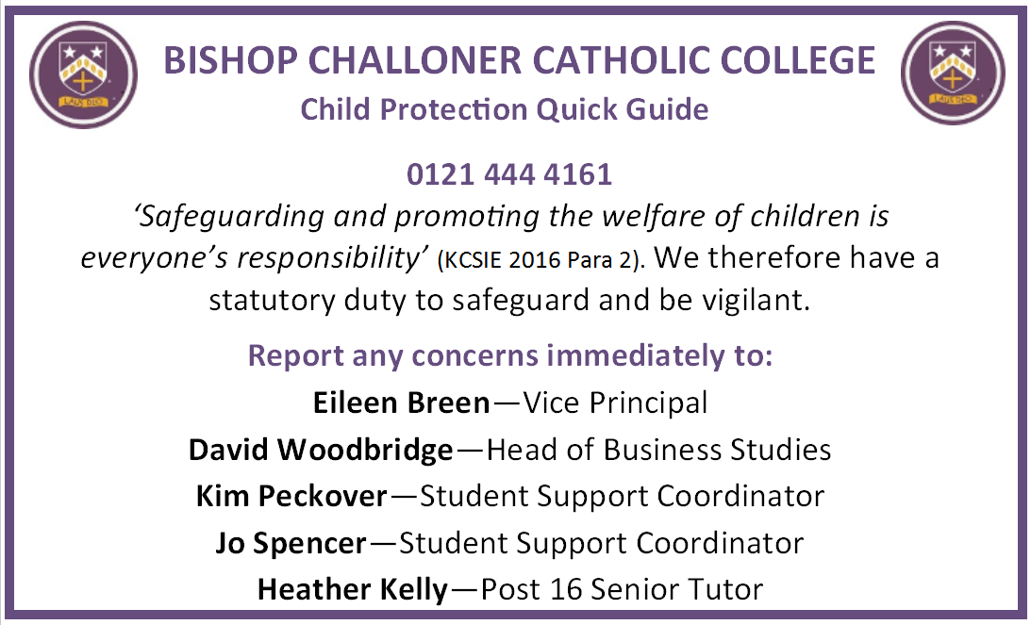
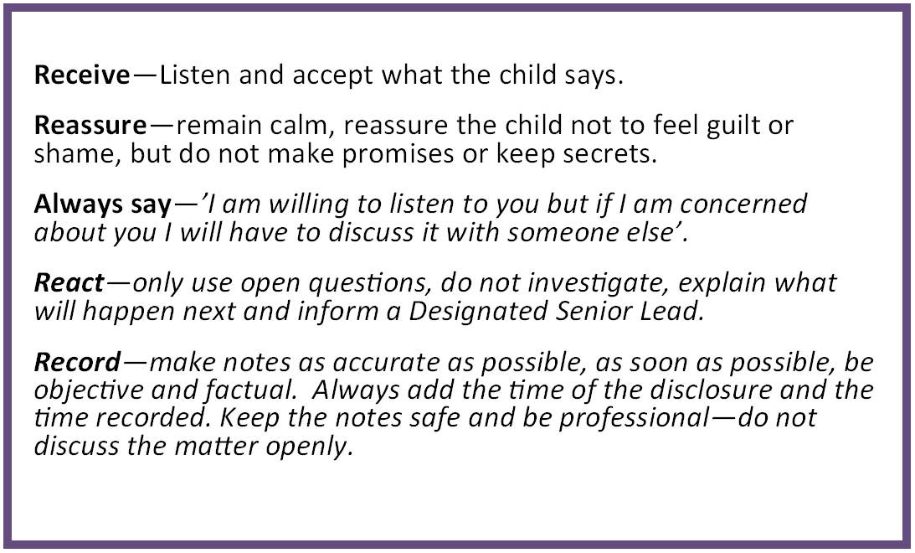
Annual staff safeguarding training - updates throughout the
year – emails, leaflets, prompt cards
Lanyards – I.D. cards

Slide 4
Training for DSL’s – network briefings, conferences, training opportunities, signs of safety and Well-being RHRT
Early Help; Family Plans & Early Help Assessments
Supervision – external and group supervison.
Morning briefings - scenarios
Curriculum (English, History, Geography)PSHE, assemblies, health days this is in line with s175
s175 audit
Single Central Register review – governor and LA audit

Slide 5
Key Meetings in School
DSL weekly Inclusion meeting – Primarily to discuss live cases.
Inclusion register -Early Help, LAC, Parents in Prison, Temporary accommodation, Young Carers, CP, CIN, Referrals to DSL/CASS ,Young Offenders, PP, Family Support Workers, Bereaved pupils, SSWIS (Student Social Workers in School), Counselling, School Refusers, Dual registered, FTB/Pause, School Nurse Referrals, YOS/YOT, CME, CSE, Medical, Fast Track, Court Orders, Safe and Well checks,

Slide 6
Academic Monitoring Meeting (AMM)(7-13)
Priority Case Meetings(PCM) – thinking outside of the box: trying to prevent exclusion, sharing panel referrals, families in crisis
Review In school Safeguarding Committee (RISC) fortnightly – Lock Down, GDPR, site security – current issues
Safeguarding is a standing agenda item at the Senior Management Team meetings
SEND meetings – Termly review meeting

Slide 7
Day to day work
Student Social Workers (SSWIS)
School counsellor (Change)
Attendance – home school liaison team; make & receive phone calls, home visits, Fast Track, referrals to JB, request police safe and well checks, daily visits to young people on a CP/CIN Plan
Lead and/or attend all multi-agency meetings
Sign post & refer to external agencies & services
On-line monitoring - securus
GDPR – Staff training
Follow DfEs Guidance and legislation
Policies in line with BCSB
SIP – safeguarding section reviewed termly.
School Notice Board – updates & briefings BCSB & LA safeguarding websites

Slide 8
Schools response to medical needs.
First Aid & Medical –annual staff training- Epilepsy, Allergy/Epi-pen, Diabetes and Asthma. Medical Conditions in School, First Aid, School nurse drop-ins,
Termly School Health Advisory Service (SHAS) meeting- led by the school nurse.
School Allergy Awareness Group (SAAG)this group includes catering staff, parents, pupils.
Emotional and Mental Health - working with external agencies to offer support to pupils and parents.

Slide 9
Transition – CIN. All information and concerns were shared
–
AMM
Progress, presentation, health issues discussed
Communication social worker/agencies
Foster care – out of area
Parent consultation/meetings –Parents did not engage with school.
Continued Internal monitoring
SSWIS 1:1 Therapeutic support in the absence of TESS and/or FTB
AMM
Inclusion meeting
SEND
Nurture group
AMM- Attendance now an added concern - home visits request police safe + well
Referral to school nurse
PCM
Exploring different strategies to engage the YP.
Foster care – placement inappropriate
Reporting to Governors – Safeguarding report
LAC – transport – PEP’s
LAC reviews
Multi agency meetings/discussions
Raising concerns
Communication with school nurse, GP, social worker
2nd CP review decision made
Internal monitoring
AMM
PCM
Inclusion meeting
Escalated to CP
Continued concerns
Parents unable to implement or sustain change

