Slide 1
FAST-track to Attendance
Edwina Langley
Lead Attendance Officer
Education Legal Intervention Team

Slide 2
The Law
Parents are responsible for making sure that their children of compulsory school age receive efficient full-time education that is suitable to the child’s age, ability and aptitude and to any special educational needs the child may have.
This can be by regular attendance at school, alternative provision, or otherwise (e.g. the parent can choose to educate their child at home).
Section 7, Education Act 1996

Slide 3
Why Fast-Track?
Early Help offered
Voice of the Child – (Daniel Pelka, Tia Sharp, Ellie Butler)
Legal action – a last resort
Engagement from schools
Training not required (though preferred)

Slide 4
Criteria for Fast-Track
Compulsory school age pupils
Concerning levels of absence either authorised or not
NOT include Looked After Children

Slide 5
Pupil with concerning levels of absence
Check reasons for absence -
‘Signs of Safety and Wellbeing’
Non-cooperation
Additional concerns
If unauthorised absence – go to Step 2
Early Help assessment / Think Family / MASH and discuss with Court Section (via email)

Slide 6
Step One
Early Help
Concerning levels of absence either authorised or unauthorised – (once a year schools should send the ‘School Attendance’ whole school letter to parents by pupil post, email, or by placing it on their website/in their prospectus)
Action the school must take before a referral to ELIT can be made

Slide 7
School Absence Procedures
Essential
First day calling
Sending a letter
Home visit
‘Children with a safeguarding vulnerability’ list
‘Signs of Safety & Wellbeing’ – voice of the child
Informal meeting
Request for medical evidence (only in cases of concern)
Time limited interventions

Slide 8
Early Help
Right Help, Right Time
Signs of Safety and Wellbeing
Early Help Panel
Early Help Assessment
CASS ‘Request for Support’ form/Phone Consultation
Children Missing from Education team (formally LSNT)
School Nurse (Public Health)
James Brindley
FAST-Track
Notes:
Schools can do Early Help Assessment replaced fCAF
Not sure go via Early Help Panel for advise
Ref right service right time
Any referral via CASS - phone consult or via request for support form – can indicate what support you think is needed
Birmingham Safeguarding children's board website

Slide 9
3 Steps to delivering Early Help in Education
Identify children/ Young people with unmet safeguarding needs (RSRT changing to RHRT)
Enable the child`s voice by evidencing their lived experience ( 3 houses)
Assess current needs and choose an Early Help action
Notes:
We have listened to your request for school focused EH guidelines and have developed a 3 step flowchart – copies available at the briefing and on https://www.birmingham.gov.uk/schoolsafeguarding

Slide 10
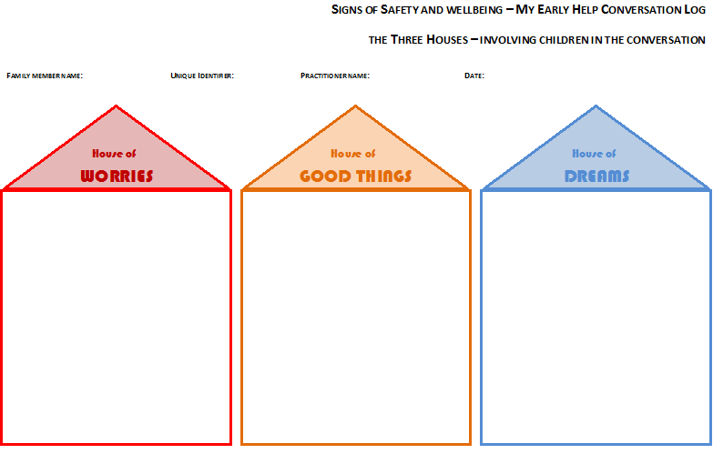
Notes:
The EHSP has adopted this strength based approach to working with children and families : Signs of Safety and Wellbeing . It is designed to put children and families at the heart of any work we do. Sometimes broaching the subject of early help can be difficult for practitioners so this tool has been developed to help practitioners to note down their conversations with children and families , ensuring that strengths as well as needs are identified and that families have a say in what they want to achieve .
When working directly with children think about
Explaining the 3 houses to the child using 1 sheet of paper per house
Use words and drawings as appropriate and anything else to engage the child in the process
Often start with the `house of good things ` particularly when the child is anxious or uncertain
Once finished ,obtain permission of the child to show others- Parents extended family and professionals. Address safety issues for child in presenting to others.

Slide 11
Tackling illness
Trust your parents!
Do not routinely ask for medical evidence
Consider NHS capacity!
Include in your policy
Set a threshold for requests based on concern that an offence is being committed
If a school routinely asks for medical evidence from all parents to authorise absence the LA will not prosecute cases for that school

Slide 12
Step Two
The SARM
(School Attendance Review Meeting)
The pupil has at least one session of unauthorised absence - Early Help has been refused (this includes ‘no response’ to attempts by the school to engage the family); the circumstances of the family do not meet the threshold for Early Help/Social Care support; Early Help/Social Care strategies have not resulted in sustained attendance improvement

Slide 13
Step Three
Formal Warning Notice
(ELIT 1)
The pupil has further unauthorised absence adding up to at least 10 sessions in total over the previous 12 calendar months

Slide 14
Step Four
Send to ELIT/Court Section!
The pupil has a minimum of 10 further sessions of unauthorised absence within 12 school weeks of the warning notice being issued

Slide 15
Where DSLs can help
Poor attendance can be a safeguarding indicator
Meet with Attendance staff – plan!
Joined up working
Children with a Safeguarding vulnerability list
Who is going to do the ‘3 houses’ with the child
3 day Early Help Practice Skills course (BESS)
½ day Signs of Safety and Well being course (BESS)
1 day FAST-track training course (www.thepactgroup.co.uk)
School Noticeboard

