Slide 1
Substance Misuse and Neglect
8th – 10th July 2019

Slide 2
The Birmingham Context
Population:
A ‘young’ city 46% under 30 – set to rise
37% children live below the poverty line
Children’s Social Care 2015/16
1807 new fCAFs
4997 family support assessments
2,088 CIN plans, mostly neglect or emotional abuse
13,013 MASH referrals, 11,470 assessments (3781 S47)
Substance Misuse
Analysis of 175 serious case reviews from 2011-14 found that 47% of cases featured parental substance misuse (Sidebotham et al, 2016)
1/6 ‘troubled families’ included dependent substance use

Slide 3
Learning from serious case reviews
Key issues around parental substance misuse in serious case reviews were..
Assessments
Rule of optimism
Communicating with parents
Interventions

Slide 4
Assessments
Timely and thorough for all children cared for by substance misusing parent
Child-focused with clear picture of drug/alcohol use
Behaviour and parenting capacity properly analysed to understand risks to children
Where other risk factors present (MH, DV), relationship between these factors and substance use should be reviewed
Risk assessments should be dynamic, not a one-off process

Slide 5
Rule of Optimism
Parents given too many chances which had adverse outcomes for children
Professionals often didn’t question parents’ self-reporting drug and alcohol use
Substance use known but not seen as excessive/problematic- particularly alcohol
Some reviews talk about tidy, clean homes and happy, healthy children

Slide 6
Communication
Information needs to be delivered in a way that parents can understand.
Regularly check that parents have understood risks and are complying with advice.
E.g. Some parents said they did not feel that the risks of co-sleeping had been explained in such a way that they had fully understood them, or had been able to take them on board.
Written leaflets are not suitable for functionally illiterate adults.

Slide 7
Interventions
Work with adults often focused on their individual needs rather than their role as parents
Often the focus is on looking for a holistic family support package, which means the immediate risks faced by the child are not prioritised

Slide 8
Risk Factors- What to look for…
Pre Birth
Foetal damage
FASD (Foetal Alcohol Spectrum Disorder)
Withdrawal symptoms
Physical/neurological damage
Prematurity, low birth weight/still birth
Miscarriage
Lack of ante-natal care
Note: Impact will depend on which substances, at what stage of pregnancy, administration route, amount and duration.

Slide 9
Alcohol vs other substances
Effect | Alcohol | Cannabis | Cocaine | Heroin | Tobacco
Low birth weight | X |  | X | X | X
Impaired growth | X
Facial malformation | X
Small head | X
Development delay | X | X
Hyperactivity | X | X |  | X | X
Sleeping problems | X | X | X | X | X
Poor feeding | X |  | X
Excessive crying | X | X | X | X
Risk of cot death | X |  |  | X | X
Organ damage | X
Respiratory issues | X |  |  | X | X
FASD Trust: www.fasdtrust.co.uk

Slide 10
FASD (Foetal Alcohol Spectrum Disorder)

Slide 11
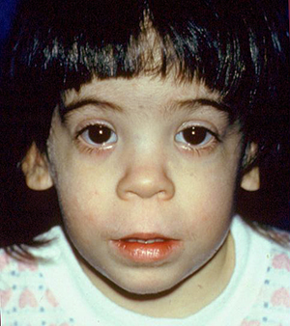
Facial Features of FASD
Small head
Short palpebral fissures
Small nose
Small midface
Long philtrum, thin upper lip

Slide 12
FASD- Other symptoms
Poor social understanding
Working memory deficits
Poor attention
Obsessional
Tics
Language deficits
Poor planning
Hyperactivity
Issues with cognitive flexibility
Poor imagination
Impulsivity
FASD Trust: www.fasdtrust.co.uk

Slide 13
What FASD can be mistaken for?
Borderline personality disorder
Autistic spectrum disorder
Conduct disorder
Attention deficit hyperactivity disorder
Dyspraxia
Learning difficulties
Attachment disorder
Post traumatic stress disorder
FASD Trust: www.fasdtrust.co.uk

Slide 14
Impact of Substance Using Parents on Children Nursery School (0-5 years)
Withdrawal symptoms (newborn)
Lack of physical and emotional stimulation
Attachment issues
Inappropriate carers
Impoverished physical environment
Missed health checks and immunisations
Sudden Infant Death syndrome (SID’s)
Physical danger from environment
Violence
Poor hygiene and nutrition
No pre-school involvement with other children
Inconsistent parenting
Not meeting key developmental milestones

Slide 15
Impact of Substance Using Parents on Children Primary School (6-11 years)
Missed medical checks
Risk of physical injury
Poor social skills
Problematic behaviour in school
Poor self-esteem
Carer role for parent and/or siblings
Poor school attendance
Inappropriate carers

Slide 16
Impact of Substance Using Parents on Children Secondary School (12+)
Poor support for puberty
Inappropriate boundaries
Carer role
Social isolation, bullying
Sexualised behaviour
Inappropriate role models
Exposed to risky adults
Problems with sexual relationships
Inappropriate relationships
Substance misuse
School exclusion and social isolation
Poor social skills
Emotional difficulties - suicide, self harm, anxiety depression
Low self-esteem
Exploitation

Slide 17
What is Hidden Harm?
Report by ACMD (2003)
Response to increasing numbers of problem drug users in the UK
Estimate the numbers of children affected
Examine the immediate and long-term consequences for these children
Identify best practice to improve outcomes for children
Make recommendations (48 in total)
6 Key messages
http://drugs.homeoffice.gov.uk/publication-search/acmd/hidden-harm
Notes:
Advisory Council of the Misuse of Drugs

Slide 18
Hidden Harm: Key Messages
There are between 250,000 - 350,000 children of problem drug users in the UK – about 1 for every problem drug user
Parental problem drug use causes serious harm to children at every age from conception to adulthood
Reducing the harm to children from parental problem drug use should become a main objective of policy and practice

Slide 19
Hidden Harm: Key Messages
Treatment of parent can have major benefits for child
By working together, services can take many practical steps to protect and improve the health and well-being of affected children
The number of affected children is only likely to decrease when the number of problem drug users decreases

Slide 20
Key Messages- 7 C’s
I didn’t cause it
I can’t cure it
I can’t control it
I can take care of myself
I can communicate my feelings
I can make healthy choices
I can celebrate myself

Slide 21
Video
https://www.childrenssociety.org.uk/parental-alcohol-misuse

Slide 22
Protective Factors for Children & Families
Use of substances controlled in dosage and stable across time
There are family routines and activities
There is protective partner and/or supportive family network
No co-existing mental health, domestic violence or family conflict issues
Cohesive parental relationship
Notes:
Stress the importance of family first model i.e including non-using family members in assessment and support networks.
Including non –using partners in care plans.

Slide 23
Protective Factors for Children & Families
Supportive agencies involved- signposting
Finances maintained
Having hobbies/talents/interests
Social life/close friends outside home
Successful school experience
Easy temperament / sense of humour
Planning for the future

Slide 24
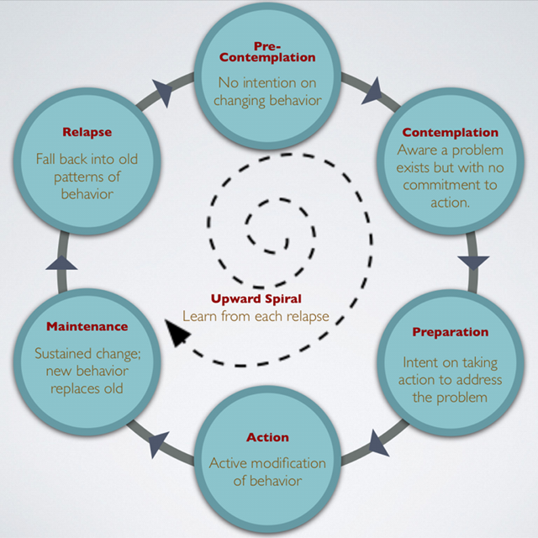
The Cycle of Change
Prochaska and DiClemente

Slide 26
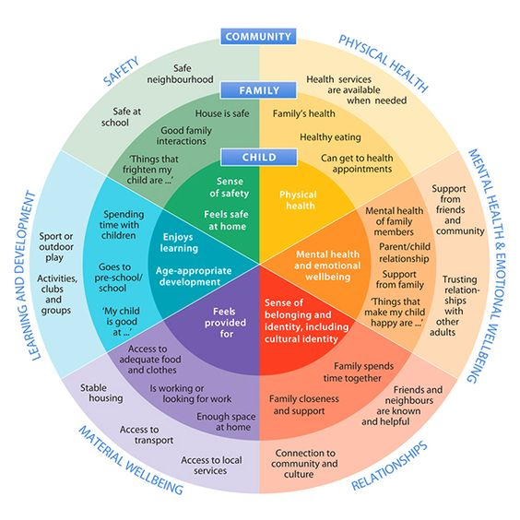
Adapted from Bronfenbrenner Ecological Model
Notes:
https://www.dhhs.tas.gov.au/__data/assets/pdf_file/0007/220696/0032_Strong_Families_Safe_Kids_-_Implementation_v9_final.pdf

Slide 27
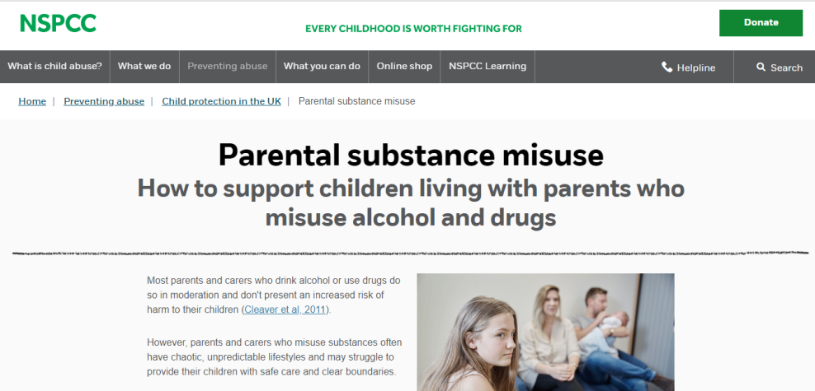
Resources/Training
www.nspcc.org.uk/preventing-abuse/child-protection-system/parental-substance-alcohol-drug-misuse/
www.cheshireeastlscb.org.uk/pdf/rip-frontline-impact-of-psm-briefing-web.pdf
www.childrenssociety.org.uk/what-we-do/our-work/the-impact-of-parental-substance-misuse
Birmingham Safeguarding Children Partnership- Working with Substance Misusing Parents Training

Slide 28
Aquarius Choices & Aquarius Cares Project
Choices- We support 10-19 year olds where they are affected by parental substance misuse
Cares- We support 8-24 year olds where they are affected by parental substance misuse or mental health and are care experienced young people
The aim is to improve the emotional well being of the young person and to build resilience

Slide 29
Aquarius Young People Substance Misuse Service
We support 0-18 year olds with a substance misuse problem.
City wide- community based
Provide brief advice and information, 1-2-1 support, awareness sessions.
Working alongside Forward Thinking Birmingham (FTB), Barnardo's Child Exploitation Team, St Basils and Youth Offending Teams.

Slide 30
Aquarius Life
Notes:
Works with Education providers to offer training for staff and young people and well as group and 1:1 support and interventions
We give education providers immediate access to a multi-disciplinary team, which can develop tailored solutions to improve the psychological health and wellbeing of pupils and staff

Slide 31
Some of the training we provide…
An introductions to alcohol and drugs
INROADS – preventing drink and drug driving
An introduction to problematic gambling
An introduction to mental health
Resilience – managing stress and coping skills for wellbeing
Safeguarding children and young people
Safeguarding vulnerable adults
Information Governance
Equality and Diversity
Working with substance misusing parents
Working with families affected by substance misuse
Working with resistant clients/challenging behaviour
Working with people at risk of knife crime
Suicide awareness training
Sexual Health
Finance and budgeting

Slide 32
CONTACT US
Aquarius
youngpeople@aquarius.org.uk
aquariuslife@aquarius.org.uk
Tel: 0121 6227780
www.aquarius.org.uk

