Slide 1

Impact of Neglect on Child Development and Attachment
Nicky Probert
Training and Consultancy Manager
Family Action
2019

Slide 2
Working Together 2018
Definition
Neglect is the persistent failure to meet a child’s basic physical and/or psychological needs, likely to result in the serious impairment of the child’s health or development. Neglect may occur during pregnancy as a result of maternal substance abuse. Once a child is born, neglect may involve a parent or carer failing to:
  provide adequate food, clothing and shelter (including exclusion from home or abandonment);
  protect a child from physical and emotional harm or danger;
  ensure adequate supervision (including the use of inadequate care-givers); or
  ensure access to appropriate medical care or treatment.
It may also include neglect of, or unresponsiveness to, a child’s basic emotional needs.
(HM Government 2018)

Slide 3
Neglect
Impact on areas of development
NEGLECT
Physical
Language and Communication
Social and Emotional
Cognitive

Slide 4

Exercise
Twelve Hours
Describe what things in the last 12 hours have enabled you to function at today’s conference

Slide 5
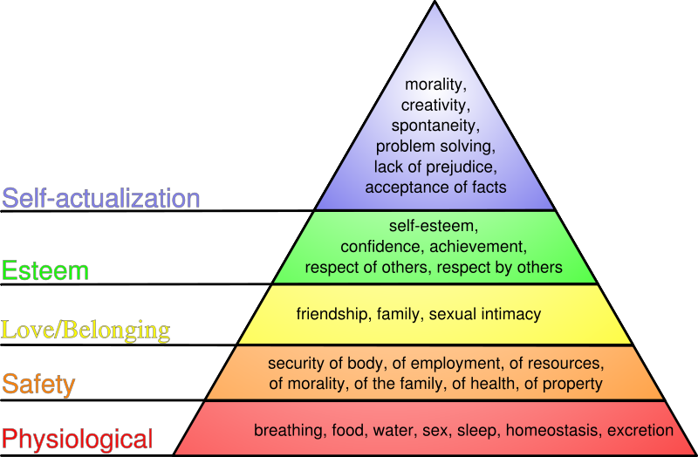
Maslow’s Hierarchy of Needs
Notes:
See handout
Unless basic needs are met cannot begin to meet other needs.
This is the underpinning model on which GCP is based. Prompt to use language from GCP

Slide 6
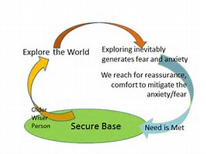
Attachment Theory
Basics
What do we know?
Infants biologically driven to attach to caregivers
Attachment relationships provide security and safety
When child feels safe, they can explore and learn

Slide 7
Attachment behaviours
Impact of stress
Proximity – getting close
Separation protest - crying
Secure Base Effect – comfort and emotional regulation
These behaviours can be triggered by anxiety, fear or need for comfort:
Actual or threatened separation when child feels insecure
Something in the environment causes alarm
The carer rejects the child
The carer is psychologically unavailable to the child
The child feels tired or ill

Slide 8

Baby at rest
Baby experiences discomfort or need
Baby protests – usually by crying
Carer responds – eye contact, picks baby up, soothes and calms
Baby calms and trust develops
Baby and carer interact
Cycle of Attachment
Secure

Slide 9
Core beliefs
Secure attachment
Self: “I am good, lovable, wanted, worthwhile, competent”.
Caregivers, other people and relationships: “They are responsive to my needs, sensitive, caring and trustworthy.”
Life in general : “The world is safe, life is good”.

Slide 10
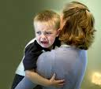
Emotional Regulation
As infants we are “co regulated” by our carers.
As toddlers we begin to “self regulate” and manage feelings ourselves.
As children and adults we move between “co – regulating” and “self regulating” all the time.
P

Slide 11

Cycle of Attachment
Insecure
Baby at rest or disassociated
Baby experiences discomfort or need
Baby protests – usually by crying
Carer response Ignore Abort Distort
Carer response escalates
Baby unable to self regulate
Baby protests more
Rage then apathy

Slide 12
Core beliefs
Insecure attachment
Self:“I am bad, helpless, unwanted, worthless, unlovable.”
Caregivers, other people and relationships: “They are hurtful, insensitive, untrustworthy and can’t or won’t meet my needs. Other people always let me down in the end”
Life in general : “The world is unsafe, It’s best not to trust anything. Bad times follow good times”
Notes:
RELATIONAL TRAUMA

Slide 13
Child’s Internal Working Model
STIRS
    Stress
    Trust and empathy
    Impulse
    Rage
    Shame
If children experience developmental harm, the child’s internal working model of the world changes and this will affect how they communicate and how they interpret other people’s communication.

Slide 14



Trauma
Defence response
Fear Terror
Alarm
Heightened vigilance
Overwhelming or repeated trauma
Defence Response

Slide 15


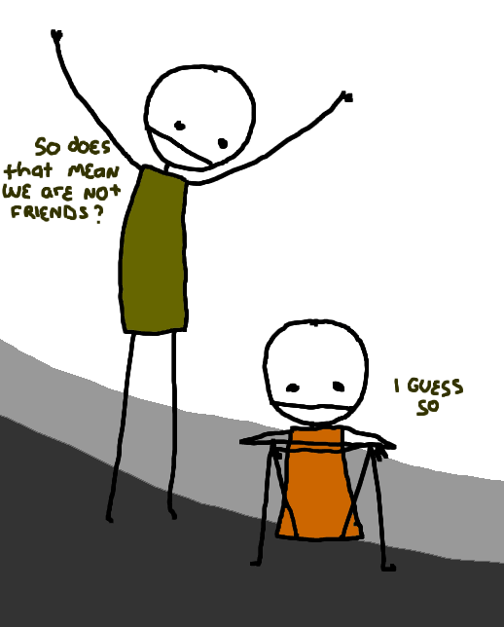

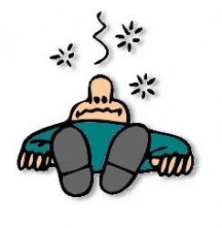
Trauma
DEFENSIVE REACTIONS
FIGHT
FLOP
FRIEND
FLIGHT
FREEZE
Defence Response

Slide 16
“Perplexing behaviour often
makes sense
in the context of the environment
the child grew up within”
Kim Golding

Slide 17
Brain Development
Impact on structure and function
The amygdala, which is key to processing emotions
The hippocampus, which is central to learning and memory
The orbitofrontal cortex, which is responsible for reinforcement-based decision-making and emotional regulation
The cerebellum, which helps coordinate motor behaviour and executive functioning
The corpus callosum, which is responsible for left brain/right brain communication and other processes (e.g., arousal, emotion, higher cognitive abilities)
(Bick & Nelson, 2016)

Slide 18

When the brains automatic response is ALARM
Brains become permanently on high alert.
Stress chemicals - Adrenaline and Cortisol pump constantly around the body
Children seem restless, hyperactive, unable to concentrate irritable
For some children, the stress is overwhelming and they shut down – dissociated or frozen children

Slide 19
The Adolescent Brain
Structural Changes
Brain architecture changes to meet cognitive and emotional challenges
Connections are again strengthened or eliminated – growth and pruning (similar to infants)
Rise in Dopamine levels lead to ‘thrill seeking’ and risk taking
Part of the brain (amygdala) eliciting emotional response is not well connected to the thinking part of the brain (frontal cortex) leading to an inability to modulate the response
Many parts of the brain are not fully mature. Nerves not fully myelinated until the early 20s.
Notes:
Job is to break away from parents and form peer relationships

Slide 20
The Adolescent Brain
Impact of previous trauma and neglect
Impulsive behaviour more apparent
Brains focus on survival not advanced thinking (cortex)
May be emotionally immature in responses
May show delays in school and in social skills
Over develop regions of the brain affecting fear and anxiety
Difficulty interpreting and identifying emotional responses
More drawn to taking risks

Slide 21

“
Impact on Learning
“The troubled child becomes the troublesome child”
States become traits. If a child is in a constant state of ‘dis-regulation’, the child becomes hyper-sensitive to stimuli.
This involves a whole body response including regions of the brain which organise:
regulating arousal
vigilance and affect
behaviour irritability
locomotion
attention and sleep
the startle response
responses to threat e.g. aggression

Slide 22
Executive Functioning
Impact on Social Competence and Learning
Working memory the ability to retain and manipulate distinct pieces of information over short periods of time.
Mental flexibility helps us to sustain focus or shift attention in response to different demands, apply different rules in different settings and plan actions
Self-control enables us to set priorities and resist impulsive actions or responses
Notes:
It is also important to note that the brain regions and circuits associated with executive functioning have extensive interconnections with deeper brain structures that control the developing child’s responses to threat and stress.16,17,18 !is implies that the developing executive functioning system both influences and is affected by the young child’s experience and management of threat, stress,10,19 and strong emotions. Thus, extended exposure to threatening situations can compromise the development and deployment of executive function skills, yet well-developed capabilities in these areas can also help children (and adults) manage stress effectively.
WORKING MEMORY is the capacity to hold and manipulate information in our heads over short periods of time. It provides a mental surface on which we can place important information so that it is ready to use in the course of our everyday lives. It enables us to remember a phone number long enough to dial it, to return to our place in a magazine article before a friend interrupted us, and to recall whether we had added the salt to what we were cooking before we had to help our child find a missing shoe. It enables children to remember and connect information from one paragraph to the next, to perform an arithmetic problem with several steps, to keep track of the moves and make a logical next step in a game of checkers, and to follow multiple-step instructions without reminders (“go to your cubbies, put away your storybooks, bring back your arithmetic books, and open them to page 30”). It also helps children with social interactions, such as planning and acting out a skit, taking turns in group activities, or easily rejoining a game after stepping away to get a drink of water. INHIBITORY CONTROL is the skill we use to master and filter our thoughts and impulses so we can resist temptations, distractions, and habits and to pause and think before we act. It makes possible selective, focused, and sustained attention, prioritization, and action. This capacity keeps us from acting as completely impulsive creatures who do whatever comes into our minds. It is the skill we call on to push aside daydreams about what we would rather be doing so we can focus on important tasks. It is the skill we rely on to help us “bite our tongue” and say something nice, and to control our emotions at the same time, even when we are angry, rushed, or frustrated. Children rely on this skill to wait until they are called on when they know the answer, to be good at games like “Simon Says” and “Red Light/Green Light,” to stop themselves from yelling at or hitting a child who has inadvertently bumped into them, and to ignore distractions and stay on task in school. COGNITIVE OR MENTAL FLEXIBILITY is the capacity to nimbly switch gears and adjust to changed demands, priorities, or perspectives. It is what enables us to apply different rules in different settings. We might say one thing to a co-worker privately, but something quite different in the public context of a staff meeting. If a friend asks if we like her new haircut and we don’t, we are able to flexibly shift to the social convention that governs not hurting people’s feelings. Likewise, we teach our children about “outside voices” and “inside voices” and the different situations in which they should use each. As the author of The Executive Brain, Elkhonon Goldberg, notes, “The ability to stay on track is an asset, but being ‘dead in the track’ is not.”4 Stated differently, self-control and persistence are assets, rigidity is not. Cognitive flexibility enables us to catch mistakes and fix them, to revise ways of doing things in light of new information, to consider something from a fresh perspective, and to “think outside the box.” If the “church in two blocks” where we were told to turn right is actually a school, we adjust and turn anyway. If we are missing a recipe ingredient, we call a neighbor or make a substitution. Children deploy this skill to learn exceptions to rules of grammar, to approach a science experiment in different ways until they get it to work, or to try different strategies when they are working out a conflict with another child.

Slide 23
Myths
Centre on the Developing Child Harvard University
“They will learn in time”
“They’re being naughty”
“We need to concentrate on teaching them numeracy and literacy”
https://46y5eh11fhgw3ve3ytpwxt9r-wpengine.netdna-ssl.com/wp-content/uploads/2015/05/Enhancing-and-Practicing-Executive-Function-Skills-with-Children-from-Infancy-to-Adolescence-1.pdf

Slide 24
Executive Functioning
How to Help
Sensitive, responsive caregiving
Individualized teaching in the context of situations that require making choices
Opportunities for children to direct their own activities with decreasing adult supervision over time
Promoting sustained joint attention
Supporting children with emotional regulation
Available adults who are not under such pressure that they cannot make time for children to practice their skills

Slide 25
Practical Ideas
School Settings
Key Adult/s physically and emotionally available
  Meet and greet at beginning of day
  ‘Time in’ with trusted adult
  Check in cards
  Supports breaks from school – transitional objects, ‘child in mind’, support transition points

Slide 26
Practical Ideas
School Settings
Permission cards to go to a safe space – can be used by all students
Nurture through food and drinks
Physical activity to aid concentration by providing ‘brain breaks’ – get to know limit of child’s task centred activity
Consistent approach from all staff, messages that school is a safe place
Relational repair where adults have ‘got things wrong’
Home – school communication
Action plan for challenges

Slide 27
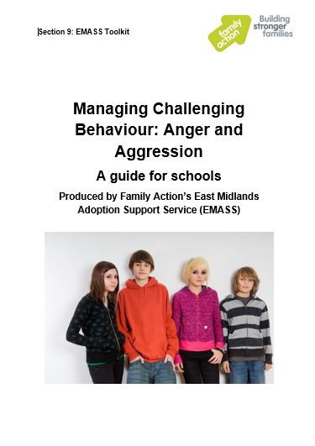
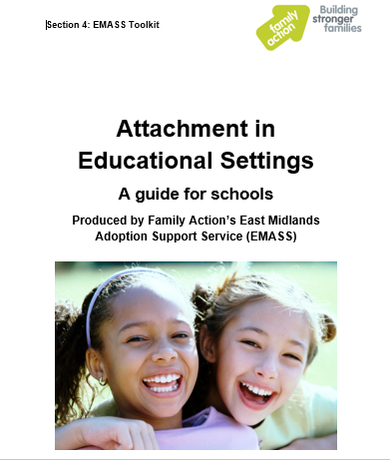
Family Action
Resources for Schools
https://www.family-action.org.uk/what-we-do/children-families/schools-education/emass-training-and-resources/

Slide 28

The Importance of Relationship
‘If relationships are where things developmentally can go wrong, then relationships are where they are most likely to be put right.’ David Howe
“Personal relationships are the fertile soil from which all advancement, all success, all achievement in real life grows” Ben Stein

Slide 29
www.family-action.org.uk

