Slide 1
Neglect and young people with special educational needs and disabilities
Area Safeguarding conferences –Tackling Childhood Neglect in Birmingham
Emma Hunt and Sarah Clark

Slide 2
Introduction
Emma Hunt
Associate Head of School and Lead DSL at Mayfield Special School.
15 years in SEND
7 at senior leadership level - Lead DSL role for 6 years.
Sarah C
Pastoral Manager and DSL for Hamilton School.
Notes:
EMMA – Mayfield - 280 pupils currently. Majority travel to school on transport provided by LA. Lack of parental relationships - difficult to engage as many see education as respite. Non verbal students with behaviours that can be linked to disability so not always easy to determine root cause. Work closely with LA – asked to re-define safeguarding procedures at Mayfield school as lack of confidence in raising concerns and concerns being acted upon. Positive OFSTED Nov 2018, huge shift in culture – now a safer place for students
SARAH –
say a bit about Hamilton School -123 pupils, large proportion are complex non verbal, 95% travel to school by LA minibus, difficult to build relationships with parents due to distance, Early years manager, always worked with SEN pupils in a range of different positions throughout my career.

Slide 3
Aims
‘What can Practitioners do and how can they do it better?’
Discuss influence of Local and National Guidance
Intentional versus unintentional neglect (Maslow hierarchy need) – impact on early support and putting the child first
Case studies – when things go wrong/missed opportunities for early help.
ACTION PLANNING - What can we do to get it right?
Notes:
Emma to share aims

Slide 4
Safeguarding young people with disabilities
https://youtu.be/BY3HvmyNDJE
Notes:
Sarah to introduce

Slide 5
Safeguarding young people with disabilities
All children have the right to be safeguarded and protected from abuse.
Children with disabilities will not always be able to disclose abuse. It is our job to know our children and be aware of when things change in their appearance, behaviour, etc.
If a child does disclose abuse:
Stay calm, listen, do not ask leading questions, such as - did Daddy do it? (who, what, when?) are all we need to know, the police will do the rest. It is their job to interview not ours.
We need to be aware of the signs and symptoms of abuse. How confident are you?
The presence of a disability should not obstruct the process of identifying and responding appropriately to child protection concerns.

Slide 6
National guidance
Appearance
Behaviour
Communication
Notes:
Stress importance of first 2 – non verbal students – always has to be considered in relation to the ‘norm’ for that individual, staff awareness and observation is vital – is it the condition/disability driving the behaviour or is there something else – why is it different?
Appearance: such as unusual injuries or consistently poor hygiene.
Behaviour: such as being withdrawn, overly anxious, disruptive or self-harming or any other sudden changes in behaviour.
Communication: such as talking aggressively, using sexual language or becoming secretive.

Slide 7
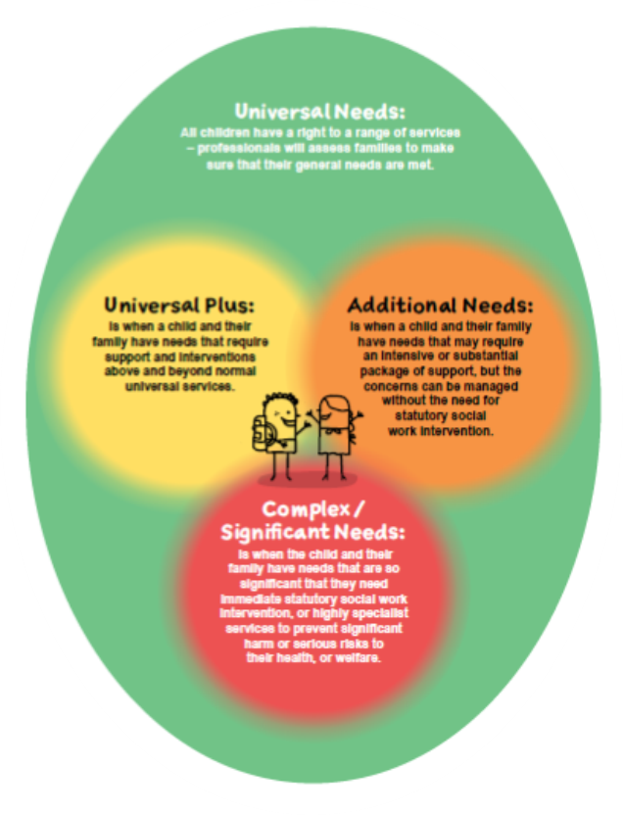
Local guidance
Right Help, Right Time is the Birmingham model of delivering effective support for children and families.
There are four levels of need outlined in this guidance. Universal needs, Universal Plus, Additional Needs and, Complex/Significant needs.
This guidance allows all practitioners to use the same language as one another when discussing family situations and safeguarding concerns.
A large percentage of the pupils that attend special schools like ours, will arrive with additional issues that require some form of intervention. What may look like additional needs to a mainstream school, could be universal plus to a special school. This can put a huge strain upon special schools to deliver ‘Early Help’ due to the complexity of the family situation.
RHRT has been updated to include more of an emphasis on SEN and disability. This has had an impact on how many cases are picked up from CASS when we refer.

Slide 8
Neglect matters
Neglect Matters is an initiative created to inform professionals, and families about neglect.
The booklet explains neglect in a way that all can understand.
It details what neglect is, and the impact of neglect upon a child.
Although this booklet is a few years old, its message is just as powerful today and the information within the booklet is still relevant.
It reiterates the national message that neglect is abuse and that neglect can have huge ramifications upon a child/ young person.

Slide 9
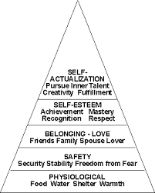
Unintentional Neglect
What is unintentional neglect (UN)?
UN is when a parent decides to put a priority of lower value over the ultimate well-being of his or her child. In many cases the parent thinks they are acting in the child’s best interest.
In current cases we have within school the unintentional neglect is a direct result of a parents lack of knowledge of their child's SEND. There can be a tendency to use the disability as an excuse for poor hygiene and frequently missed medical appointments. ‘They don’t like to wash’ or ‘they hit crisis at the doctors’. This means that the child's basic needs are not being met. When the basic needs are not met, the child cannot reach their full potential.
See Maslow's Hierarchy of need
Unintentional neglect should not be confused with deliberate or malicious failure to meet a child's needs in the full knowledge of the potential effects on the child.

Slide 10
Case studies and evidencing Neglect
ABC
GCP
Differentiation of 3 houses /conversation tools
Behaviour database
Relationships with families/knowing families
Attendance – what’s the ‘norm’ for that individual?
Importance of safe and well visits – not typical in mainstream settings
Parental capacity/mental health/disability – accepting help
Case studies

Slide 11
CASE STUDY – CHILD A
Child A is a wonderful little boy with autism and learning difficulties.
Child A came to Hamilton school at the age of 4. He had no verbal communication, his attention was fleeting and he had no work skills.
Child A also came with an FCAF (old school Early Help)
This was due to the family home being unliveable, Mothers substance addiction, the selling of drugs from the home, Child A’s attendance and presentation (clothes far too big, not weather appropriate, Child A always hungry, looking for food in bins. The graded care profile was completed by the school to inform services of the issues.
The case was eventually escalated to a child protection plan when evidence suggested that Mum was not meeting basic needs, attendance dropped to below 30% and Mum did not engage with services. Child A and his brother was removed from the family home and placed in foster care under a section 20. This should have been the beginning of a new life for Child A, but it wasn’t.
Child A started to raise concerns with staff at school about the foster carers ‘drinking’
Child A told staff that foster carer took him to hotels alone, even though there were 4 children living in the home
Child A told staff that he had been touched inappropriately by his foster carer.
Child A would repeatedly soil himself, especially before contact with biological mum or after play therapy.
Child A told staff that he was not offered food at home and that he was hungry.
This was shared with the social worker. We had countless meetings discussing our concerns with social workers and team managers. The other children in the house told social workers that family life was good and that there were no concerns.
We could see that Child A was suffering emotionally and we were monitoring his behaviour for changes, but we could not get outside agencies to listen to Child A. Child A’s voice was not conventional, he could not express himself like typically developing children and would struggle to answer questions, At school, we would track behaviour, watch his mood, listen when he muttered to himself, all of these things are normal signs in a SEN school, but social workers do not always recognise these as they are not the norm.
Eventually, Child A’s brother told his teacher that Child A had been telling the truth.
When the police interviewed Child A, I was there to support him. After the interview I was told that as Child A has autism and learning difficulties he was not seen to be reliable and the case was closed.
Child A and his brother were removed from the foster carer and another home was found for them.
Child A still lives with this family, but his brother became the abuser and it was deemed necessary to spilt the boys up. Child A’s brother now lives in a residential home.

Slide 12
CASE STUDY – CHILD B
Child B is a 17 year old girl with Autism and additional complex needs, she is non verbal and is NG tube fed.
In September 2018 EH started to raise concerns about presentation and attendance.
Parents offered support for sleep issues which were apparently linked to poor attendance.
Referral to Cerebra made – parents declined support.
Request for support OCT 2018 – consent gained – Contacted by children's services - support declined by parents.
Request for support without consent – concerns around presentation and parents lack of willingness to engage when issues with NG tube and fathers management of her.
Informed by Senior social worker that ‘neglect’ claims were too harsh and school needed to continue offering support to family.
School staff continue to monitor and carry out home visits when not in school.
Feb 2019 – presents with a large bruise to front of head – unexplained injury (strat discussion) – 7 children previously removed due to severe neglect.
Home visit carried out – living conditions deemed by SW and police as ‘disgusting’ ‘oppressive’ and extremely neglectful given her needs.
Guardian put in place in form of uncle due to no appropriate placements – to safeguard her – wanted to take under police protection due to living conditions
11th March 2019 – presents with a cigarette burn to hand – again want to take under police protection but no placements.
20th March – ICO in place.
Due back in court July – FCO – guardian suing in relation to human rights act and the length of time she has been subjected to neglectful conditions etc, she will never return home!
Notes:
Where it went wrong:
Aclimatisation
Disguised compliance
Lack of information sharing – from previous school and children’s services
Putting needs of parents first – ‘They’re older’ ‘just old fashioned’ ‘just because they smoke doesn’t mean it’s CP@ - talk about living conditions and her needs - neglectful.

Slide 13
Working together and getting it right
Acceptance: Neglect can happen to anyone, it is not dependent on wealth, education or family dynamics.
Putting the young person and their needs first: Although we are talking about young people with SEN, this should not mean that we should have differing standards. All children regardless of their disability have the right to have their needs met. A disability should not be a barrier to improving outcomes for young people.
Cultural beliefs: this should not have an impact on outcomes for children. Cultural differences can be a barrier to following through interventions, but as above, the child should be the center of the plan, and not the families views on disability.
Sharing information with other schools/professionals: Time after time serious case reviews reveal the same issues, professionals are scared to share information. We are not learning from tragedies.
Acclimatization: professionals can sometimes become acclimatized to families that have historic issues with neglect. This can be particularly dangerous when the child has complex needs, is non verbal and cannot disclose abuse. Professionals should hold the same expectations of care for all families.
Disguised compliance and deflection: Parents can use the disability as an excuse not to take the child to medical appointments, dentist visits etc. It can be challenging to get a child with SEN to try something new but there is support for families. If a family is offered support but still do not make changes, is this ok? What is life like for this child? It is vital that we do not become unintentionally complicit to the neglect and that we always have the child at the forefront of any plans.

Slide 14
‘What can Practitioners do and how can they do it better?’
Notes:
Thank everyone for listening.

