Slide 1
‘Diverting Young People
Away From
Extremism and Radicalisation’
Colvin White – BCT Prevent Lead

Slide 2
Workshop Aim:
To increase understanding of vulnerabilities aligned to radicalisation and extremism.
To enhance understanding of how support is determined within the broader context of safeguarding.
Provide practitioners with an understanding of referral pathway and how to access advice, guidance and support.

Slide 3
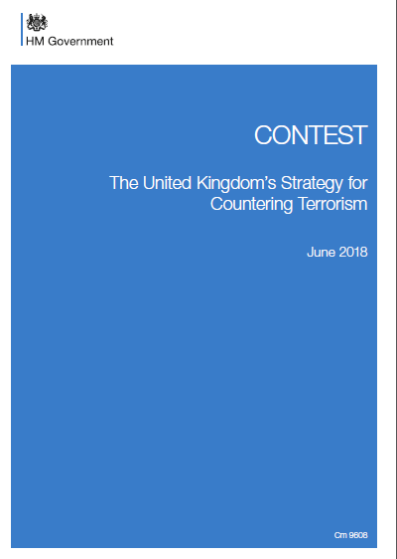
Prevent Duty
The Counter Terrorism and Security (CTS) ACT 2015 places a duty on specified authorities including the police, local authorities, prisons, schools and universities, to prevent people being drawn into terrorism. By introducing the duty the Government intends to increase the consistency of Prevent delivery across England, Wales and Scotland.
The duty seeks to provide guidance to specified authorities to give ‘Due Regard’ to the Prevent Strategy 2011.
Channel
The CTS Act 2015 also places Channel on a statutory footing. Channel programmes already exist in every local authority area and in most areas the local authority and other partners already work effectively together to support people at risk of radicalisation and getting drawn into terrorism.

Slide 4
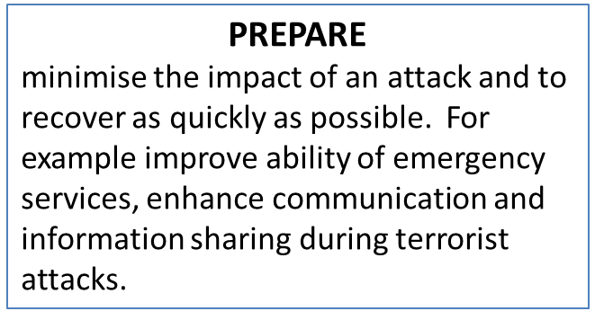
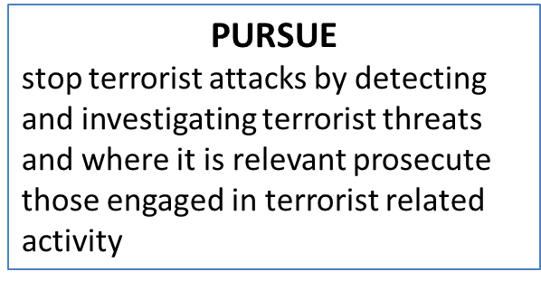
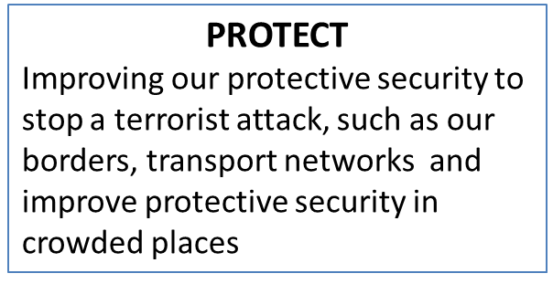
PREVENT IS PART OF CONTEST
(UK’S COUNTER TERRORISM STRATEGY)
PREVENT
Tackle the causes of radicalisation and respond to the ideological challenges of terrorism
Safeguard and support those most at risk of radicalisation through early intervention, identifying them and offering support
Enable those who have already engaged in terrorism to disengage and rehabilitate
Notes:
CONTEST 3 update

Slide 5
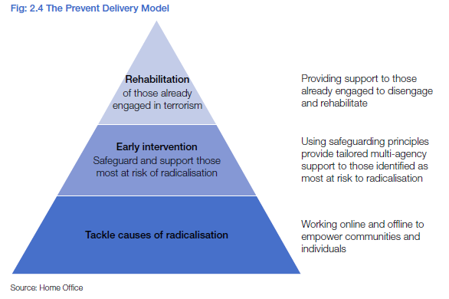
Desistance
and Disengagement
Government and academic research has consistently indicated that there is no single socio-demographic profile of a terrorist in the UK, and no single pathway, or ‘conveyor belt’, leading to involvement in terrorism.
Notes:
New intensive tailored interventions and practical support, including mentoring, psychological and ideological.

Slide 6
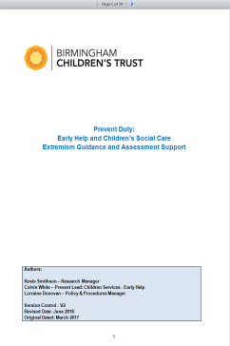
Prevent Guidance - In Birmingham we are strongly committed to meeting the Prevent duty
This guidance document contains a screening tool and assessment questions to assist with exploring extremism concerns
The Extremism guidance is to provide children’s practitioners with an explorative set of questions to assess the nature of extremism concerns being presented by a child or young person (CYP) and their family.

Slide 7
Threat: International Terrorism
The threat from international terrorism is SEVERE
There are a range of threats – the most serious of these is from Daesh
900 people travelled to Syria/Iraq. 40% have returned, 20% have died
Travelled to Syria
Plots
Daesh is promoting the use of “lone actor” attacks. These low-sophistication attacks are harder to detect / disrupt and the attack plans move faster from concept to execution.
Agencies and police have disrupted 25 Daesh-inspired plots in the UK since June 2013
12 Daesh-inspired plots foiled since 2017
OFFICIAL
London Bridge Attack 2017

Slide 8
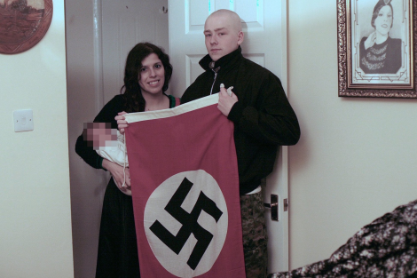
Threat: Domestic Terrorism
Figures also showed that one-in-three terrorism arrest suspects
is for Extreme Far Right, up from a quarter in 2015.
National Action in December2016 became the first extreme Right-wing group to be banned as a terrorist organisation.
The UK suffered 12 far-right terror attacks last year, including the attack outside Finsbury Park mosque, where 47-year-old man drove a van into Muslim worshippers, killing one person and injured at least nine others.
Birmingham Terror conviction - convicted for being members of national action

Slide 9

Warning signs of vulnerabilities
Newly reverted/converted Islam.
Social Alienation (Lack of belonging to society)
Lack of integration in society. Lack of attachment.
In Custody or at risk of custody.
Poor self esteem. Poor Consequential Thinking.
Feelings of injustice.
Demonstration of a Poor attitude.
Homeless/Hostel/Children homes.
Gang affiliation
Exploitation
Mental Health

Slide 10
Radicalisation? Extremism? Terrorism?
Radicalisation (Prevent Strategy)
“the process by which a person comes to support terrorism and forms of extremism leading to terrorism.”
Extremism (Prevent Strategy)
“Vocal or active opposition to fundamental British Values, including democracy, the rule of law, individual liberty and mutual respect and tolerance of different faith and beliefs.”
Terrorism (Terrorism Act 2000)
Violence/property damage/endanger life/disrupt electronic systems
Designed to influence government or intimidate the public
Purpose to advance a political, religious, racial or ideological cause of
extremism leading to terrorism.”
Notes:
Syrian returners – new de-radicalisation programme will be crucial in managing these individuals

Slide 11
Currently in Birmingham Childrens Trust
Children services work with the RHRT framework to determine threshold of concern to enable support.
Practitioner, Parents and professional can request support through CASS – were risk will be explored and assessed to determine whether threshold met for Universal/ additional or complex and significant. Where there is an imminent concerns a crime is being or will be committed the WMCTU police should be informed.
Referral to, Prevent gateway is made to access Channel panel support or to share information to request specialist mentor if needed
All request for support and accompanying extremism screening through CASS.
Dedicated prevent staff were professionals can access information and guidance.

Slide 12

Safeguarding vulnerable people for frontline practioners
Prevent screening / Request for support
Early Help / Family Assessment. whole family approach
Family assessment / 47s
SOS wellbeing - Strength base assessment
Three Houses – to enable conversation
Vulnerbility Assessment – IAT8 to determine strength and protective factor
Channel Panel – de-confliction to determine whether 3Ms. Malicious, Misguided, Maligned intent also to enable multi agency partnership to affect reduction in risk.

Slide 13
The internet and radicalisation
Terrorist material could include:
Articles, images, speeches or
videos that promote terrorism
Content encouraging people
to commit acts of terrorism
Websites made by terrorist
organisations
Videos of terrorist attacks

Slide 14
Prevent Intervention
1: Educative: Generic in nature. Addressing disaffection and alienation by using goal setting workshops discussion based, allowing young people to let off steam and air their views and concerns in a safe and comforting environment. Safe space.
2: Diversionary: Taking groups of young people and allowing them to experience “Other” cultures. Foods, places of worship etc... To enable inclusion.
3: Inclusion: appreciation of other communities and culture through joint initiative to provide understanding.
4: Challenging narratives: KIKIT, ODARA, Channel Mentor, Multi Agency/single agency support

Slide 15
Intervention’s for frontline workers
Extremism Guidance
Prevent in Birmingham EY, EH, SG, - Adults guidance for practioners
Request for support - completed by all professional making referral
Referral pathways: Channel and CS - see prevent guidance for referral pathway
Extremism Screening tool – Prevent guidance and accessible through BSCB and BCT Academy and School Noticeboard.
Explorative questions to aid assessment
Prevent Vulnerbility assessment – practitioner assessment
Signs of safety wellbeing (SOS) see practice tool online resources
Three Houses – to enable conversation and dialogue with practitioner and client

Slide 16
Case Study
Jamal is Iraqi and has just started a new school where he is attending sixth form and attending a faith forum that is exploring Anthropology. Jamal has a tendency to go online to find out fact. In particular topic of on coercion and violent extremist narratives.
Belinda is a member of the tutorial team and has also been assigned to work with him in as teaching support. After a period of eight months Belinda approaches her DSL with concerns about Jamal’s behaviour and the DSL referrer him to a prevent coordinator.
Belinda tells the coordinator that Jamal often talks about the Syrian conflict and about how not enough is not being done to save the people. He talks about how he feels the only response is to fight back harder and about his belief that westerners are to privileged and choose not to see suffering of the Syrian [people.
before going to the DSL Belinda has recorded some of Jamal’s conversation on her mobile phone and has taken picture of his note pad where he had collated a scrap book with photos and text about the Syrian conflict.
Belinda also tells the Prevent coordinator that Jamal has books that she believes are related to terrorism, including the blood sacrifice history of rebellions against the British Empire. Belinda also felt that he prays a lot and describes him has being a fundamentalist.

Slide 17
Questions to explore ?
Do you think Belinda has done the right thing?
Do you Think Jamal is doing anything wrong? If Yes, What?
Are Jamal's action and beliefs evidence that he has been radicalised or that he might be involved in terrorism?
Could Belinda have done anything different?
Notes:
Answers
Belinda has broken the law by taking pictures of Jamal property without his knowledge or permission and secretly recording his private conversations. She may lose her place on the post sixteen centre for her action – may need to involve LADO.
Jamal’s review about Syria are not unique and are certainly not illegal.
Jamal is Muslim, and praying regularly is an integral part of his religion. The pad Belinda took photo of is part of his course.
Before resorting to photographing and recording Jamal, she could have gone to her DSL first.

Slide 18
Exercise
How would you deal with a young person saying any of the following:
“British Jewish teenagers volunteer to help the Israeli forces, where as if a Muslim teenagers did the same to help their country of origin, they would definitely be arrested under the terrorist laws, Why?”
“I want to wear a Niqab but my employer will sack me”.
“I hate all non Muslims”.
“Your only talking about terrorism because I'm a Muslim”.
“Suicide bombing works ISIL / Al-Qaeda has shown the way”.

Slide 19
Answers
Belinda has broken the law by taking pictures of Jamal property without his knowledge or permission and secretly recording his private conversations. She may lose her place on the post sixteen Centre for her action – may need to involve LADO.
Jamal’s review about Syria are not unique and are certainly not illegal.
Jamal is Muslim, and praying regularly is an integral part of his religion. The pad Belinda took photo of is part of his course.
Before resorting to photographing and recording Jamal, she could have gone to her DSL first.

Slide 20
Next steps
Complete online training recourse
Familiarise your self with reporting mechanism.
Know who prevent staff are and colleagues with support responsibility
Get copy of Prevent guidance and screening
Thank you!

Slide 21
Colvin White
Early Help Family Support
Tel: 0121 303 9905
Mobile:07920 088512
colvin.white@birminghamchildrenstrust.co.uk
Secure: Colvin.X.White@birmingham.gcsx.gov.uk

