Slide 1
Education Legal Intervention Team :
Children in Need of Protection
Children In Need of Protection Team
1 Lancaster Circus
Birmingham
B4 7DJ
April 2019

Slide 2
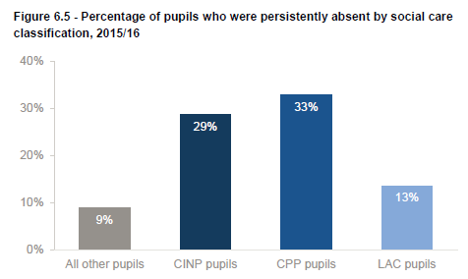
Introduction
CIN / CP poor attendance nationally
Attendance in Birmingham
Ofsted inspection / DfE report
Our role
Four times worse
41%
Three times worse
33%
33%
29%
Figure 5 taken from DfE report : Children in Need of Help and Protection March 2018

Slide 3
Our Process
School
Social Worker
Outside
Agencies
CareFirst
Attendance
Data
Court Team
Fair Access
CIN/P report
No School Place
Travel Assist
Michelle
West & Central
Wendy
North & East
Rachael
South
BCC
Elective Home Education
SENAR
Admissions
Child Missing Education

Slide 4
Case Study

Slide 5
How you can help
Keep doing what you’re doing
MIS attendance data uploaded at least weekly
Challenge, then escalate
Information sharing / Joint working

Slide 6
Our work so far
770 cases closed
215 phone calls and emails to the duty line/inbox
Extended to now cover Think Family
COBS CIN/P children no longer on part time timetables for extended periods

Slide 7
Children In Need of Protection Team
Email: attendance-cinp@birmingham.gov.uk
West and Central
Michelle: 0121 303 4084
North and East
Wendy: 0121 303 4085
South
Rachael: 0121 303 4089

