Slide 1
Term 3
Primary
Curriculum planning-SMSC the golden thread
Featherstone Primary School- outstanding curriculum planning of SMSC and FBV
Persona Dolls- Rewind

Slide 2


Slide 3
DFE-RR119
May 2011

Slide 4
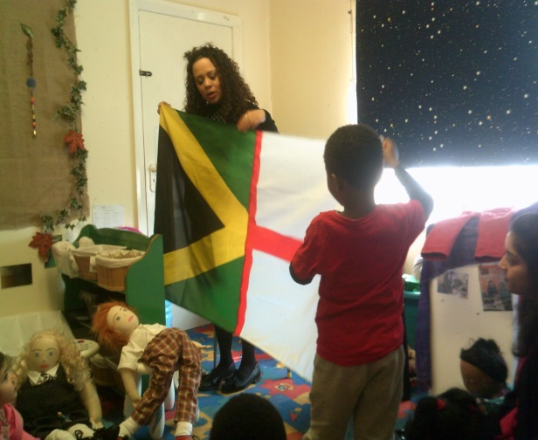
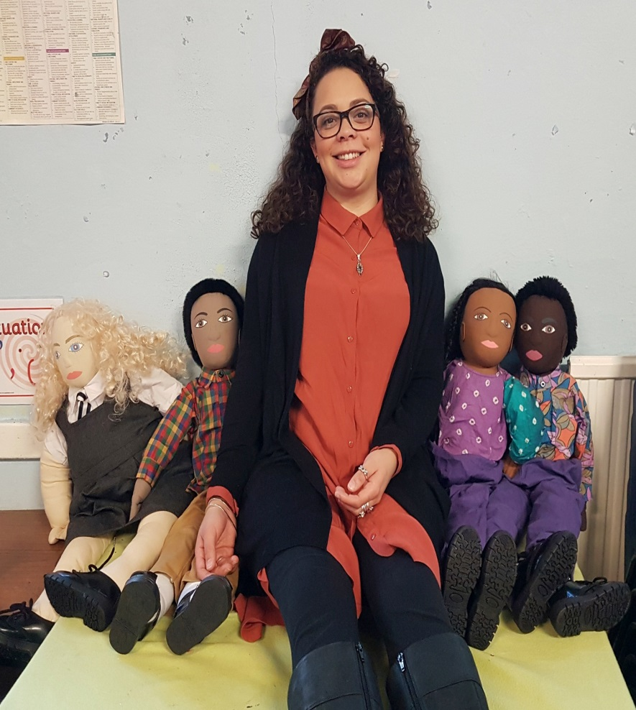
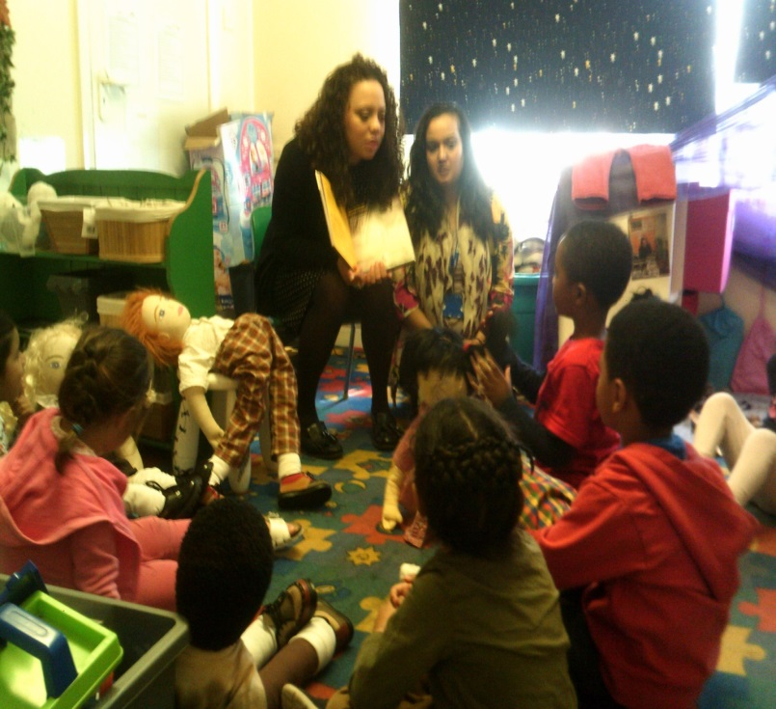
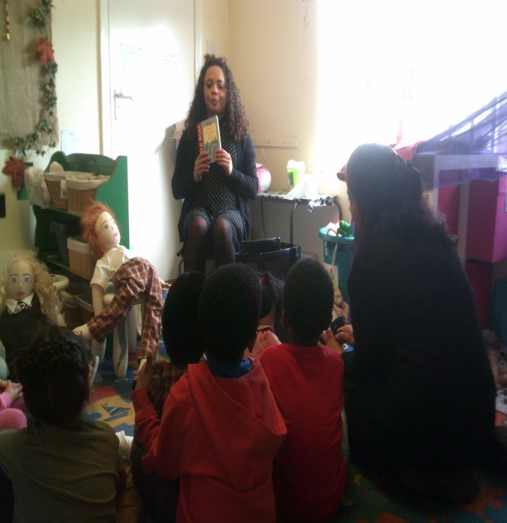


Early Years work using Persona Dolls : West Smethwick Enterprise

Slide 5
Feedback comments…
The REWIND staff helped us understand how PREVENT is also applicable in an Early Years setting
Amazing session. The children wanted REWIND to stay all day with them!
Very informative, engaging, really great, the children and staff found it very useful.
The Identity Bag and dna exercises really made the pupils think about who they are. Thank you so much.
Pupils were amazed by the real life stories, videos and loved the message of ‘one race’
Held the children's attention for the whole hour session which is not easy!

Slide 6
ANY QUESTIONS?
Karis Allport
REWIND UK
Karis.rewind@gmail.com
www.rewind.org.uk

Slide 7

PSHE – THE GOLDEN THREAD
Drawing back the curtain of a
Dynamic
PSHE Programme

Slide 8
Laying Foundations
Key Supporting Components
Bespoke Programme - Topics
Golden Thread of a Holistic Curriculum

Slide 9
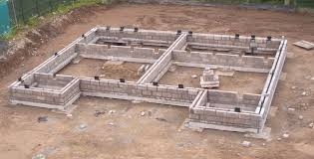
Relationships
Health and wellbeing
Living the wider world
Building foundations

Slide 10
Relationship
Self
Others
products
Future
Notes:
Statutory status – PSHE Stat status can be thread

Slide 11

The Bespoke Package
National, Regional and Local Statistics
Health Data
Safeguarding
Health & Wellbeing
Living in the Wider World
Relationships
Notes:
The framework to build your programme
Can begin with a published scheme – paths/ seal/ jigssaw/ - these will give a baseline to begin

Slide 12
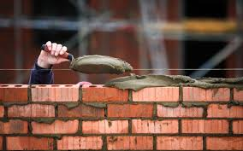
What is the
PSHE Golden Thread through Spiritual, Moral ,
Social & Cultural Ethos
Notes:
school values this week/ month= Celebration of honest, perseverance- not just a certificate- but a letter/ post card home- praise continues from home to school – models expectation positively
BHM- Does this coverage reflect your school community? Anti bullying Messages -

Slide 13
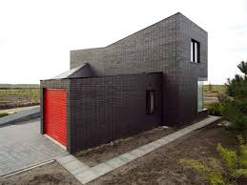

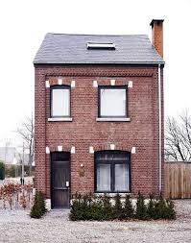
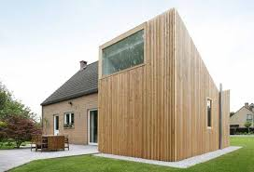
HOLISTIC PSHE PROGRAMME

