Slide 1
Post-16 Term 2 Working with young people on the issue of mental health

Slide 2
Mental Health- Raising Awareness and Challenging Stigma
‘Inspiration and Excellence’
Bishop Vesey’s Grammar School
Ofsted 2014:
“This school is a pioneer in the development of young people’s attitudes to mental health”

Slide 3
The Background
Key: Proactive response to any issues student present
Began in 2009
‘Time to Change’ link – used their posters, literature
Assemblies on ‘Time to Change’ campaign, self-harm, eating disorders and stress.
Staff Training
In 2012, we attended a Time To Change course and became the first school in the Midlands to sign up to their campaign and became a partner school in 2013.
In 2016, became part of Birmingham’s New Start programme

Slide 4
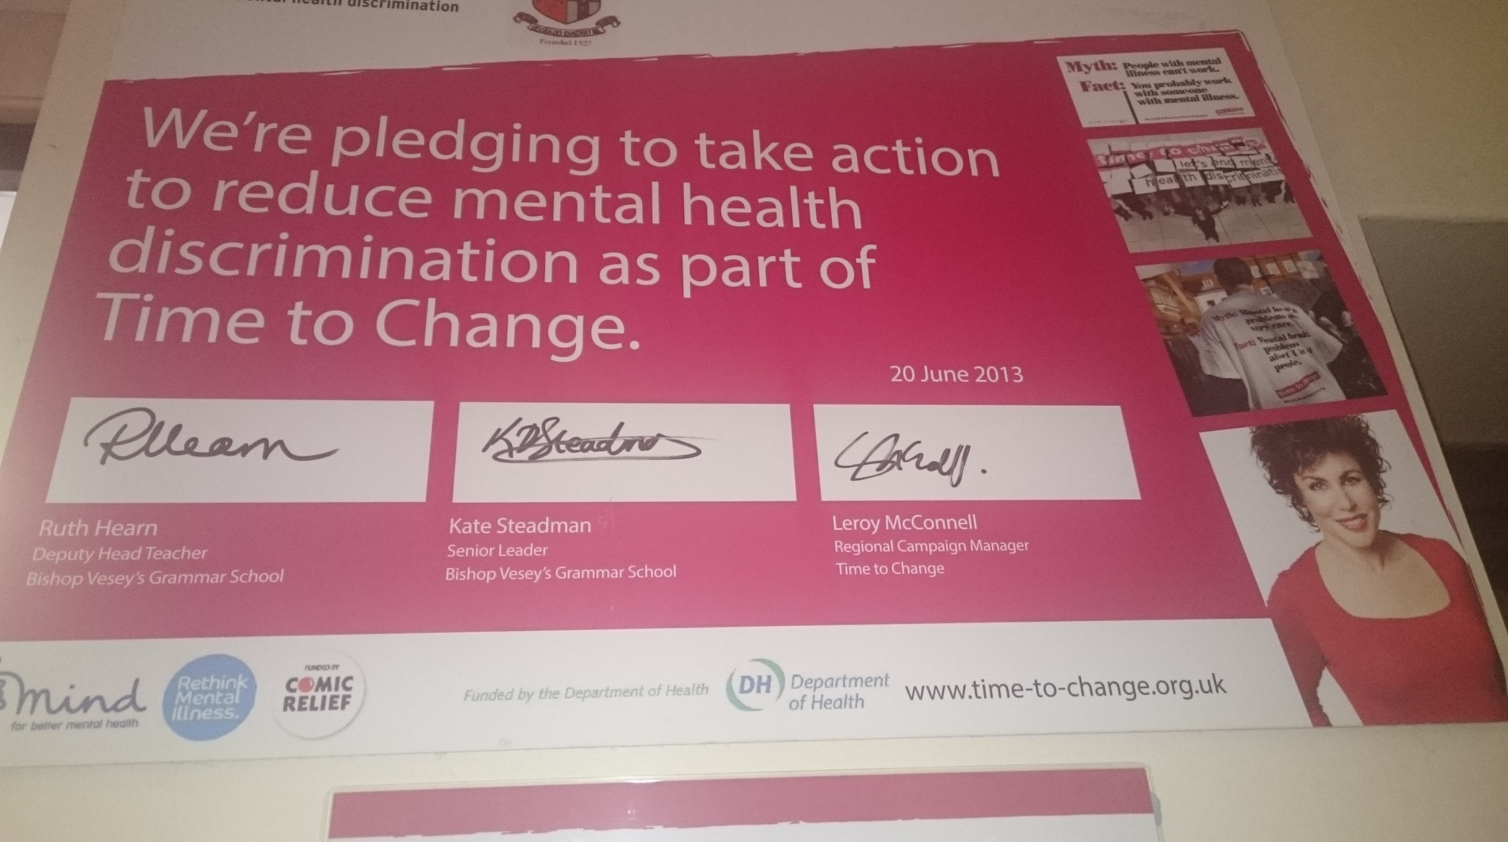
‘Time to Change’ AIM: To promote awareness and reduce stigma

Slide 5
The facts
1 in 10 young people will suffer from a mental illness.
That’s 3 in every average classroom.
1 in 4 adults will suffer from a mental illness.
Suicide is the second biggest cause of death in young men aged 14-25.
https://www.youtube.com/watch?v=SE5Ip60_HJk&safe=active

Slide 6
Time to Change trained 25 members of the Lower Sixth.
These 25 students became our Mental Health Ambassadors.
Led assemblies across the three Key Stages of the school.
Two of the Ambassadors were selected to become Officers, a senior position of responsibility within the school.
A Mental Health Awareness unit of work is incorporated into every year group and delivered through Citizenship lessons.

Slide 7
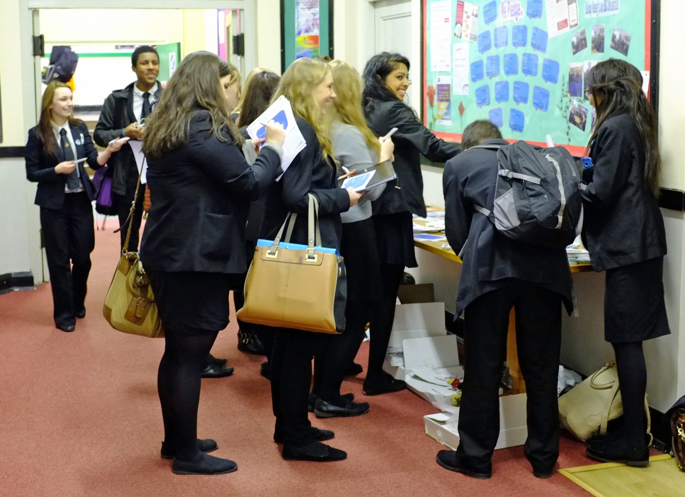
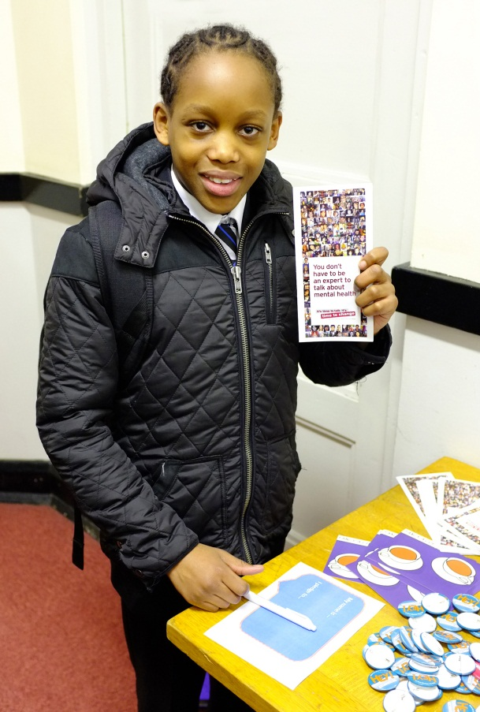
‘Time to Change’ Day AIM: To promote awareness and reduce stigma Badges, pens etc given out & in return, pupils pledged their support to reduce stigma surrounding mental illness

Slide 8
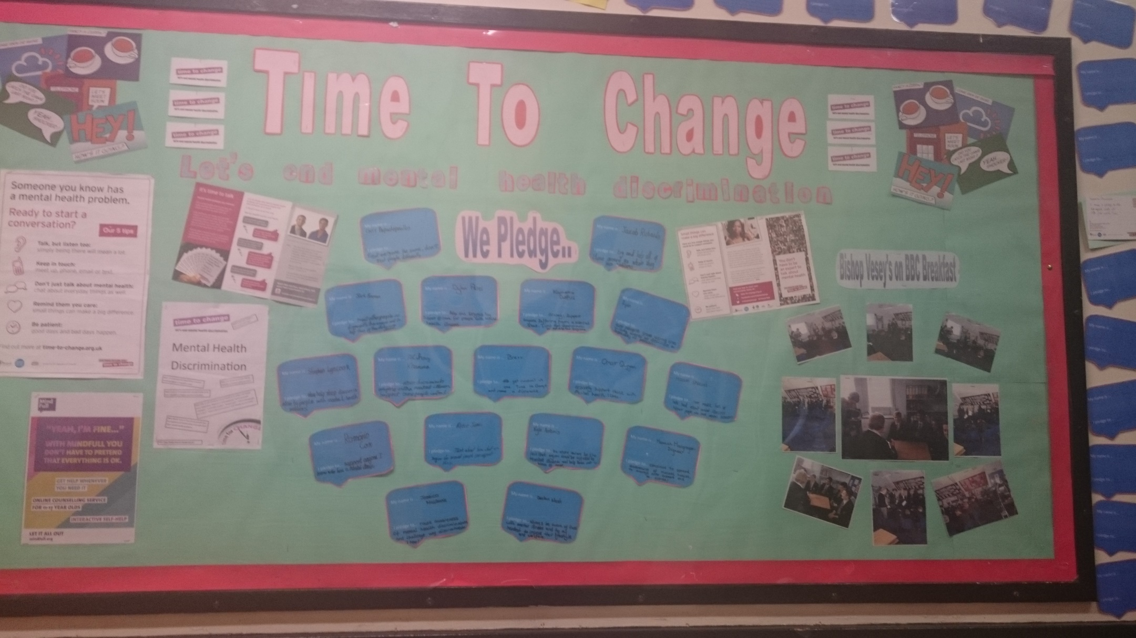
‘Time to Change’ Day AIM: To promote awareness and reduce stigma

Slide 9
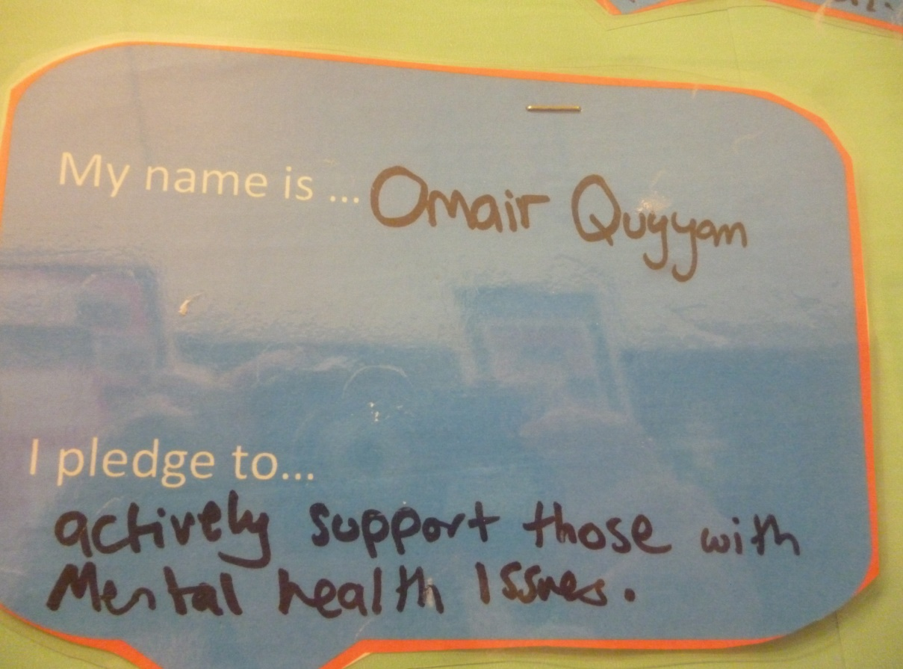
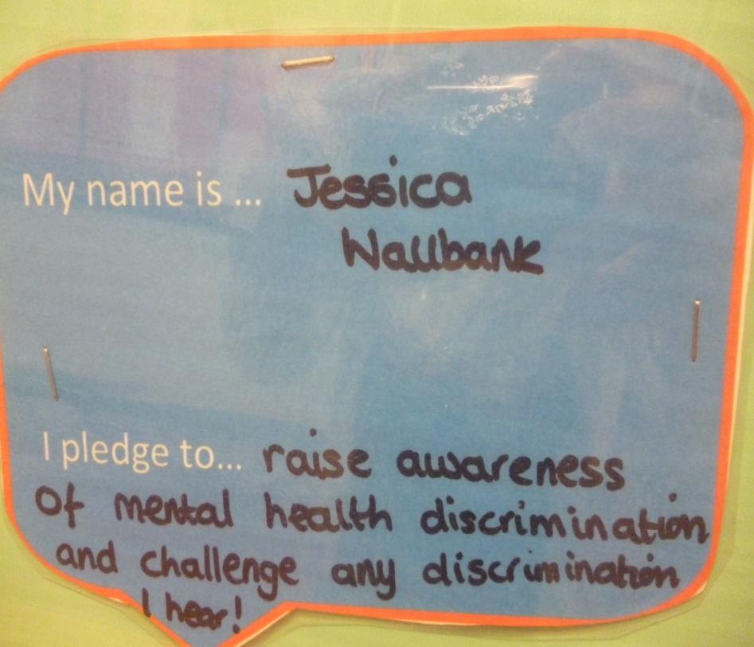
‘Time to Change’ Day AIM: To promote awareness and reduce stigma

Slide 10
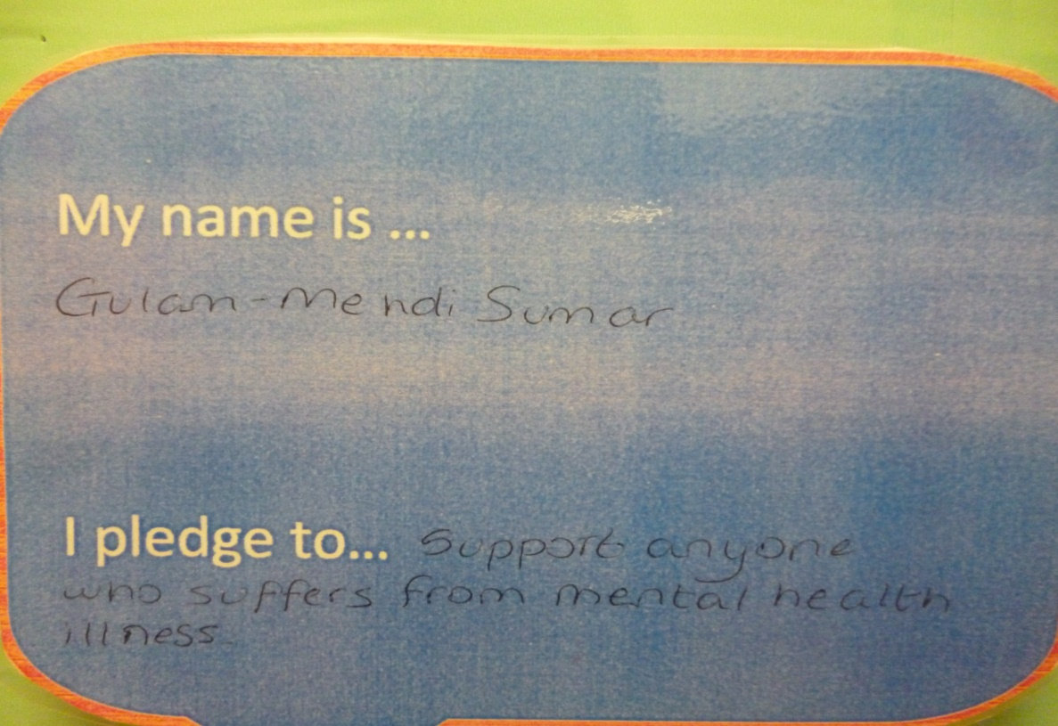
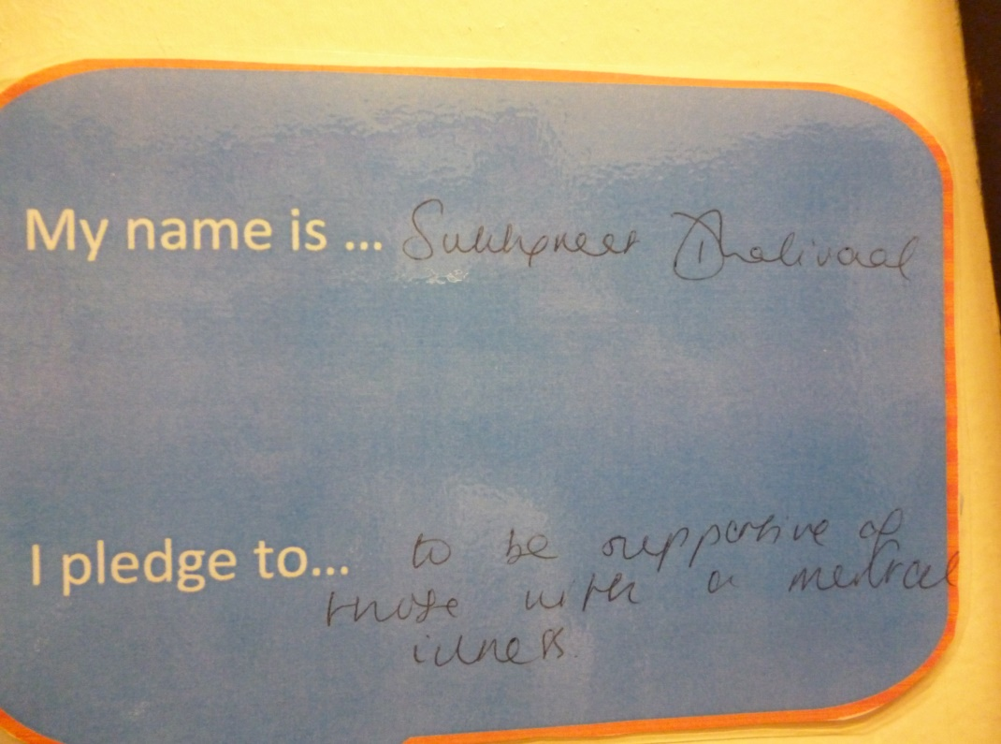
‘Time to Change’ Day AIM: To promote awareness and reduce stigma

Slide 11
We appeared on BBC Breakfast showcasing our actions towards ending mental health discrimination 3 students were filmed training pupils from Year 10 on how to reduce stigma

Slide 12
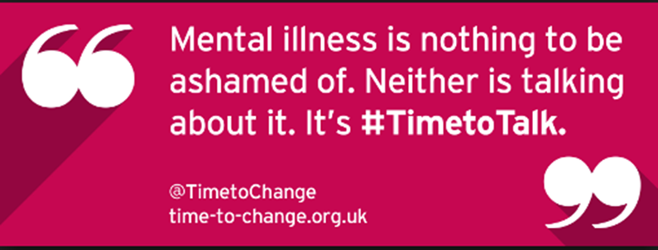
Recent actions - 2015-17:
Outgoing Officers trained another 25 new Ambassadors
3 selected as Officers (16 applications)
Constant consolidation of work of their predecessors and then extending it.
Face book page which THEY manage and add posts to
AIM: always to raise awareness and reduce stigma
Led a Parents Information Evening about mental health and illness .
Quizzes about mental illness given to prospective students and parents on Open Evenings (answers to which are placed around the school).
Spoken at two local primaries – focus group - Year 6 pupils.
March 2017- spoke at another local primary to Years 4-6.

Slide 13
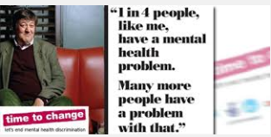
Consequently, a Head Teacher at one of the schools visited wrote to the Officers stating that:
“As staff it has made us consider the emotional well being of those in our care. It has shown us that we need to ensure the children know that being mentally or emotionally ‘under the weather’ is common place and that it is important to express these feelings and ask for support.”

Slide 14
Involving Lower Years
Curriculum Involvement:
Art competitions organised by the Officers to design new posters.
Task set as homework
A prize was awarded for the best entry in each form and three overall winners were selected.
Design a mental health poster
Design an anti-bullying poster

Slide 15
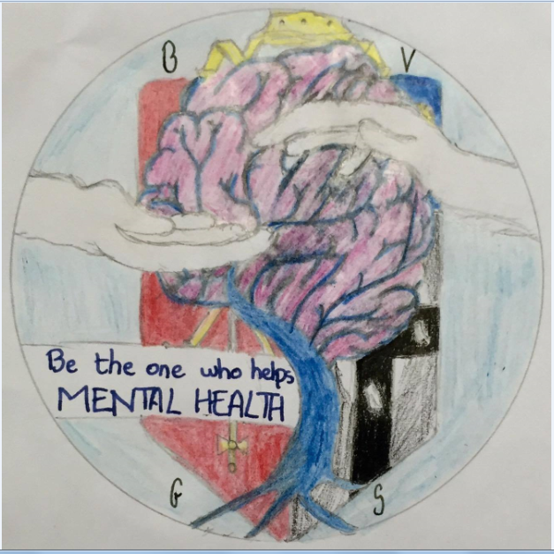

Slide 16
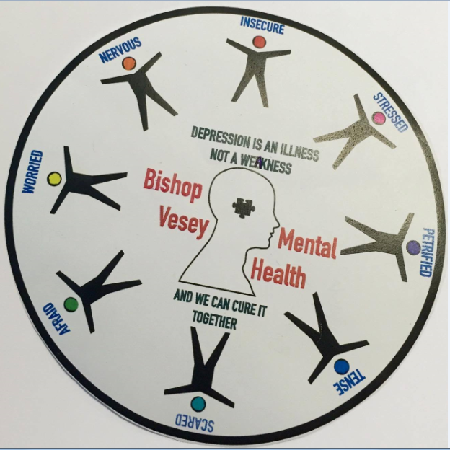

Slide 18
Birmingham New Start
Aim: improve resilience
Establish Well Being Leads in Year 9 trained through three Saturday morning sessions
Well Being Leads have delivered assemblies to Key Stage Three year groups
Each form has a Well Being representative and have been trained by the Year 9 students
Well Being leads prepared quizzes for form time on issues such as stress
Sharing good practice with Lordswood Girls, Queen Mary’s Walsall and Erdington Academy
Assembly to Year 11 students in other schools on stress
Year 7 have a presentation on resilience at the beginning of the year and the people they can ask for help are signposted to them.

Slide 19
Student suggestions
Consult students or use a suggestion box to incorporate their ideas.
Ideas we have employed from the student body- quizzes, short films about mental health to use in extended registration, mindfulness activities- colouring, Sudoku, word searches and puzzles- and jigsaws in quiet spaces when students need time out.

Slide 20
Outside Experts
We offer:
Assemblies
Outside speakers to all students:
To liaise with, educate and inform our ambassadors
To discuss potential careers in Mental Health with students
To speak to those students studying Psychology and prospective medics.
These have included a speaker from the organisation ACAS, David Wait, and Professor David Sallah who is the Clinical Lead for Mental Health, Learning Disability and Dementia for Health Education England.

Slide 21
Workshops
Dove workshops
Children’s society- body image and e-safety Years 7, 8 and 9
February 2018-Year 9 and 10 students Time To change Youth Ambassadors and presentation from Manic Arts theatre group.
Educate and celebrate- Sixth formers and Year 11
Sexuality- Years 9/10 delivered by ex-student

Slide 22
Curriculum
Not just PSHE!
Psychology
History
English Literature
Art
In planners- pages for well being and organisations that can be contacted

Slide 23
Impact:
Following our initial assemblies, there was a rise in the number of pupils reporting issues related to mental health.
Over time, what we have found is that pupils come forward for help sooner.
Reason: School has created an ethos where difficulties related to mental and emotional well being are discussed. The stigma has been reduced. It is NORMAL.
***Staff are also willing to discuss experiences and feelings

Slide 24
What’s next?
Developing outreach programme to more local primaries.
Pastoral evening inviting parents from schools in the local area.
Invite speakers from more local and national mental health charities into school to speak in assemblies
Appoint Ambassadors throughout the school years
Resilience programme at the beginning of Year 7

Slide 25
Advice
It HAS to be a whole school initiative but should be led by staff with a real interest in raising awareness and reducing stigma.
ALL staff need training
Get resources for free from Time To Change, Young Minds, Mind, Heads Together and other charities
Have a clear long term vision but changing attitudes takes time and commitment.
Your students are your greatest resource- use them!
k.steadman@bishopveseys,bham.sch.uk;

