Slide 1
Special schools
Term 2
UNICEF
Selly Oak Trust schools-talking about healthy relationships
Primary mental Health resource
TFF- primary and Secondary schools workshops

Slide 2
Primary Themes
Mental Health
Faith and cohesion,FBV

Slide 3

Welcome!

Slide 4



Keep In Touch…
  www.3ff.org.uk
  rich@3ff.org.uk
Or follow us on social media…
Notes:
Additional training opportunities
Connect with us
Facebook (threefaithsforum)
Twitter (@threefaiths)
Twitter (@tamandawalker)

Slide 5



Feedback on Talking Mental Health
16 November 2017
Shahista Zamir
Middle Leader (PSHE)

Slide 6
Focus of the lesson:
Initially, ground rules were set to create a safe environment.
Objective: To understand the difference between a small, everyday feeling and a big feeling.
1. Pupils can use the appropriate language to talk about mental health and wellbeing.
2. Pupils can identify the trusted adults in my life and know how to ask them for help and support.
3. Pupils can compare feelings.
4. Each pupil has improved as a listener.

Slide 7
Definition of mental health clarified:
Mental Health is about our feelings, our thinking, our emotions and our moods – things you can’t really see, but that affect our lives in lots of ways.

Slide 8
http://www.annafreud.org/what-we-do/schools-in-mind/youre-never-too-young-to-talk-mental-health/talking-mental-health-animation-teacher-toolkit/
Watch to [02:50].

Slide 9
Discussion
What did you notice in the animation?
*
*
*
‘Small everyday feelings’ – what are these?
Are there any other examples that you can give?

Slide 10

What are small feelings?
Year 4
How do I deal
with big feelings?
*identify exactly what makes you feel this way
*act brave
*don’t avoid what makes you upset
*deep breaths
*brain holiday
*paint, write a letter
*exercise
*do what you like
*talk to someone who can help
*communicate
How do I deal
with small feelings?
*talk about them
*write them down
*draw pictures
*take a bath
*eat comfort food
*be with your friends, family and loved ones
What is mental health?
*when big feelings take over your life
*make you think or feel negative emotions about yourself or your life
*needs looking after or problems can happen
What are big feelings?
*always worrying
*feeling very anger
*being so scared all the time
*extreme sadness

Slide 11
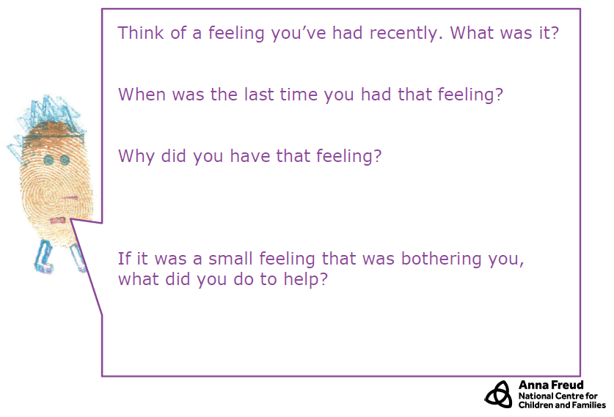
Year 5

Slide 12
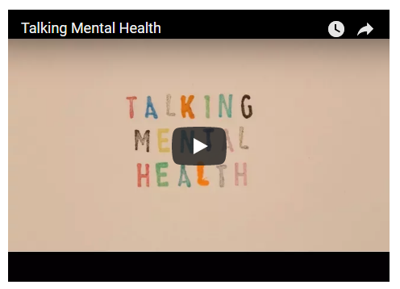
2. Talking
http://www.annafreud.org/what-we-do/schools-in-mind/youre-never-too-young-to-talk-mental-health/talking-mental-health-animation-teacher-toolkit/
Watch to [03:31].

Slide 13
Discuss:
Sometimes our feelings get too big for us to manage on our own.
What can we do when our feelings become too much/get too big?

Slide 14
Aim: There are ways for you to talk about your feelings and identify people to talk to.
After watching the clip, what is the key message of the clip?
2. What is happening for Jay?
3. What could Jay do?

Slide 15
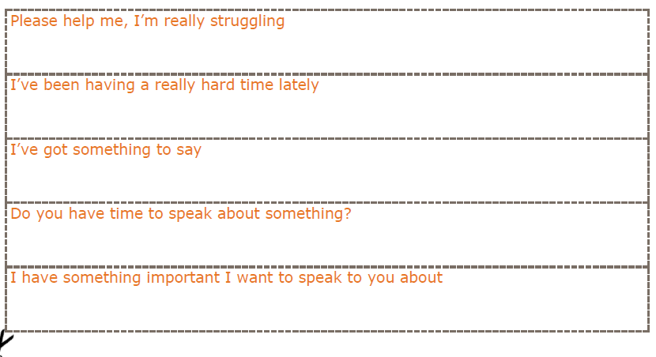
Activity
Use the cut up sentence starters in pairs to roleplay talking to someone about a problem or a worry. One person to use the sentence starter to help them begin the conversation.
Talk about issues at school, for example, “I am worried that I can’t do my homework”, “I am worried that my friend doesn’t like me anymore, “I am worried about a test a school”.

Slide 16

Activity
Complete your Circle of Support sheet.
Identify who the trusted people are in your life who you can talk to when you are feeling worried.
Write or draw them on the worksheet. On the sheet, place the people who you would speak to first, closest to you.
This activity should be kept private. There is no need to discuss what you have put down afterwards.

Slide 17
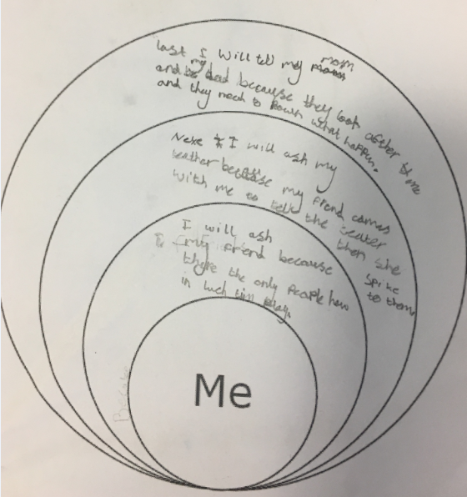
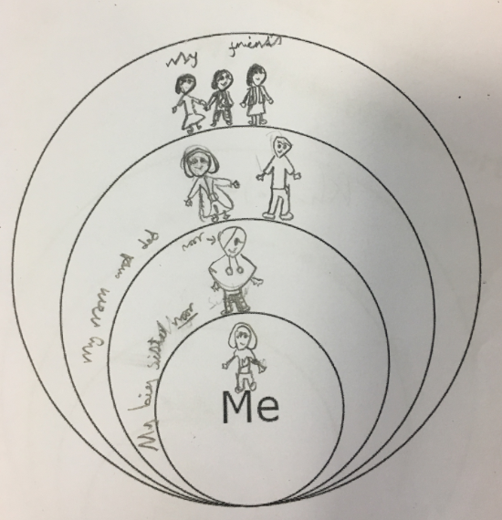
Year 4

Slide 18
3. Listening
Jay needs someone to listen to her. How can we be good listeners when people want to tell us about how they are feeling?
Stand in two lines, with children facing a partner.
• Using the cards, you are to act out the instruction on the cards for 30 seconds at a time.
• Tell your partner after each one:
How did it feel?
Were you being listened to?
What was the other person doing that stopped them from being a good listener?
Using this information, draw or write down the rules of being a good listener using the good listener worksheet.

Slide 19
Plenary
What happened for Jay in the end?
“If your feelings are getting too big to cope with on your own, talking to someone you trust might really help.”
Let’s recap what we have learnt today about the following:
• What is mental health?
• Talking about mental health
• Being a good listener
• Who to talk to about our feelings

Slide 20
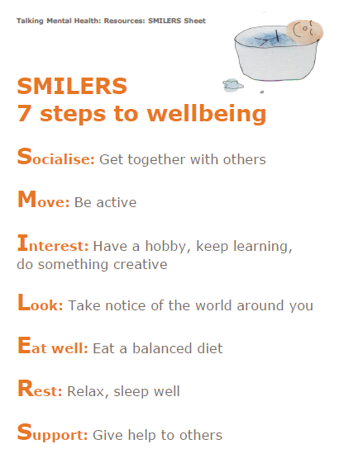
Benefits
Identification of potential safeguarding matters.
Further mental health lessons are being planned to meet the needs of the learners.
Children felt ‘listened to’.
Safer class environment.
Children’s emotional needs were explored and discussed.

Slide 21
Strengths
Well structured lesson plan.
Clarity with instructions: a list of resources needed at every stage of lesson and the duration of clip to show.
A topic which engaged and developed children’s understanding of the topic.
Finger print with real voices was abstract yet powerful.
Children commented on how they benefitted immensely from discussing this topic.
Children demonstrated greater understanding of different feelings which are felt by them.
Children were made to feel that it’s acceptable to have ranging feelings and explored strategies to cope.

Slide 22
Even better if...
I wish we could discuss things more.
I wish that this can happen everyday.
I wish we had more time.
I wish to learn more.
I want to explore where I can get help from outside of school for big feelings?
I want to know where to get help if I’m not at school, who should I go to?
I wish everyone was happy.

Slide 23
Suggestions
Video clip to include real faces to show what different emotions look like.
Video clip to show clips of cartoons or popular children’s shows to showcase everyday ‘little’ and ‘big’ feelings as well.
Differentiated resources (sentence prompts, images for low attaining children).
More guidance on support strategies outside of school, including a handout.
More guidance required on what can be done after the session for teachers.
Handout for children to take home for parents and carers.
Expectation of outcomes – Is there a scale (can these even be measurable)?

Slide 24

Safeguarding Curriculum
UNICEF in school
Rights Respecting School Level 1

Slide 25

The safeguarding curriculum will ensure that our children are informed and educated about such issues
Preventative rather than reactive

Slide 26

Safeguarding Curriculum
Abusive relationships
The law and sexting (dangers of online material)
FGM
Dangers of drugs
Personal health/wellbeing
Anti-bullying
Extremism

Slide 27
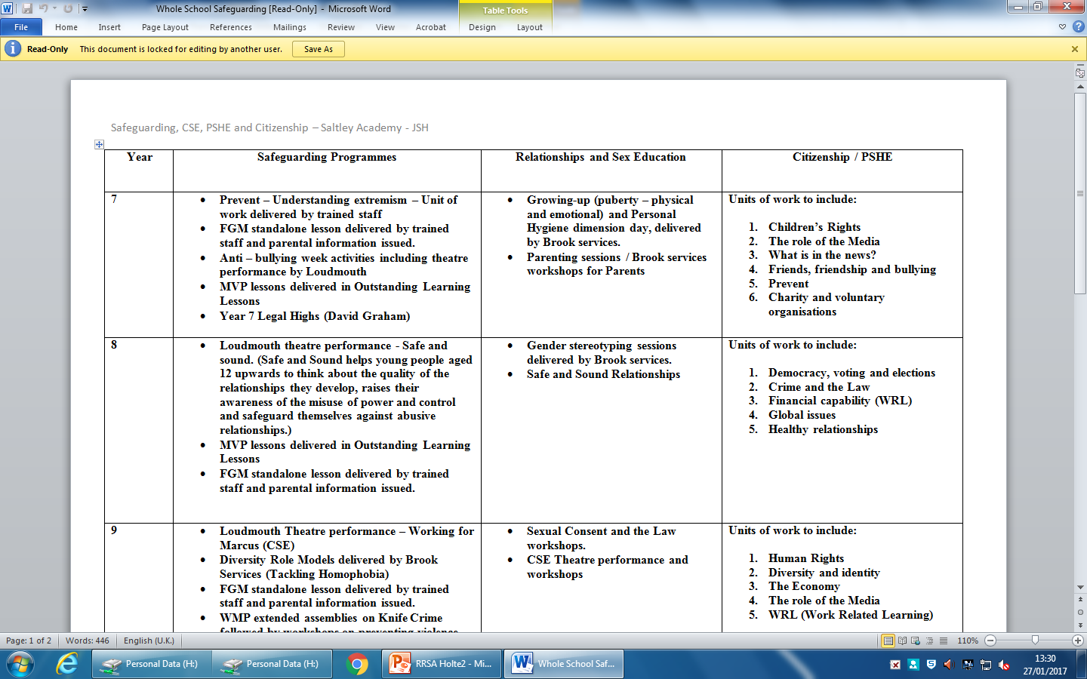

Slide 28
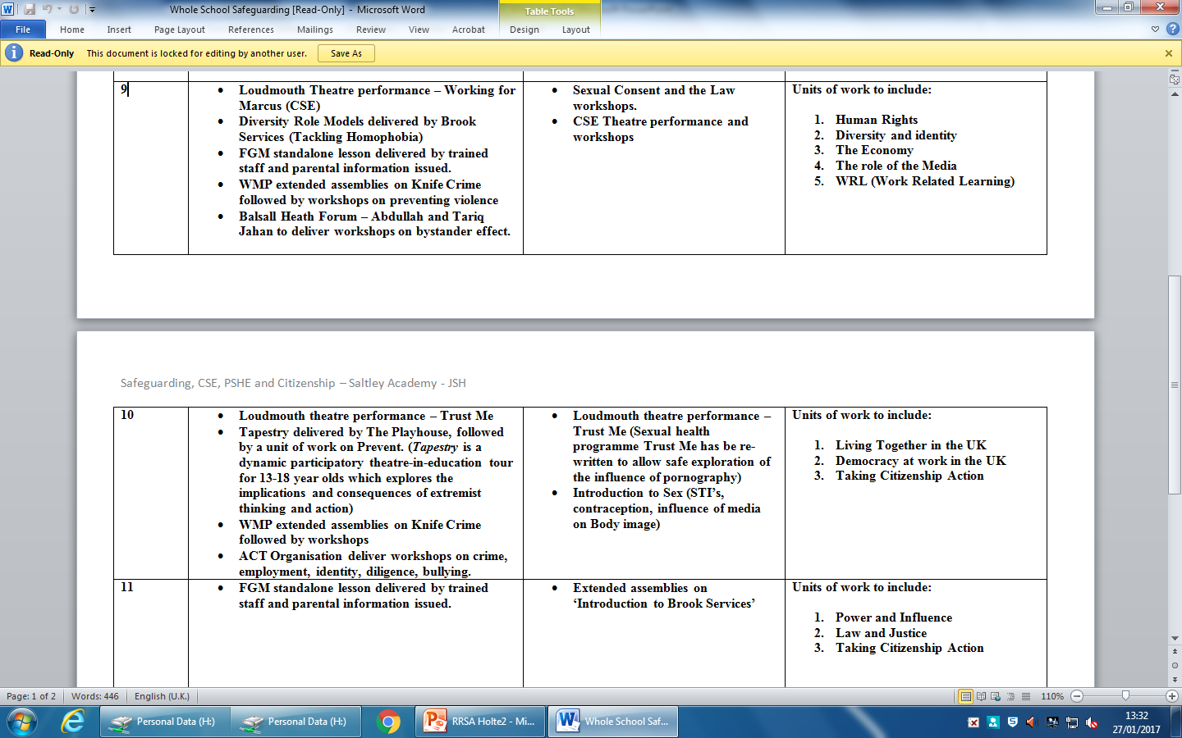

Slide 29







Notes:
Experts, up to date knowledge, pupil/teacher relations

Slide 30

What is a rights respecting school?
A Unicef UK Rights Respecting School is a community where children’s rights are learned, taught, practised, respected, protected and promoted.
Schools that are able to explicitly demonstrate the above can receive accreditation.

Slide 31
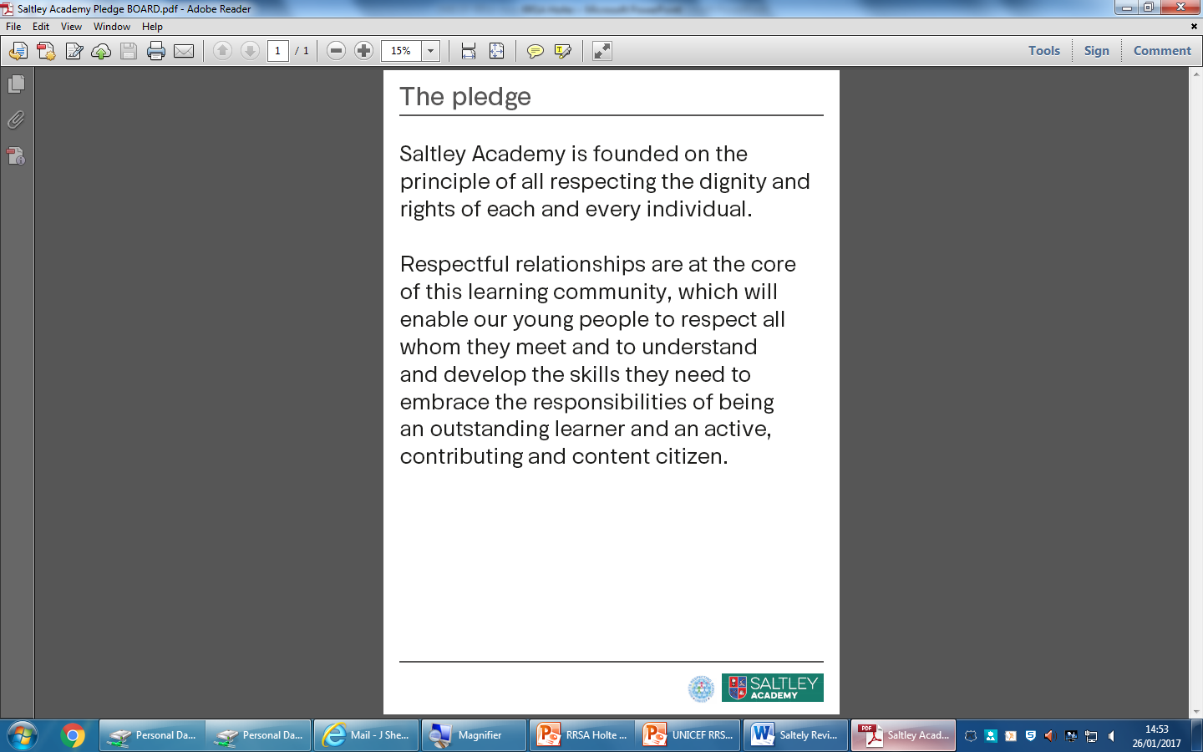
The agreed charter
A charter was agreed to
by all students and staff.
The charter states that..
Notes:
Mutual agreement

Slide 32
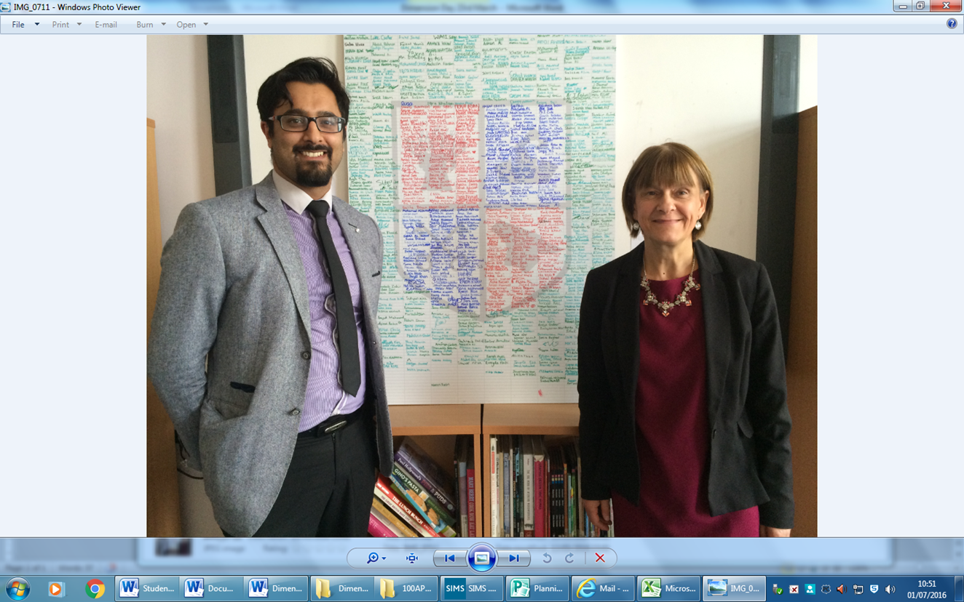
The agreed charter

Slide 33
Steering group
Combination of teaching staff from various departments
Support staff / TAs
Member of SLT
Lead Practioners

Slide 34
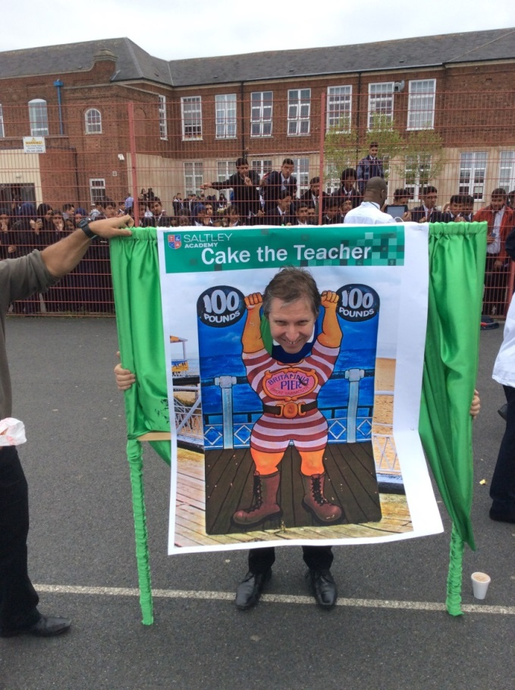
UNICEF Day for Change
The big Day for Change will be on Wednesday 24 May
Charitable work co-ordinated by student leaders.
Notes:
Raised over £1000

Slide 35

World’s Largest Lesson

Slide 36
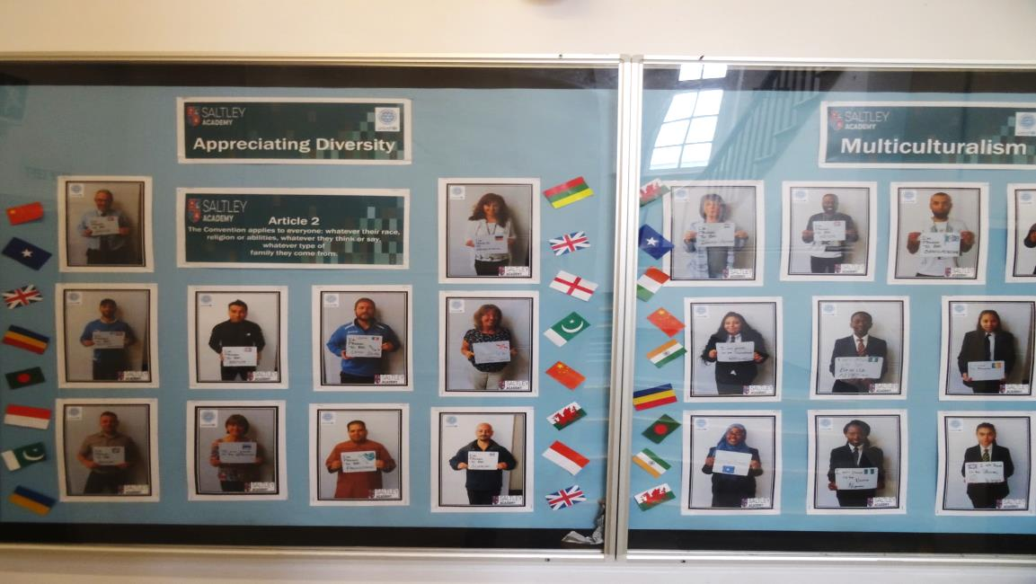
Multi-cultural Board

Slide 37
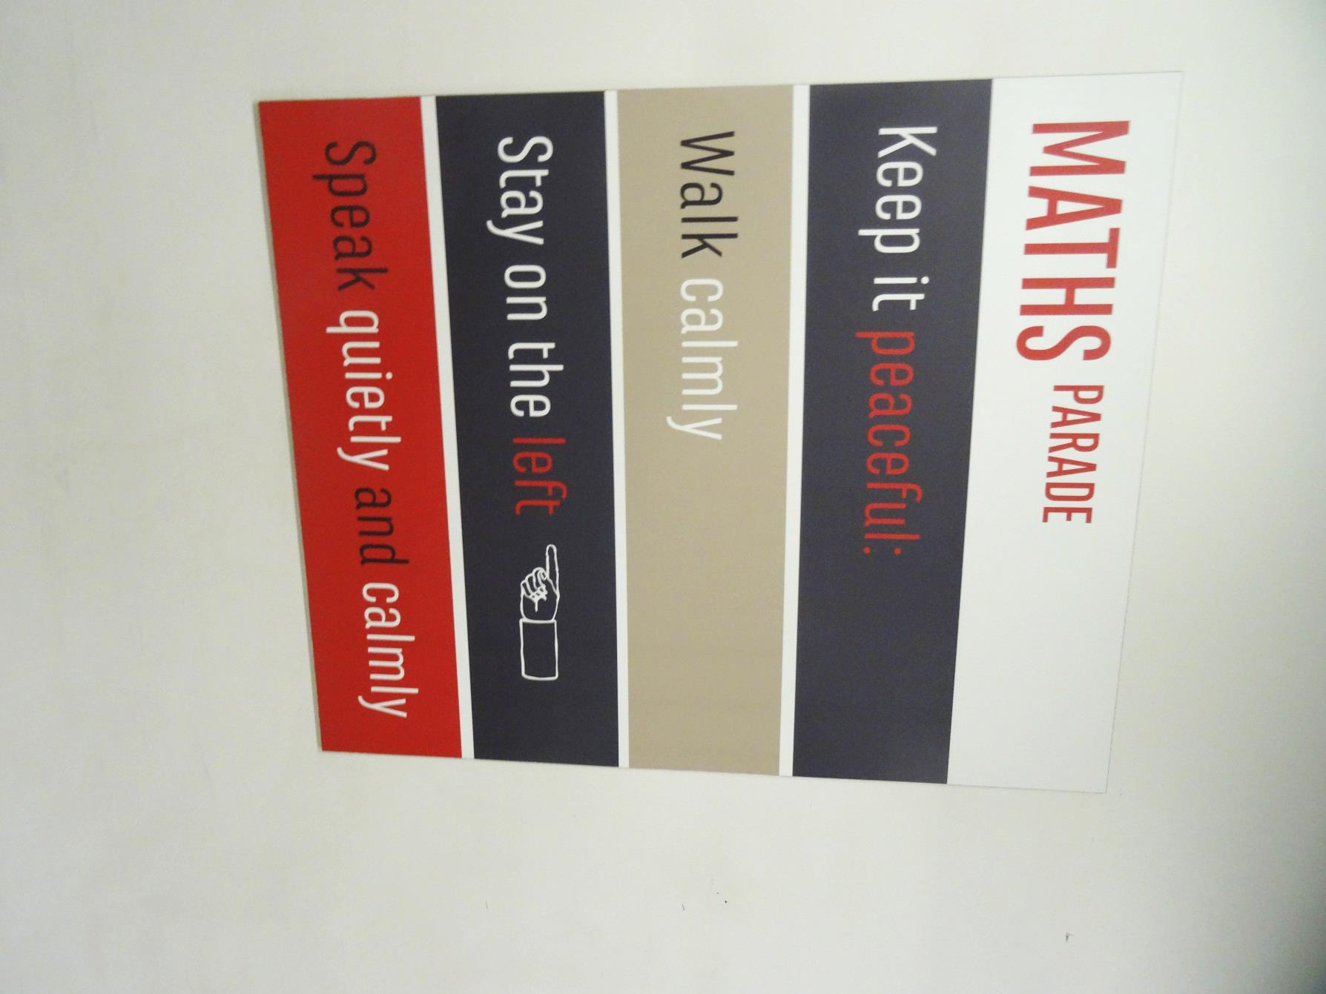
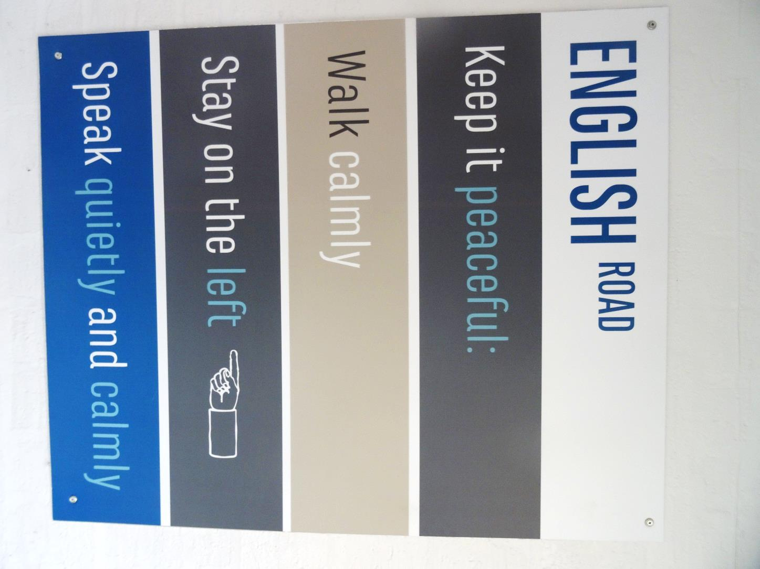

Slide 38
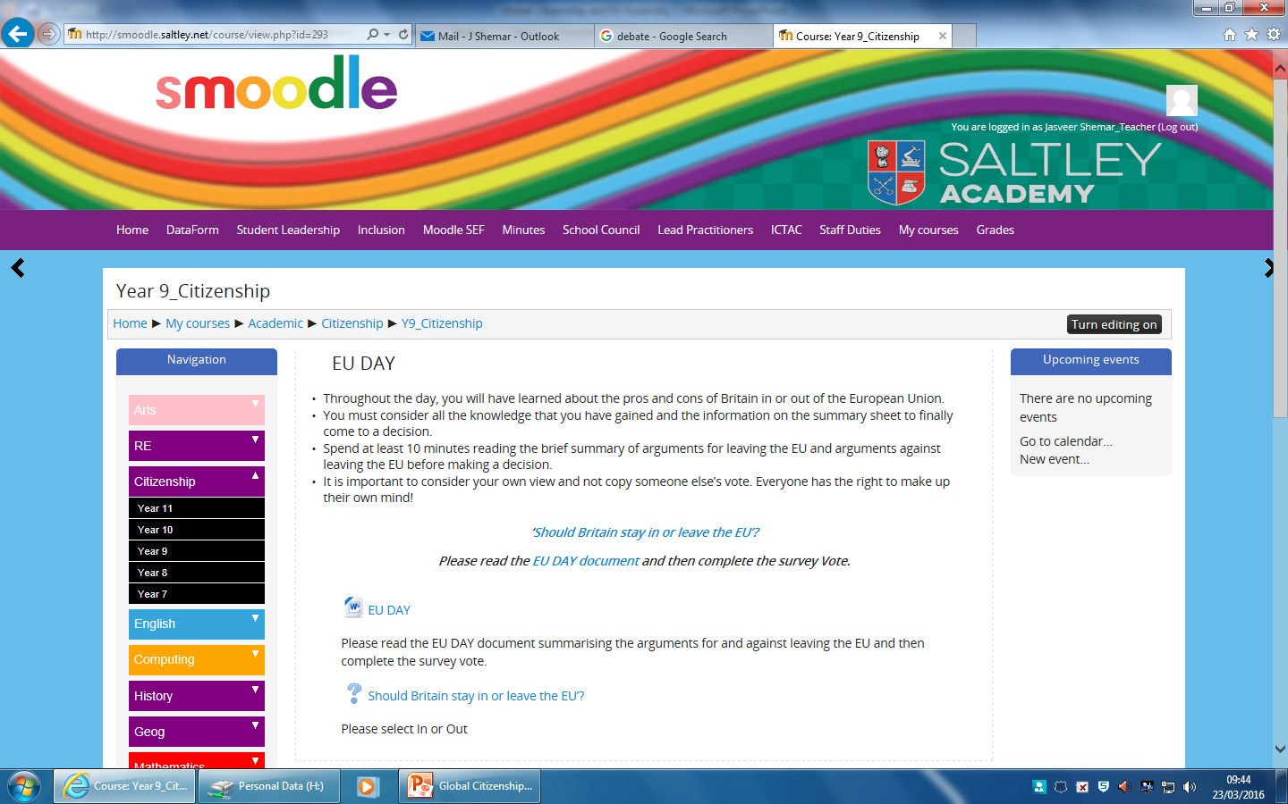
EU day and current affairs

Slide 39
Saltley Guarantee
Year 7 Walk through Birmingham to learn about the culture, spiritual, geographical and historical importance of Birmingham Year 7 attend a live ‘Arts’ Performance – Symphony Hall to listen to the orchestra. Year 8 went to the Lickey Hills to appreciate the countryside and what can be done around Birmingham. Between Year 7 – 9 students should see a live sporting event. All students know about the OLQs. Year 7 – 8 have a series of lessons highlighting this. Year 10 students go on a 1 week work experience programme; visits to universities; colleges etc. All students in Years 7 and 8 have a careers unit. (Included Year 9 next year). A group of students worked with Stan’s Café to highlight the Periodic table for all students in the school to have access to – Year 9 Year 8 students putting on a performance of The Tempest for the school and at Stratford. Houses of Parliament visit – Year 11

Slide 40
Mocksted
The school has undertaken the ‘Rights Respecting School’ award, an initiative run by UNICEF.
This is central to the positive ethos of the school and widely displayed across the school promoting inclusivity and equality. Pupils are clear about the importance of these rights and how they can help them to make positive choices.

Slide 41
Mocksted
Senior school leaders have consistently high expectations and have created a culture in which pupils’ tolerance of diversity are exemplary.
An encompassing approach to SMSC prepares pupils well for life in modern Britain; pupils were able to speak extensively about the voting process and how it gave them a voice in society.

Slide 42
Mocksted
Pupils demonstrate the school’s culture of respect and tolerance through their daily actions. They move around the site calmly and are polite and welcoming to visitors.
Pupils understand how to stay safe online and at the school. They are clear about the school’s systems to prevent bullying and discrimination and are clear about who they need to speak to if they have a concern.
Pupils have experience of the full range of values and they can speak at length of the importance of this and the impact it has on their own lives.

Slide 43
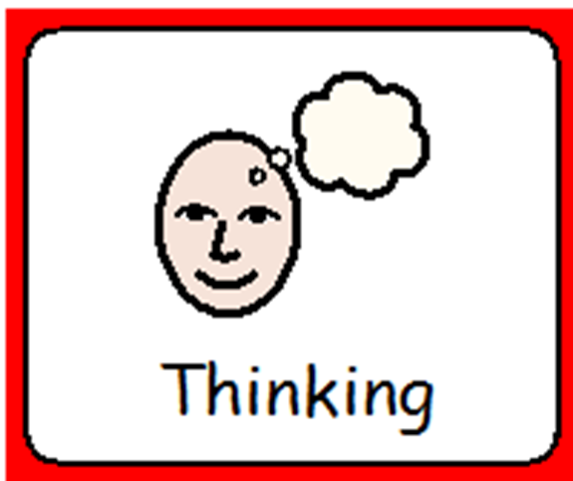
What is a friend?

Slide 44

Learning Outcome:
To understand what a friend is
I can select, from options*, one way to help a friend.
I can communicate one way/ways* to help a friend.
I can identify/describe/explain* 1/2/3* ways to be a good friend.
Notes:
*delete as appropriate

Slide 45
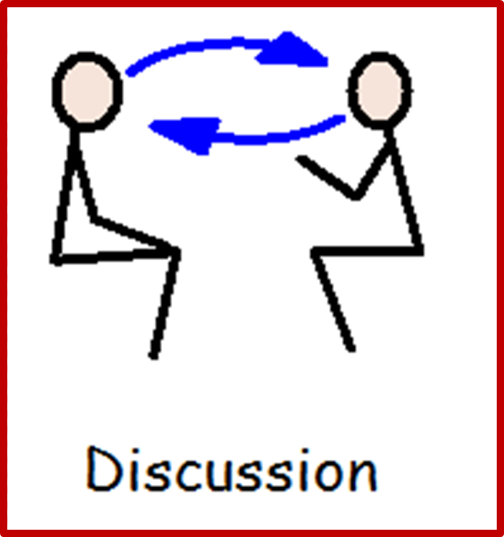
What do friends do?

Slide 46
What Would You Do As A Good Friend?
Sue is confused. She has heard a rumour that her best friend George has been talking about her behind her back.
Pam is upset. Her best friend Adrian has been avoiding her lately and Pam doesn’t really know why. She thinks it might have something to do with the fact that she’s going on holiday to Florida and Adrian can’t afford a holiday.
Tom is worried. All his friends have decided to play a trick on a teacher, Mr Smith. Tom doesn’t want to as he likes Mr Smith but he doesn’t want to be the odd one out.
Notes:
Edit for your class’ reading age where appropriate

Slide 47
What Would You Do As A Good Friend?
Lucy and Jo have been friends for years but lately Jo has been moody and wanting to be on her own. Lucy thinks Jo doesn’t want to be her friend any more and is thinking of asking Alex if she wants to hang out with her after school.
Chris has a new friend, Matt, but Matt has an annoying habit of copying Chris’ work and Chris is worried that they will get into trouble. Chris has already been in trouble once this term and his mum will ground him if anything else happens.
Jan is upset. Yesterday she said something mean to her best friend Marina and now Marina is not talking to her. Jan can understand that Marina is upset too but she doesn’t know what to do.
Notes:
Edit for your class’ reading age where appropriate

Slide 48
Are you a good friend?
Notes:
So, based on the previous situations you have discussed, ask the students to give you examples of how they are good friends
The next 3 slides are differentiated slightly for students to fill in about how they are good friends.
Students can share their examples with the class.

Slide 49
I am a good friend because……
I am a good friend because I ___________________________
________________________________________________________
________________________________________________________
I am a good friend because I ___________________________
________________________________________________________
________________________________________________________

Slide 50
I am a good friend because……
1. _____________________________________________________
________________________________________________________
2. _____________________________________________________
________________________________________________________

Slide 51
I am a good friend because……
1. _____________________________________________________
________________________________________________________
________________________________________________________
2. _____________________________________________________
________________________________________________________
________________________________________________________
3. ______________________________________________________
________________________________________________________
________________________________________________________

Slide 52
Week 2

Slide 53
Learning Outcome:
To understand what a community is
I can identify/describe/explain* types of communities.
I can identify/describe/explain* what a community does
I can evaluate what communities do for us.
Notes:
*delete as appropriate

Slide 54
What is a community?
Notes:
See if students know what a community is, if not discuss the next slide

Slide 55
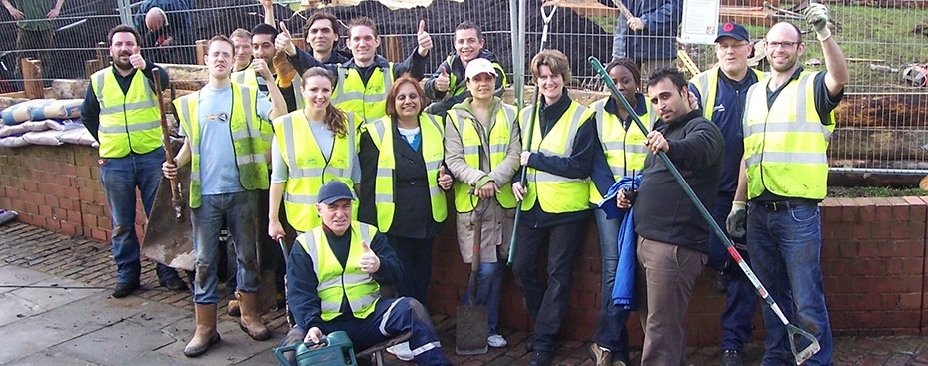
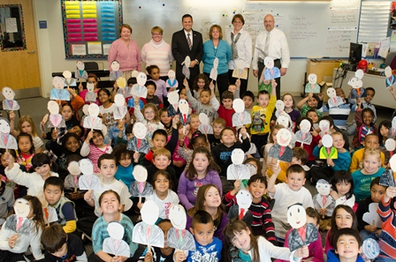
What is a community?
A group of people living or working in the same place or having something in common.

Slide 56
What community are you part of?
Notes:
Discuss where they live, year group, ethnic group, clubs e.g. Scouts, Guide, Chess club etc.

Slide 57
What can communities do for us?
What can we do for our communities?
Notes:
Think of all social benefits, safety, fun, etc.
Then discuss what students do for their community, think about the Cadets as a good example.

Slide 58
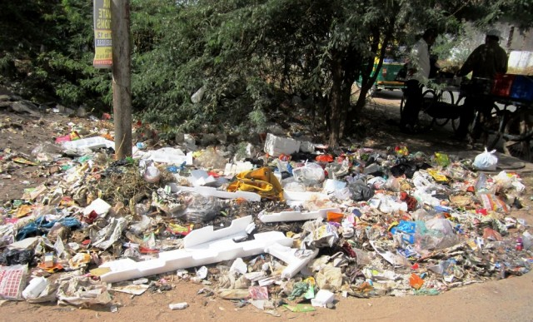
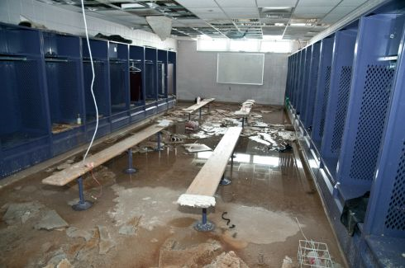
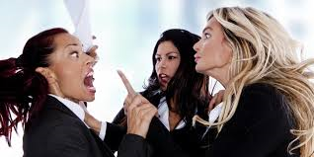
What problems do communities have?
Notes:
School issues, local area issues, club issues e.g. funding.

Slide 59
Solving problems
Schools
Local community
Council
What problems do councils solve?

Slide 60

Big up my community!
Think of a community you are part of….
Create a poster to promote it.
What makes it so good?
What do you do?
Where is it?
How do you look after each other?
Notes:
Students could promote their year group, a club they go to, etc.

Slide 61
Week 3

Slide 62
Learning Outcome:
To learn to access facilities in the community
I can identify/describe/explain* a community facility.
I can identify/describe/explain* what the facility is used for and what would happen if it was taken away.
I can design a poster and/or* write a letter trying to stop a community facility being closed.
Notes:
*delete as appropriate

Slide 63
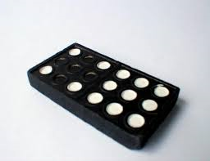
HOT SEATING!
You all have a picture of a community facility.
Match your picture with someone you don’t normally work with and talk about how the facilities are similar!
Get as many reasons as you can.
Notes:
Use the pictures on slide 25 for students to match. Alternatively you can pick who works with who.

Slide 64

CAROUSEL
Stick your picture to your paper and mind map:
What it does for the community
How you use it
What would happen if it was taken away
Notes:
In pairs students now stick their community picture to an A3 sheet. They write their ideas around the outside then move onto another sheet. Time the activity as you see fit.

Slide 65
We have all talked about what would happen if these things went away.
Over the last few years communities have lost lots of these facilities because of austerity, spending cuts and under-use.
Organise our facilities with a partner from BEST to get rid of to WORST to get rid of. Prepare to explain your choices to the class.
Best to get rid of
Worst to get rid of

Slide 66
Best to get rid of
Worst to get rid of
Notes:
Print this for students to use.

Slide 67
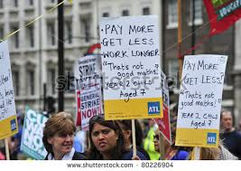
Design a protest placard for something closing down in your community.
It should tell us:
What is going wrong (“SAVE OUR POST OFFICE”)
Have some facts and slogans
Be eye-catching and well designed
*Can you think of a chant to go with it?
Notes:
*extension task.

Slide 68

You could write a letter to the council.
Dear Birmingham City Council,
My name is ... and I am writing to you to ask you to open a ... in ...
I think this will be good for the community because...
It will help people by...
I want to see it used by...
I hope you consider my suggestion.
Yours Faithfully,

Slide 69
Week 4 – Anti Bullying Week
I would like you to come up with an Anti Bullying lesson.
It can be linked to any perceived prejudice or bullying you see in your lessons, school environment, society.
You can use any resources you like for delivery
Posters are always useful
Assembly focus this week will be Cyber Bullying.
There is an Anti Bullying Resources folder in the Skills For Life curriculum folder to support you.

Slide 70
Week 5

Slide 71

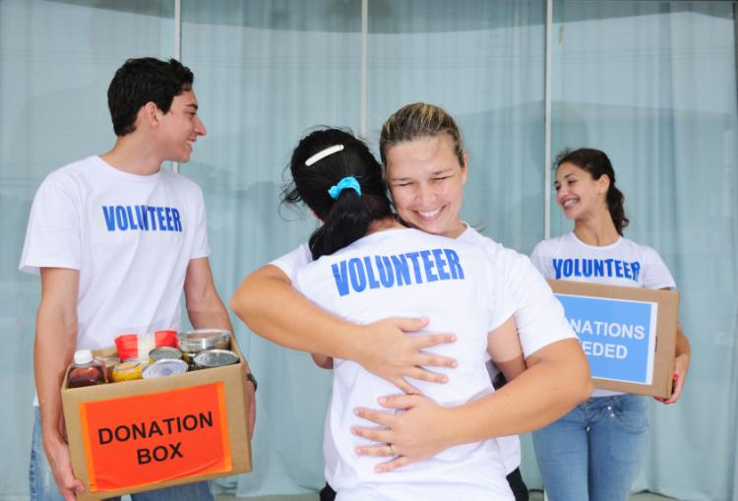
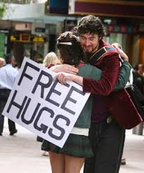

What is the link?
Notes:
Charity.

Slide 72
Learning Outcome:
To understand what charity is
I can identify/describe/explain* what charity means
I can identify/describe/explain* what charities do and their benefits.
I can suggest a fund raising idea.
Notes:
*delete as appropriate

Slide 73
What is Charity?

Slide 74
How do Charities work?
Charities rely on funding, support and volunteers
Volunteers work for free to help run shops, collect money and help run events. Have you seen volunteers before?
Charity shops take donations from people to sell in their shops. Items such as clothes, furniture, DVDs and toys are sold to raise money for the charity.
Bigger charities like Macmillan Cancer Support hold nationwide charity days, they have big cake sales, to raise money.
Why do people support charities? How do you think people feel that work for charities?
https://www.youtube.com/watch?v=2GoC3Gg6NeI
Notes:
Show students the youtube clip about the Macmillan cake sale.

Slide 75
What do Charities do with the money they raise?

Slide 76

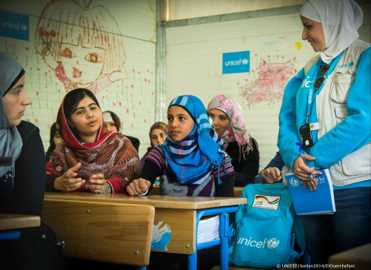
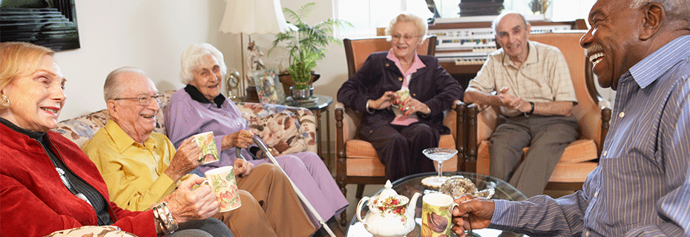
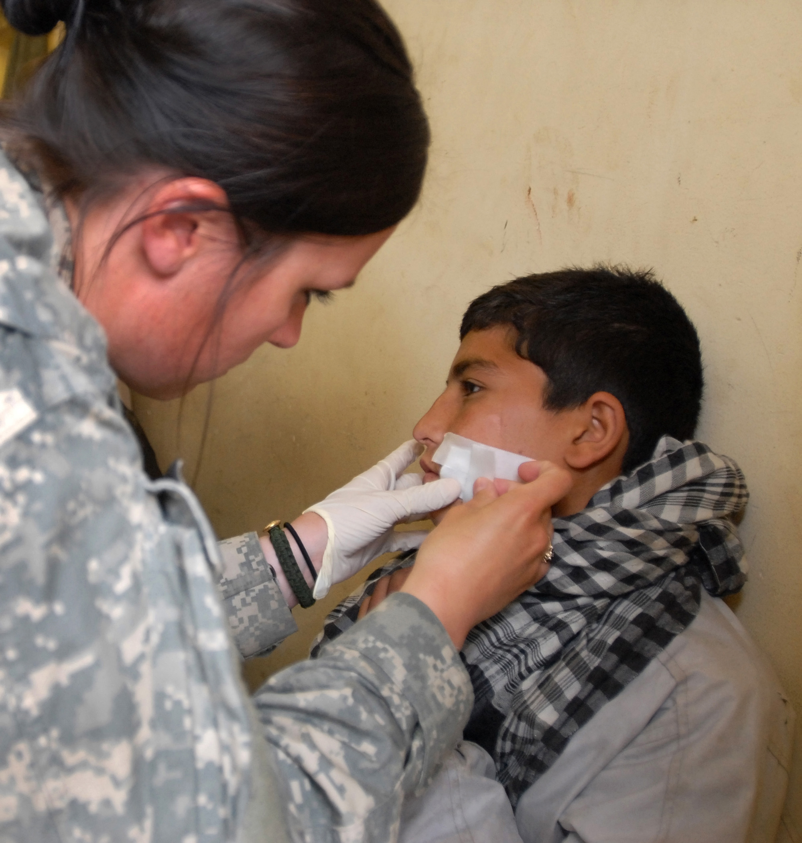
What do Charities do with the money they raise?
Clean wells
Clean water
Educating
Medical aid
Looking after the elderly
https://www.youtube.com/watch?v=XyyNCKsMSc4
Notes:
Show students the youtube clip, it shows what Oxfam do in Africa.

Slide 77
What do we do as a school for charity?
Notes:
Ask students if they know about SOFA. We often have non-uniform days and the summer fair.

Slide 78
What could you do to raise money for charity?
Notes:
Potentially the students could do a fund raising activity it sensible ideas are shared.

Slide 79
Week 6
Introduction to LGBT and Identity

Slide 80
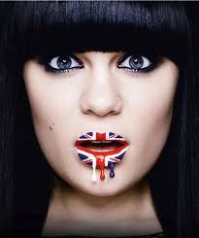
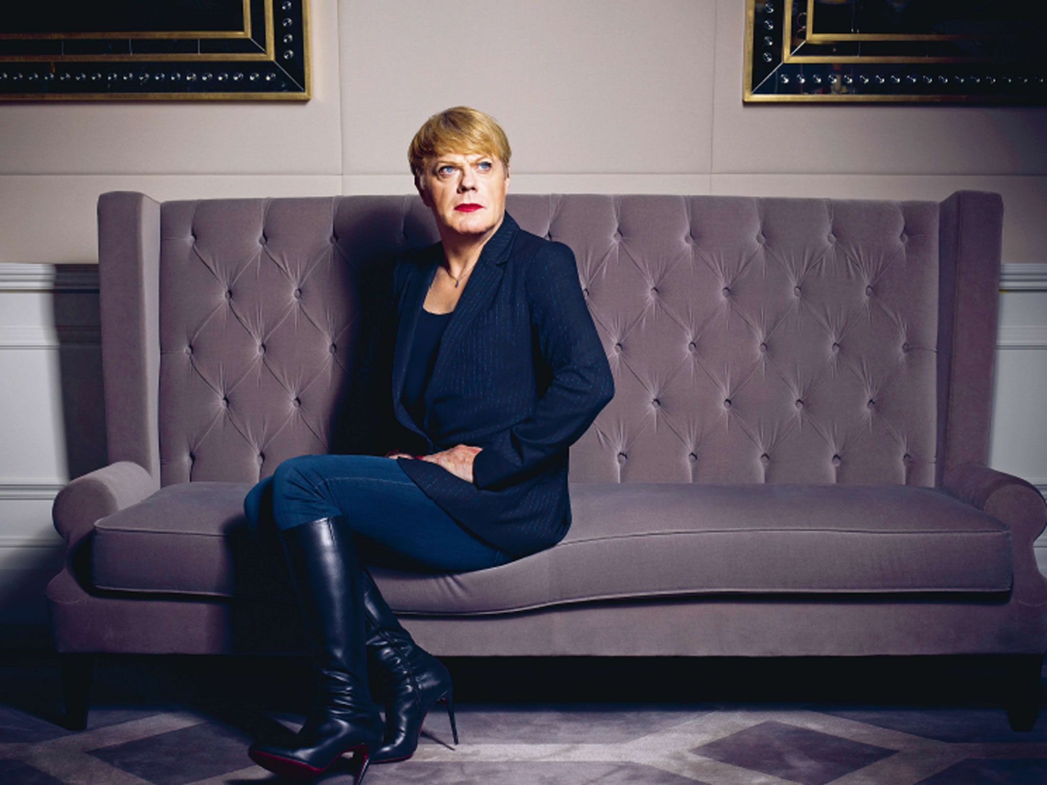
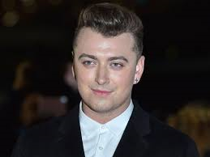
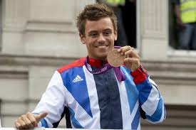
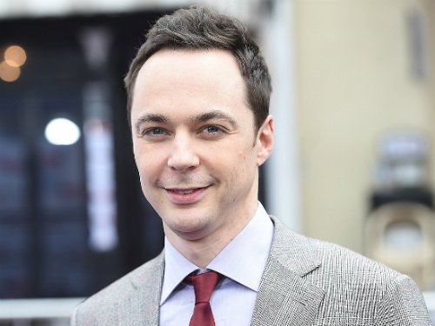
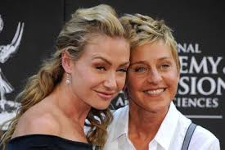
What do these people have in common?
Notes:
If you feel more topical/current LGBT celebrities would be appropriate for this slide please add them.

Slide 81
Learning Outcomes:
I will understand what LGBT means, and what an identity is.
I can state that LGBT stands for Lesbian, Gay, Bisexual and Transgender.
I can identify/describe/explain* that we all have our own identity.
I can identify/describe/explain* what my passion is.
Notes:
81

Slide 82
L.G.B.T – what does it mean?
Lesbian =
a woman who has a sexual and emotional attraction to other women and may want a relationship with a woman.

Slide 83
L.G.B.T – what does it mean?
Gay =
a man who has a sexual and emotional attraction to another man and may want a relationship with a man.

Slide 84
L.G.B.T – what does it mean?
Bisexual =
a person who would has a sexual and emotional attraction to both men and women and may want a relationship with either a man or a woman.

Slide 85
L.G.B.T – what does it mean?
Transgender =
"someone whose gender (feminine/masculine) identity doesn't match up with their sex (female/male)"

Slide 86
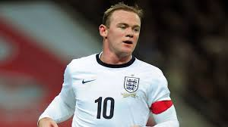
Identity
How do you want the world to see you?
What do you want people to think of you?
Wayne Rooney is famous and has an identity the public has made for him.
Can you add anything else to their identity?
Wayne Rooney:
Leader
Footballer
Father
Husband
Role model
Football fan
Hard worker
Angry

Slide 87
Your Identity
Think about Wayne Rooney’s identity?
Make a list of your own identity factors. Does this list help?
Good student, hard worker, brother, sister….

Slide 88

Identity Template:
Notes:
Print this for students to complete

Slide 89
True or False?
The following statements are Laws in different countries, or are they?
In Florida, unmarried women who parachute on Sundays can be jailed.
It England, it is an act of treason to place a postage stamp bearing the British monarch upside down.
In Victoria Australia, only a licensed electrician is allowed to change a lightbulb.
Karate films were banned in Iraq in 1979.
All true!!

Slide 90
Lesbian and Gay Weddings
Law to allow same-sex marriage in England and Wales was passed by the Parliament of the United Kingdom in July 2013 and came into force on 13 March 2014, and the first same-sex marriages took place on 29 March 2014.
Law to allow same-sex marriage in Scotland was passed by the Scottish Parliament in February 2014. The first same-sex marriages are expected to occur in Autumn 2014.
The Northern Ireland Executive has stated that it does not intend to introduce law allowing for same-sex marriage in Northern Ireland.

Slide 91




What do you think?
The UK was one of the first 16 countries to allow same sex marriage.
Some countries totally refuse it, imagine how you would feel if a passion of yours was refused??

Slide 92
What is your passion?
It took gay and lesbian couples many years to be able to marry.
How would you convince others that your passion is worth making a law??

Slide 93
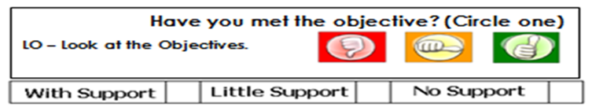
My passion is:_________________________
____________________________________
5 reasons why my passion should be the law!
_________________________________________________________________________________________________________________________________________________________________________________________________________
_________________________________________________________________________________________________________________________________________________________________________________________________________
_________________________________________________________________________________________________________________________________________________________________________________________________________
_________________________________________________________________________________________________________________________________________________________________________________________________________
_________________________________________________________________________________________________________________________________________________________________________________________________________
Lets compare your passion with other pupils’ passions
Notes:
Print this for students to complete.

