Slide 1
Special Schools
Curriculum Group Meeting
Ayisha Ali- Education Resilience Team
ayisha.ali@birmingham.gov.uk

Slide 2
Birmingham City Council- Curriculum Groups
What are curriculum group meetings?
Where do they take place?
When do they take place?
Why do we have curriculum group meetings?
How do we support schools?

Slide 3
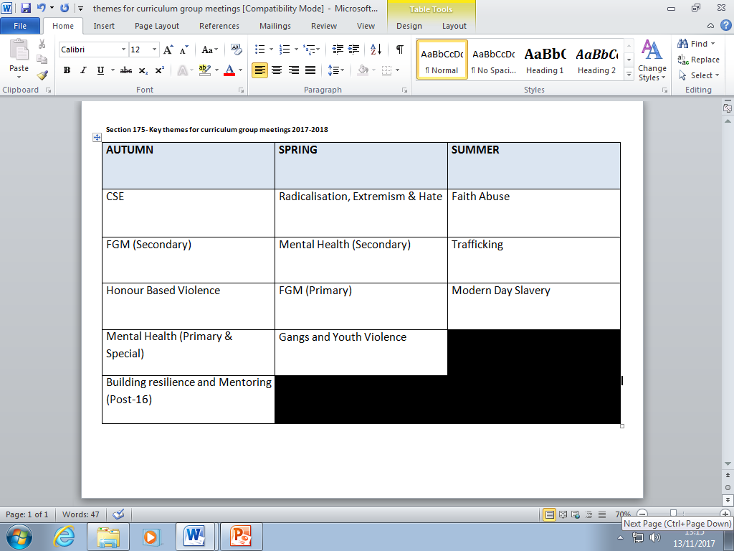
Key themes identified from Section 175- 2017

Slide 4
Autumn Curriculum Group themes
Child Sexual Exploitation
Honour based Violence/Domestic abuse
Mental Health

Slide 5
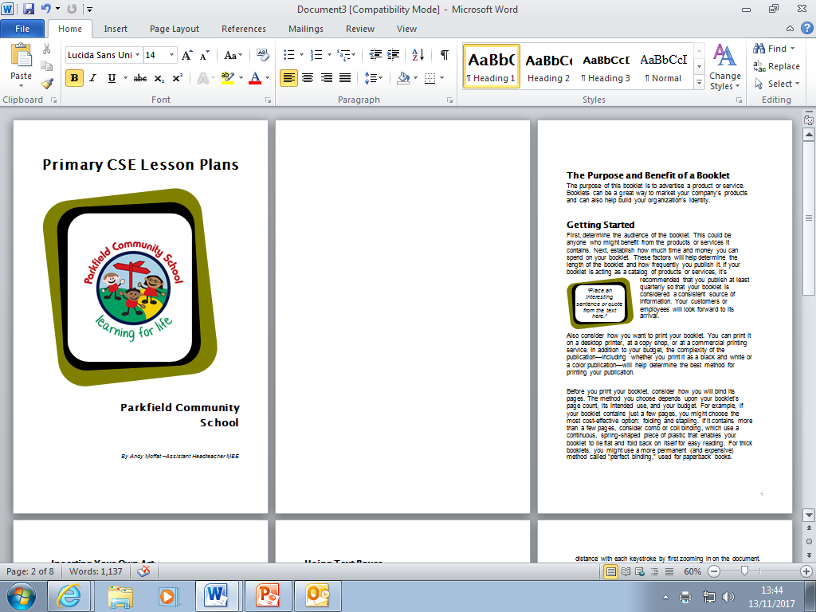
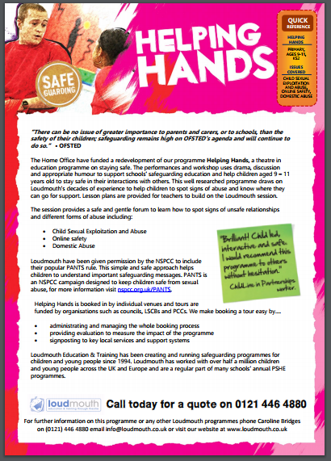
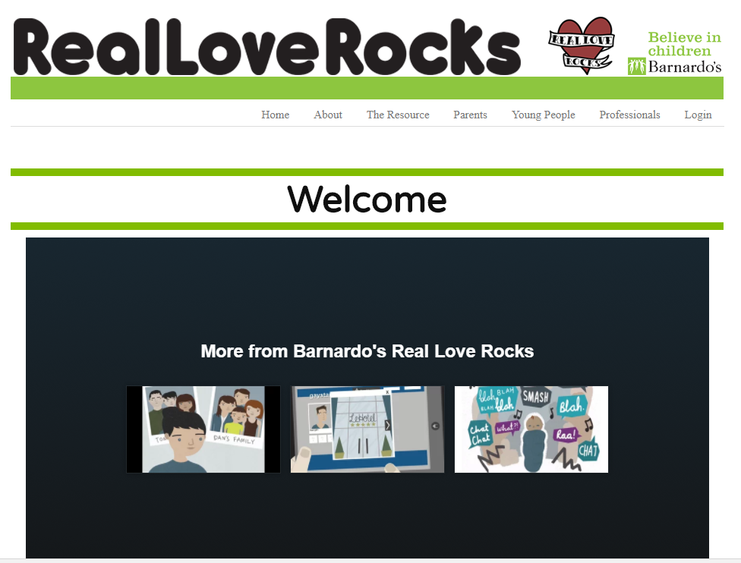
CSE resources
Loudmouth-http://www.loudmouth.co.uk/
Parkfield Primary School resource Yr. 1-Yr. 6 by Andy Moffat
Barnado’s -http://www.barnardosrealloverocks.org.uk/

Slide 6

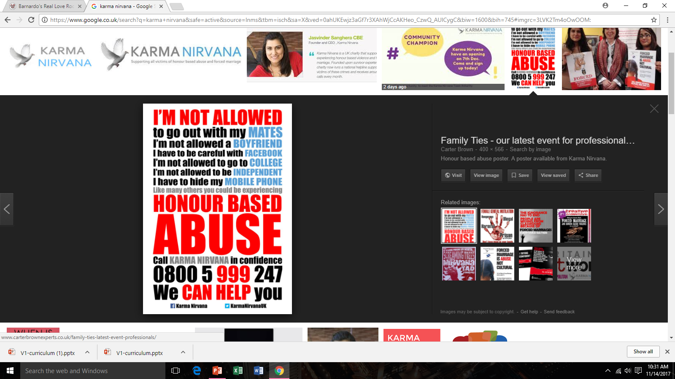
Honour Based Violence resource
Raising Awareness Through Education
Raising awareness of honour-based abuse and forced marriage in education, particularly secondary schools is essential to preventing it. Many teenage victims are confused by what their family and community demands of them and what they feel is wrong. Teachers are often unaware of these issues and nervous about how to manage them.
Karma Nirvana’s staff and survivors regularly speak in schools, 6th form colleges and universities delivering assemblies, lectures and workshops across the UK. We also offer teacher training on how to recognise honour-based abuse and best practice in handling it.
https://www.youtube.com/watch?v=h_Xh5MXA7yY
https://www.youtube.com/watch?v=wO6yRKlDKLA
“I wanted to thank you from the bottom of my heart for the time and advice you gave to one of my pupils earlier today. As a school nurse, I felt a huge gratitude that I was able to advise the girl to contact you and to talk through her current issues. This service is invaluable. I am aware of the charity, as representatives came to ‘XXX Girls High School to discuss the work of Karma Nirvana.
http://www.karmanirvana.org.uk/

Slide 7
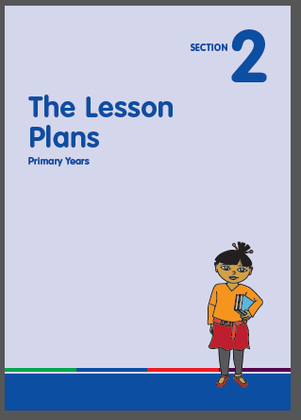

Women’s Aid Primary resource
The Expect Respect
Educational Toolkit
The Expect Respect Educational Toolkit consists of one easy to use ‘Core’ lesson for each year group from reception to year 13 and is based on themes that have been found to be effective in tackling domestic abuse.
Although the Expect Respect Education Toolkit is targeted for use by teachers within schools, it can just as easily be used by a range of other professionals working with children and young people in a variety of settings such as youth clubs or play schemes. You do not need to download the whole toolkit. You can just download the introductory section and the year that is appropriate to the age group you are working with.

Slide 8
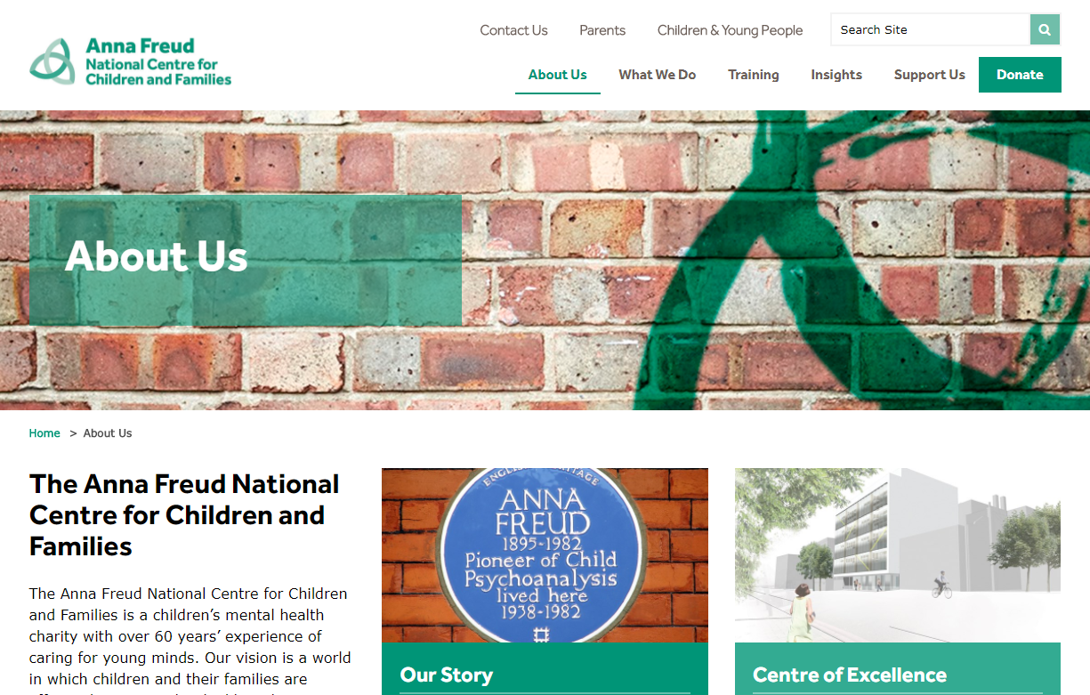

Primary Mental health resource

Slide 9
Network
How can you develop opportunities for collaborative work?
Do you want to showcase best practice?

