Slide 1
Secondary Curriculum Group Meeting
Wednesday 6th December 2017
Rockwood Academy
Ayisha Ali
Education Resilience Team- Curriculum, Teaching & Learning Lead
ayisha.ali@birmingham.gov.uk

Slide 2
Birmingham City Council- Curriculum Groups
What are curriculum group meetings?
Where do they take place?
When do they take place?
Why do we have curriculum group meetings?
How do we support schools?

Slide 3
Key themes identified from Section 175- 2017

Slide 4
Autumn Curriculum Group themes:
CSE (Child Sexual Exploitation)
Nishkam Secondary School
Saltley Academy
Loudmouth
2. Honour Based Violence/Domestic Abuse
Women’s Aid
Karma Nirvana
3. FGM (Female Genital Mutilation)
Women’s Aid
INTEGRATE

Slide 5
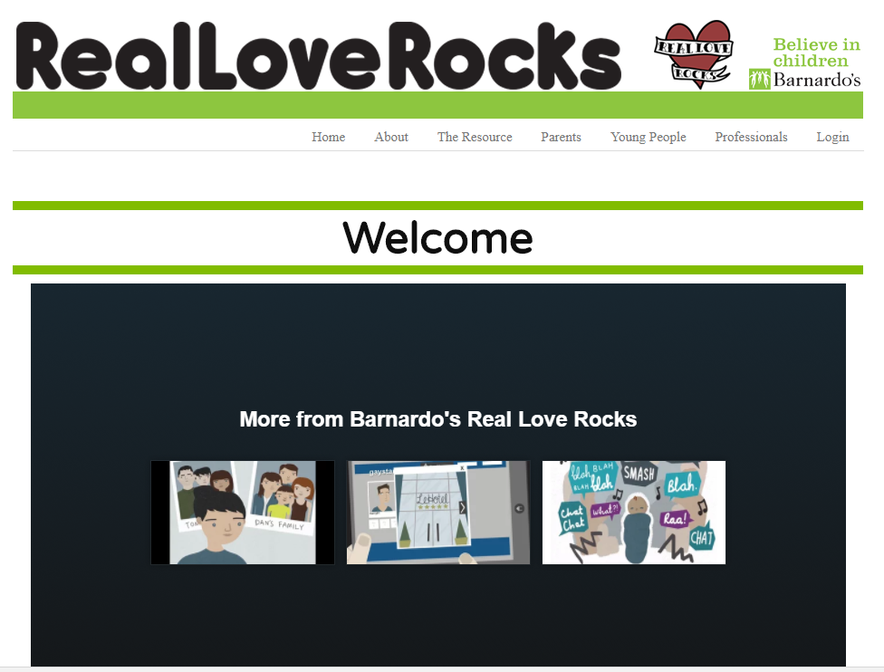
CSE resources
CSE (Child Sexual Exploitation)
Nishkam Secondary School
Saltley Academy
Loudmouth http://loudmouth.co.uk/programmes/programme/working-for-marcus

Slide 6
Honour Based Violence/Domestic Abuse
2. Honour Based Violence/Domestic Abuse
Women’s Aid
Karma Nirvana

Slide 7
Honour Based Violence resource
Raising Awareness Through Education
Raising awareness of honour-based abuse and forced marriage in education, particularly secondary schools is essential to preventing it. Many teenage victims are confused by what their family and community demands of them and what they feel is wrong. Teachers are often unaware of these issues and nervous about how to manage them.
Karma Nirvana’s staff and survivors regularly speak in schools, 6th form colleges and universities delivering assemblies, lectures and workshops across the UK. We also offer teacher training on how to recognise honour-based abuse and best practice in handling it.
https://www.youtube.com/watch?v=h_Xh5MXA7yY
https://www.youtube.com/watch?v=wO6yRKlDKLA
“I wanted to thank you from the bottom of my heart for the time and advice you gave to one of my pupils earlier today. As a school nurse, I felt a huge gratitude that I was able to advise the girl to contact you and to talk through her current issues. This service is invaluable. I am aware of the charity, as representatives came to ‘XXX Girls High School to discuss the work of Karma Nirvana.
http://www.karmanirvana.org.uk/

Slide 8
Women’s Aid resource
The Expect Respect
Educational Toolkit
The Expect Respect Educational Toolkit consists of one easy to use ‘Core’ lesson for each year group from reception to year 13 and is based on themes that have been found to be effective in tackling domestic abuse.
Although the Expect Respect Education Toolkit is targeted for use by teachers within schools, it can just as easily be used by a range of other professionals working with children and young people in a variety of settings such as youth clubs or play schemes. You do not need to download the whole toolkit. You can just download the introductory section and the year that is appropriate to the age group you are working with.

Slide 9
FGM
3. FGM (Female Genital Mutilation)
Women’s Aid
INTEGRATE

Slide 10
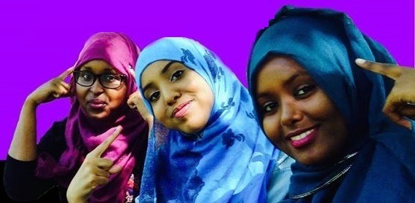
Peer education and training for front line professionals.
www.integrateuk.org
@_IntegrateUK
Integrate UK

Slide 11
Talking about values and virtues School ethos
Nishkam

Slide 12
Nishkam High School A Multi Faith School with a Sikh Ethos

Slide 13
Our Patron

Slide 15
Prayer
Prayer and worship are an essential part of school life. They are a means of helping pupils to learn about and from prayer enabling them, in turn, to experience spiritual aspects of life.
Spiritual development is promoted through inclusive acts of collective worship which cover Sikh, Hindu, Islamic and Christian prayers.
Assembly is an opportunity for the school to collect together and has been a hugely important platform to raise awareness of world events and how they have impacted on us as a school, a community and on a global level as society.
Prayers are also said when the school comes together at lunch time before the meal is served.

Slide 16
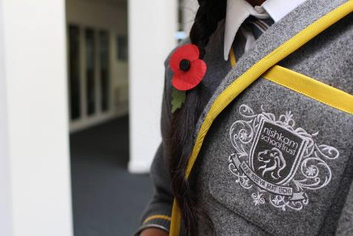
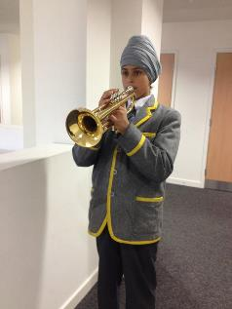
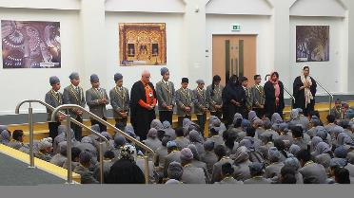
Prayer and our Spiritual Space
Staff and students paid their respects to the fallen during a Remembrance Service.
More than Academic Excellence | More than a School | More than ‘Self’

Slide 17
Faith Mentors

Slide 18
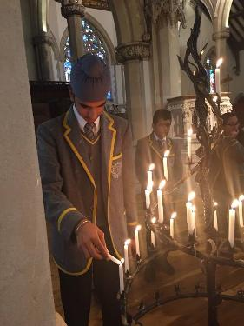
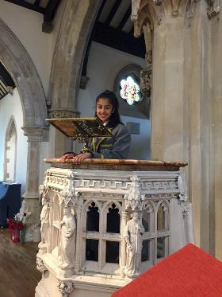
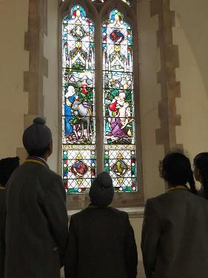
Faith Visits
Year 8 visit to St John and St Peter’s Church.
More than Academic Excellence | More than a School | More than ‘Self’

Slide 19
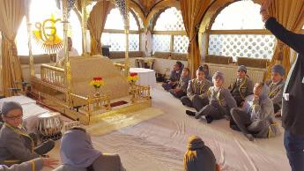
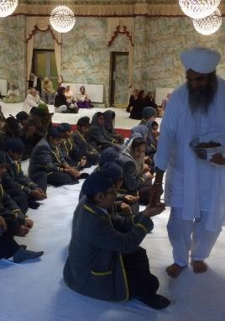
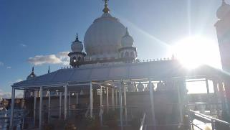
Faith Visits
More than Academic Excellence | More than a School | More than ‘Self’

Slide 20
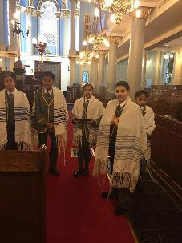
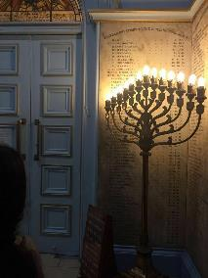
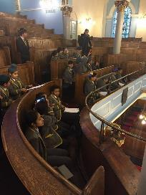
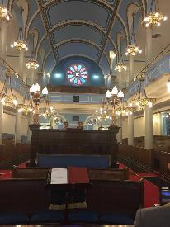
Faith Visits
Visit to Singers Hill Synagogue.
More than Academic Excellence | More than a School | More than ‘Self’

Slide 21
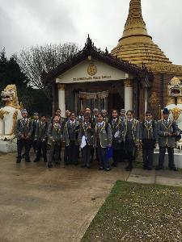
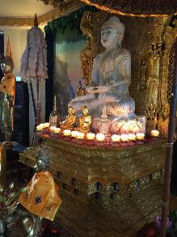
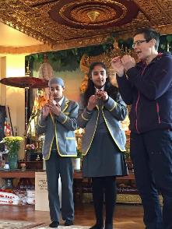
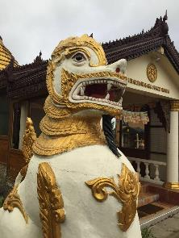
Faith Visits
More than Academic Excellence | More than a School | More than ‘Self’

Slide 22
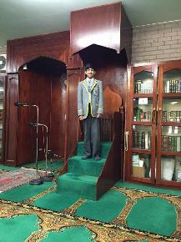
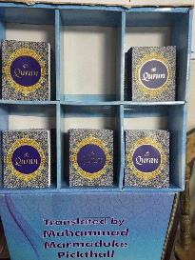
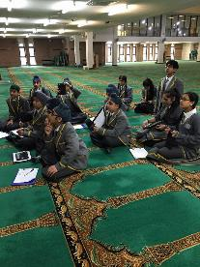
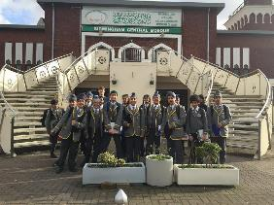
Faith Visits
Visit to Birmingham Central Mosque.
More than Academic Excellence | More than a School | More than ‘Self’

Slide 23
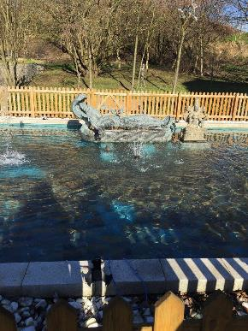
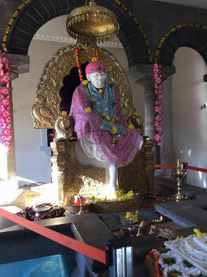
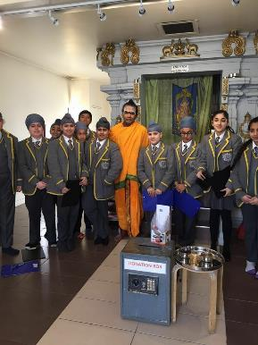
Faith Visits
Year 7 visit to the Dudley.
More than Academic Excellence | More than a School | More than ‘Self’

Slide 24
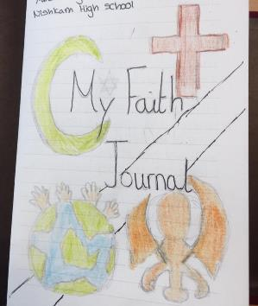
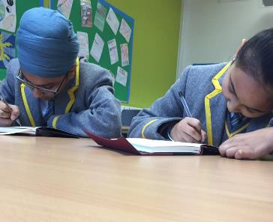
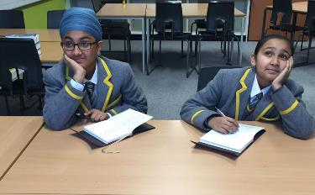
Reflections on Faith
Students all have a faith journal to help them reflect on faith and values within our school.
More than Academic Excellence | More than a School | More than ‘Self’

Slide 25
Student end of the day reflections

Slide 26
Staff Reflections
Staff are able to reflect on an issue or an idea that is important to them in the same way that students are encouraged to do here at the school.
Reflections have included:
The sacrifice of soldiers in WW1
Environmental concerns
The significance of marriage vows
Muslims and the media
Running for charity
The personal significance of tying a turban

Slide 27
More than ‘Self’
Nishkam Schools are driven and sustained by the principle of being ‘nishkam’- creating a mindset to serve others without expectation or recognition.
We recognise that this selfless practice promotes humility and unlocks great potential to transform ourselves and the world around us.

Slide 28
Ethos

Slide 34
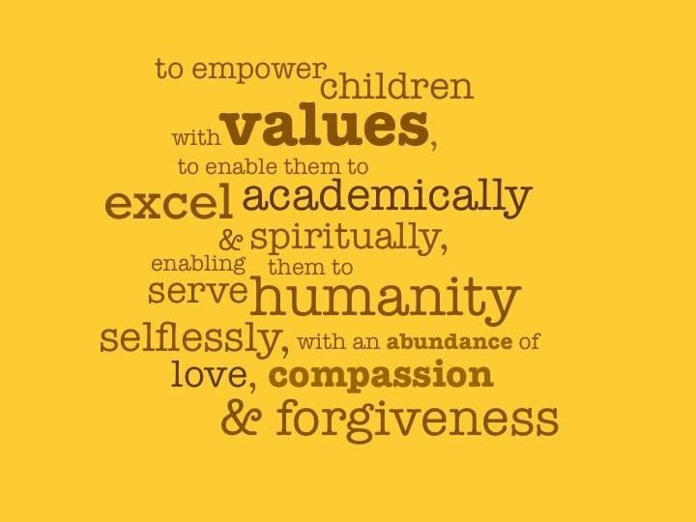
Values and Dispositions
Throughout the week:
Prayers every morning; prayers every lunchtime
Faith groups on a Tuesday
Form led assembly on Thursday
Form based activities on Friday
Student reflections: Tues/Weds/Thurs
Staff reflection on Monday
Values in every curriculum lesson
Staff modelling – every minute of every day

