Slide 1
Term 2 themes
Secondary
Mental Health
Prevent
Gangs and Crime
Restorative Justice

Slide 2
PREVENT at BGGS
Yusuf Shah

Slide 3
What we do at present
PSHE programmes of study in both main school and Sixth Form
  Spiritual, Moral, Ethical, Social (SMSC) issues and promoting British Values
‘Thought for the day’
PCSO workshops on internet security, grooming and radicalisation (KS4)
Home Office approved WRAP trainer based in school
Tapestry theatre-in-education workshops for Year 9 groups
‘Building resilience through effective dialogue’ workshops (Year 12)
  understand what resilience means.
  understand how debate and discussion can be used to build resilience around safeguarding issues.
  identify what can be done and the support/guidance available for dealing with issues impact on personal well-being
Women Against Radicalisation Network (WARN) presentation on issues that lead to radicalisation (Year 13)

Slide 4
What we are aiming for
Staff training on delivering Youstuff lessons
  Pilot lesson delivered by A Ali at BGGS with a Year 9 class
  website for 14-16 year-olds providing essential life skills required to stay safe, healthy and informed, whilst encouraging community cohesion and building resilience
  Form tutors delivering the first Youstuff module through PSHE lessons on the issue of ‘grooming’ in terms of radicalisation and child sexual exploitation
Parent and community engagement through monthly coffee mornings
  Insight into WRAP training and workshops delivered to students
  meeting with key community figures involved in the Channel programme
Sharing practice and providing support to schools at the BGGS Teaching and Learning Conference on Friday 3rd March 2017
Shamaal Project drama workshops with KS3 and KS4
  utilise classical texts (Macbeth, Great Expectations, The Lord of the Flies and Frankenstein) to promote fundamental British Values
Proposed federation with Marlborough Junior School

Slide 5
Rockwood Academy
Keeping safe from radicalisation and extremism
Ayisha Ali
Year 7-8 lesson

Slide 6


Slide 7
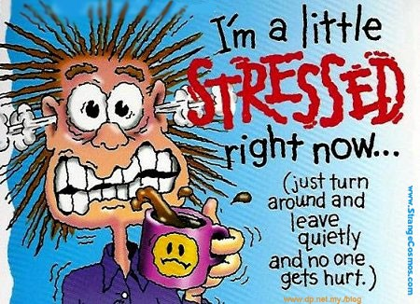
Some of us are feeling stressed …
https://www.youtube.com/watch?v=wBQp9MYlbc4

Slide 8
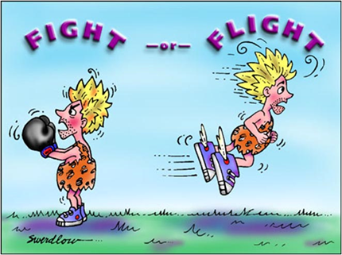
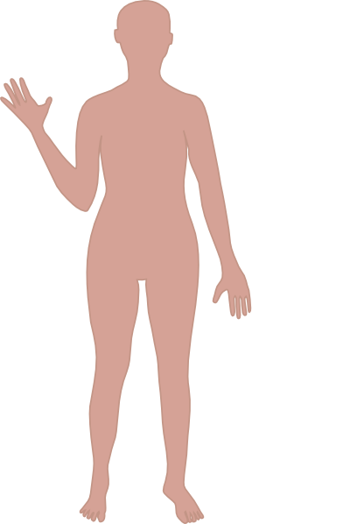
A detailed look at stress on the body.
Our ‘fight or flight’ part of the brain has given us the ability to use stress to face life threatening situations.
But a long term exposure to stress can have negative effects on your body.
Headaches and sleep issues
Diabetes
Blood pressure issues
IBS, stomach cramps and constipation
Tensions in joints
Acne
Notes:
An also make you feel irritable, emotional, angry or have a loss in interest in things you used to enjoy and can affect your appetite

Slide 9

Stress
What makes us
Stressed?

Slide 10
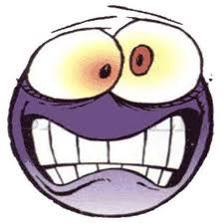
What can Cause Stress?
Work
Relationships
Exams
Worries
Guilt
Pressures

Slide 11

A report by ChildLine highlighted:
Worries at school came 7th in a list of the most calls received by the charity – nearly 35,000!
In the year 2015-16, Childline carried out 3,077 counselling sessions about exam stress
It came above other types of issues such as friendship and those to do with relationships.
Notes:
https://www.nspcc.org.uk/globalassets/documents/annual-reports/childline-review-under-pressure.pdf PAGE 14

Slide 12
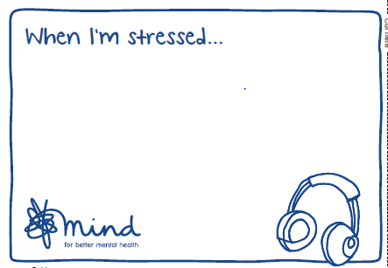
Write down what you do when you feel anxious which helps you become less stressed
Notes:
Get them to share their ideas in pairs

Slide 13


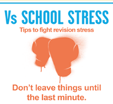
If you think you are stressed, try to:
Take time out from your work if you are over-doing it. Find time to do something you enjoy.
Alternatively, if you are stressed due to not doing enough, get going.
Exercise – this promotes the release of hormones that actively counter stress.
Eat well – you know what you need to eat. Try to overcome those impulsive binges on sugar and saturated fat. Bananas = brain food
Watch something funny!
Get enough sleep – this does not mean lying in bed watching TV, playing games, texting …
Find someone you trust to talk to about how you feel – a problem shared.
https://www.youtube.com/watch?v=hnpQrMqDoqE

Slide 14
People and organisations that can help you….
Speak to a trusted adult- this may be someone at home or a teacher, perhaps your form teacher, Head of Year or Learning Mentor.
MIND- www.mind.org.uk
www.nhs.uk
Childline- 0800 1111 or download the Childline app.

Slide 15
Lesson resource that you can use!

Slide 16






Learning Objectives:
To gain an understanding of mental health issues
Article2: The Convention applies to all children
Article 12: Resect for the views of the child
Article 13: right to freedom of expression as long as it is within the law

Slide 17

Starter: Ground Rules
Mental Health issues and the way people are treated and stigmatised are serious issues.
What ground rules do you think we need to establish before starting this lesson to create a sensible and sensitive learning environment?
Discuss in groups of four for three minutes
Notes:
After feedback, write their ideas on the board.

Slide 18
Ground rules- the absolute essentials
Confidentiality - you can talk about the session but don’t talk about personal things or names that have been shared in order to create a safe space.
Try to participate
Respect – challenge the statement not the person
Listen
Do talk to Mrs Arrandale or Miss Steadman or another adult if you need support after a lesson

Slide 19

Hands Up!
Do you have physical health?
Do you have mental health?
Have you felt happy at some point during the last week?
Have you felt stressed at any point in the last week?
Have you felt sad at any point in the last week?
Notes:
State : We all have mental health just as we all have physical health. Feelings of happiness, sadness or stress are just some of the indicators of your mental health.

Slide 20
What is mental health?
Mental Health | Mental Health problem/illness
In your groups, write down on the post-its what words, positive and negative, come to mind when you hear these terms.
Everyone should contribute at least one post-it not within the group.
Then stick the post-it on the relevant place on the board.
5 minutes
Notes:
Divide the board into two: write “Mental health” on one and “Mental illness/health problem” on the other.
Give the group post it notes to write what words, positive and negative that come to mind when they hear these terms. Individuals should then stick the post it notes on to the relevant place on the board.
Rules: Everyone must contribute at least one post it note;
People cannot cross out something they don’t agree with or think is wrong.
Once everyone has done this, go through the terms and discuss.
Consider: What terms are appropriate/inappropriate.
Ask young people what terms they use with their friends?
Identify which terms are ok to use during the session

Slide 21
“Have I ever…
Experienced a Mental
Health problem?”
Yes
You are going to be shown a number of celebrities. For each one, you need to stand on the Yes or No side. You are not allowed to be in middle/I don’t know.
No
Notes:
You need to put up A Yes on one side of the room and a no on the other ( or you can just nominate them)

Slide 22
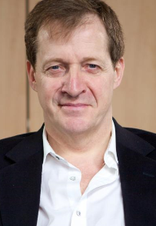
Celebrities who have a mental illness
http://www.time-to-change.org.uk/news-media/celebrity-supporters/alastair-campbell
Does anyone know who this is?
His name is Alistair Campbell and he used to work for former Prime Minister Tony Blair. He is an active supporter of mental health charities.
Notes:
Video is around 3 minutes

Slide 23
Quiz
How many young people will experience a mental health problem in any one year?
  A. 1 young person in every 10
  B. 1 young person in every 100
  C. 1 young person in every 1000
What are the most common mental health problems experienced by young people?
  A. Schizophrenia
  B. Depression, anxiety, self-harm, eating disorders
  C. Bipolar
Notes:
Place a piece of paper with A, a piece of paper with B and a piece of paper with C around the room. When the question comes up ask young people to stand next to the letter they think is the answer:
1) A- that’s three in an average class 2) B

Slide 24
Quiz
  What are the two biggest causes of death of males aged 14 to 25?
  A. Cancer and diabetes
  B. Accidents and fire
  C. Road Traffic Accidents and Suicide
  How many people in society have a diagnosis of schizophrenia?
  A. 1 in 100 people (adults and young people from the age of 14)
  B. 1 in 1000
  C. 1 in 10,000
Notes:
Place a piece of paper with A, a piece of paper with B and a piece of paper with C around the room. When the question comes up ask young people to stand next to the letter they think is the answer:
3) Answer is C- road traffic accidents are 1st and suicide is 2nd 4) Answer is A- schizophrenia is manageable via medication –if someone is managing their condition, you would not know they had it.

Slide 25
Facts and Figures
1 in 10 young people aged 5 – 16 suffer from a diagnosable mental health disorder.
Young people suffering from anxiety in childhood are 3.5 times more likely than others to suffer depression or anxiety in adulthood.
Refugee and asylum-seeking young people have more risk factors for poor mental health than other children.
The majority of people recover from mental health problems, especially if they’ve sought help early
*ONS 2004
**Sheffield CAMHS Partnership Strategy Summary Document, 2007-2010
Notes:
You can ask the group briefly if they want to respond to these figures and have explanations.
You might expect discrimination, trauma and poverty to be raised.

Slide 26
Why do people develop mental health problems?
Some people feel it is a chemical imbalance
Some feel it is all about trauma (everyone has a personal story of trauma, abuse, grief, separation loss etc)
Some feel it is about deprivation
There are a lot of views but it is important that the individual’s own view is listened to, considered important and respected
There is no one answer

Slide 27
Some types of mental health problems
Depression – low mood, hopelessness, loss of energy
Anxiety disorders – sense of worry, panic, dread on a level that has a negative impact on the person’s life
Eating disorders – sometimes distorted view of body shape and weight – not just about dieting. Often low self esteem or control.
Self harm – often a way of coping with emotional difficulties.
Psychosis – change of reality. Sometimes hearing voices and seeing things that others don’t see / hear. May feel paranoid.
For more information: www.rethink.org www.mind.org www.seemescotland.org

Slide 28
True or False?
Write down T or F in your exercise book
1) Anyone can have a mental health problem
2) Mental health problems are rare
3) There are ways you can help yourself feel better if you feel bad
4) People with mental health problems are different from other people
5) It is best not to talk to someone with a metal health problem

Slide 29
True or false?
6) One in four people will ask for help with a mental health
7) You can recover from a mental health problem like bipolar disorder
8) Someone who has a mental health problem can’t go to work
9) People with mental health problems can overcome their difficulties.

Slide 30
True or False? Answers
1) Anyone can have a mental health problem
True
2) Mental health problems are rare
False
3) There are ways you can help yourself feel better if you feel bad
True
4) People with mental health problems are different from other people
False
5) It is best not to talk to someone with a metal health problem
False

Slide 31
True or false?
6) One in four people will ask for help with a mental health
True
7) You can recover from a mental health problem like bipolar disorder
True
8) Someone who has a mental health problem can’t go to work
False
9) People with mental health problems can overcome their difficulties.
True
Notes:
Explain that some of our misconceptions about mental health problems arise from stigma which can lead to discrimination due to a lack of understanding

Slide 32
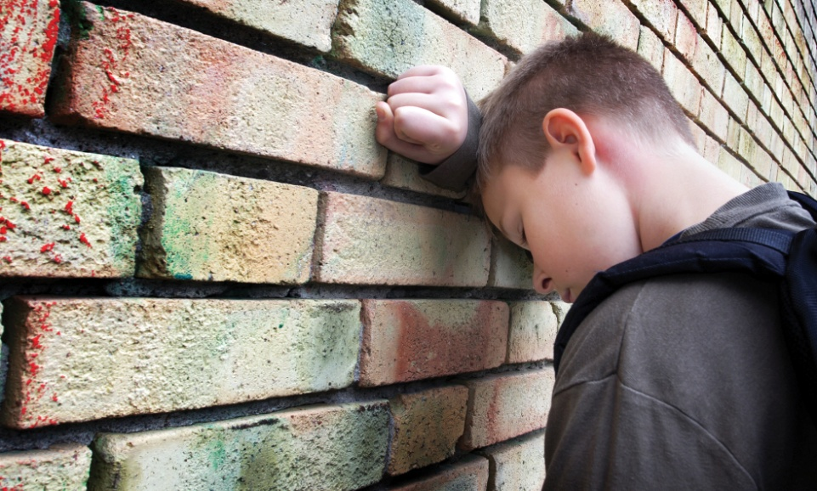
Quotes
“Many people make jokes about depression / bi-polar / other disorders and it can make people feel isolated. I was constantly picked on and called ‘emo’ because I was depressed. When people saw scars on my arms everyone made snide comments because they had no understanding.”
“Young people are afraid to admit to having a mental health problem through fear
and shame. Many people
end up suffering in silence
until something drastic
happens.”
www.time-to-change.org.uk/young-people-programme
Children and young people’s programme development. Summary
of research and insights

Slide 33
The Stand –Up Kid
https://www.youtube.com/watch?v=SE5Ip60_HJk
Watch the clip.
Notes:
Three minutes and six seconds

Slide 34
Group Work:
You have five minutes to complete the task assigned to you which is based on a section of the film.
Notes:
I minute for each group to feedback

Slide 35
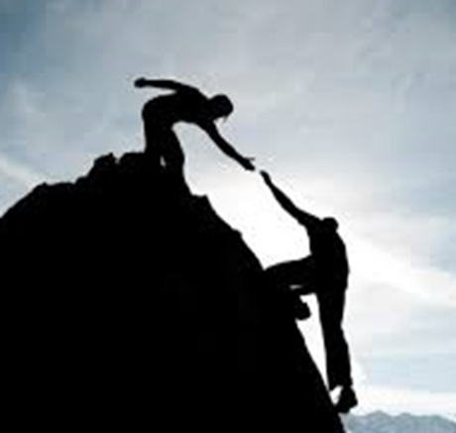
What stigma feels like
https://www.youtube.com/watch?v=z2j43Fp9IGc
Watch the clip
Notes:
Clip is around three minutes long.
Remember, if you are worried about yourself or someone you know you can talk to ANY member of staff, but in particular Miss Steadman and Mrs Arrandale.
GPs are getting much better at helping young people- if you are dismissed by one GP , doesn’t mind you can’t see another doctor at the same practice. There is also a drop in centre for young people living in Birmingham called PAUSE in Digbeth. You don’t need an appointment.

Slide 36

What can you do to help a friend?
https://www.youtube.com/watch?v=BuH_dI7Iw78
Notes:
Clip is 1 minute and twenty seconds

Slide 37
60 second Challenge!!
In pairs, what ways can you think of to support someone who is experiencing a mental health problem?
End
1
2
3
4
5
6
7
8
9
10
11
12
13
14
15
16
17
18
19
20
21
22
23
24
25
26
27
28
29
30
31
32
33
34
35
36
37
38
39
40
41
42
43
44
45
46
47
48
49
50
51
52
53
54
55
56
57
58
59
60

Slide 38

What can you do to help a friend?
https://www.youtube.com/watch?v=Lzs57qNYg08
Notes:
Clip is around 40 seconds long

Slide 39

How you can help
“Sometimes he just knew. He’d give me a big hug and I’d feel safer and happier for it.”
Lauren
“He was there for me in my hardest time. He’d text me to chat about the telly and other normal stuff.”
Rob
“Something as simple as a text can turn a bad day into a good day.”
Victoria
“I let her know that I was there to have a laugh or to listen – whatever she wanted.”
Su

Slide 40
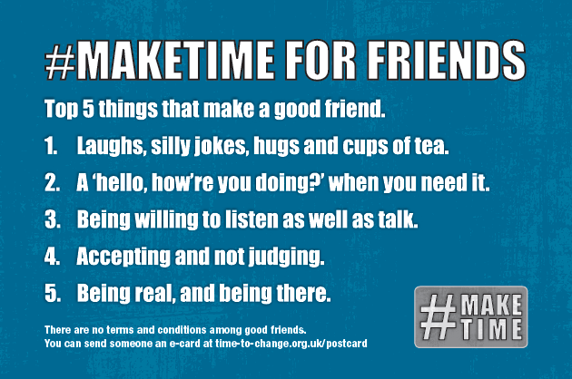

Slide 41


Plenary
Complete the gapped worksheet and fill in the blanks.
Three minutes

Slide 42
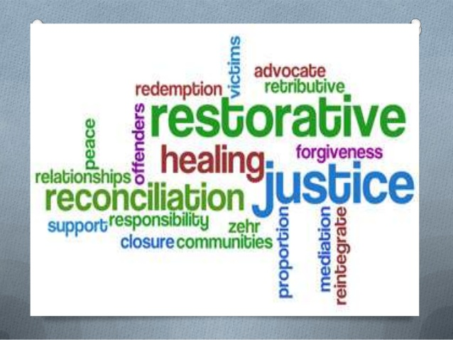
The promotion of SMSC through restorative practice
Holte |School
Notes:
-Spiritual Moral Social Cultural development has been part of legislation since 1944 but recently has assumed renewed importance, perhaps for the wrong reasons. The aim of this session is:
Define SMSC and its significance alongside a student’s academic development
Examples of how all staff within the school can promote a students’ SMSC development
Strategic plan for developing ‘thoughtful and wide ranging promotion of SMSC

Slide 43

What is iPeace?
iPeace is an innovative approach to behaviour management founded upon the principles of restorative approaches to conflict.
iPeace has been developed by Dr Cremin, University of Cambridge and has been developed in the UK, Brazil and Australia.
iPeace is a toolkit for schools on how to effectively manage conflict in all forms.
iPeace involves the whole school community, parents and the wider community.
‘dedicated to learning as the foundation for life’
Notes:
Assemblies, lessons, curriculum, ePraise, SMSC PoS

Slide 44
Why iPeace?
develop a better understanding of conflict in our school, including low level disruption in the classroom;
identify and use appropriate conflict resolution strategies that can be used in the classroom;
work towards more peaceful and productive learning environments, homes and communities;
provide opportunities for students to develop as active citizens in all communities.
Eradicate hypermasculinity.
promote an authoritative approach to behaviour management that is based on education, relationships and actively promotes social skills.
‘dedicated to learning as the foundation for life’
Notes:
Assemblies, lessons, curriculum, ePraise, SMSC PoS

Slide 45
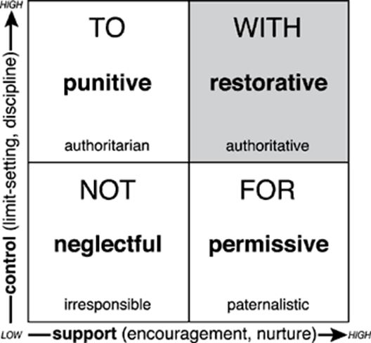
iPeace vs. behaviourist approaches
iPeace
combines both high control and high support and is characterized by doing things with people, rather than to them or for them
‘dedicated to learning as the foundation for life’
Notes:
Most important thing is that this is a toolkit – doesn’t only promote RJ. Punishment sometimes necessary.

Slide 46
Our journey…
iPeace/restorative approaches clearly defined within our BFL policy.
Annual training provided for staff. Part of induction for NQTs and new staff.
iPeace ‘action group’ including SLT, teachers, support staff, and a governor.
Mediation and restorative conversations between pupils/pupils, staff/pupils and staff/staff.
Fully accredited peer mediation service available for everyone within our community.
The use of restorative language in classrooms.
‘dedicated to learning as the foundation for life’
Notes:
Assemblies, lessons, curriculum, ePraise, SMSC PoS

Slide 47
Our journey…
Pupils complete restorative reflection forms in pupil office and Internal Exclusion, to encourage them to think about what they have done.
iPeace within our PSHE and Citizenship programme of study.
Collaborative work with local youth groups.
Peer mediation at Lozells and in the local community.
Referrals to West Midlands Police RJ service
‘dedicated to learning as the foundation for life’
Notes:
Assemblies, lessons, curriculum, ePraise, SMSC PoS

Slide 48
Peer Mediation
Peer mediators trained annually. Application process, including an interview.
Peer mediators have been trained by the College of Mediators.
Twenty Peer mediators have ongoing training provided by PhD students from Cambridge.
Each are assigned to one year group and 4 peer mediators are assigned to the primary school onsite.
There are 5 stages of peer mediation that the pupils go through.
‘dedicated to learning as the foundation for life’
Notes:
Assemblies, lessons, curriculum, ePraise, SMSC PoS

Slide 49
The importance of Mediation
Students are able to resolve their own conflicts
Empowers students
Teachers not having to deal with as much low level disruption
Peer Mediators themselves are able to learn essential life skills
The school climate has improved to become even calmer
‘dedicated to learning as the foundation for life’
Notes:
Assemblies, lessons, curriculum, ePraise, SMSC PoS

Slide 50
The impact of iPeace
No ‘them and us’, relationships are key and behaviour has to be taught
Student’s SMSC development is promoted at all times within the culture of the school.
Improved behaviour - reduction in fixed term exclusions, (incl. repeat exclusions), low level disruption, physical aggression and bullying.
Reduction in hypermasculinity.
Student leadership opportunities elicits a tangible community spirit.
‘dedicated to learning as the foundation for life’

Slide 51
Next steps…
iPeace parenting programme
iPeace working actively within the community
Increase links with feeder primary schools
Further develop restorative conferences
Participation in project with Cambridge University and Ugandan schools around supporting newly arrived refugee students who have experienced conflict.
Positive Peace in Schools: Tackling Conflict and Creating a Culture of Peace in the Classroom” by Dr Hilary Cremin, Terence Bevington
‘dedicated to learning as the foundation for life’
Notes:
Assemblies, lessons, curriculum, ePraise, SMSC PoS

Slide 52
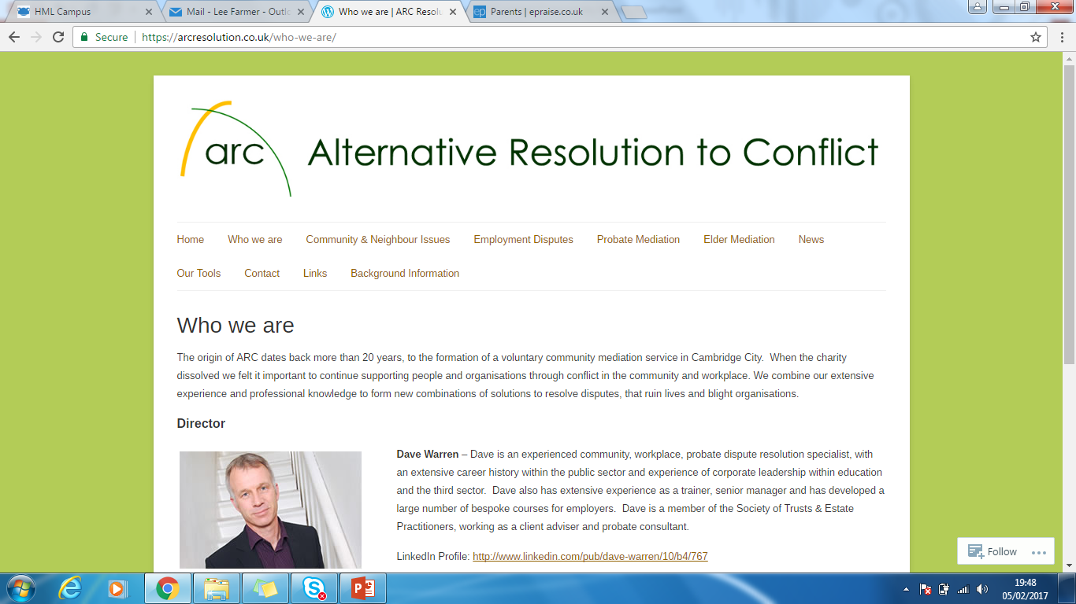
ARC lead training for peer mediators in schools. Their two day training programme is fully accredited by the College of Mediators.
www.arcresolution.co.uk

