Slide 1
Primary Themes Mental Health Faith and cohesion, FBV Staying safe

Slide 2
Primary Curriculum Group Meeting
At
Somerville Primary School

Slide 3
Good Practice at Somerville
Statutory and non-statutory

Slide 4
Model Safeguarding Policy
This is now renamed as Safeguarding and Child Protection Policy.
A Codicil Insert had to be presented to GB to be reviewed and ratified, with the name of Chair of Governors and Safeguarding Lead Governor.
Remember other policies in relation to Safeguarding: No Platform, KCSIE, Working together to Safeguard Children, Staff Conduct, The Prevent Duty, Children Missing Education…

Slide 5
Whole School Involvement
We have 7 trained DSLs in school
WRAP trainer –SPOC
RSRT trained
Attended a range of FREE training provided by BSCB: Serious Case reviews, FGM, DV, CSE
Spotlight
My Concern
Malachi (Early Help)
Safety Improvement Group (Mike)
E-safety

Slide 6
Whole School continued…
British Values
Family Skills for Parents-12 wks
RRSA working party (Karen)
IIP (Investors in Pupils)- NQT
Magic Breakfast
Vetting Visitors (Record of Self-Employed Status)
SCR –termly internal audit and annual external audit by Ellen Osborne

Slide 7
Whole School cont’d…
305 Cubs
Fire Marshal
Restraint Training-Team Teach
Paediatric First Aiders
Defibrillator Training
Children’s Society – research
Risk Assessments: EVC ratios and Y1 to Y6 residential
SRE

Slide 8
Birmingham Section 175 Safeguarding Self-Assessment Tool
Apparently it is straightforward…
Previous one is available and you can copy/paste but it is a different format with new sections
Improvement Action has to have something in it otherwise doesn’t let you move on
Goddard requirements???
Ensure others are involved and it is discussed in your GB meeting (minutes)

Slide 9
Working Together
Not in isolation
Support colleagues
Birmingham and Solihull Women’s Aid -support with lessons, staff briefings FGM, DV, Forced Marriages Bhavna Somia Outreach Development Worker (0121 685 8687)
NSPCC-assemblies and workshops tracey.hulston@nspcc.org.uk

Slide 10
ANY QUESTIONS…
Thank You

Slide 11
Welcome!

Slide 12
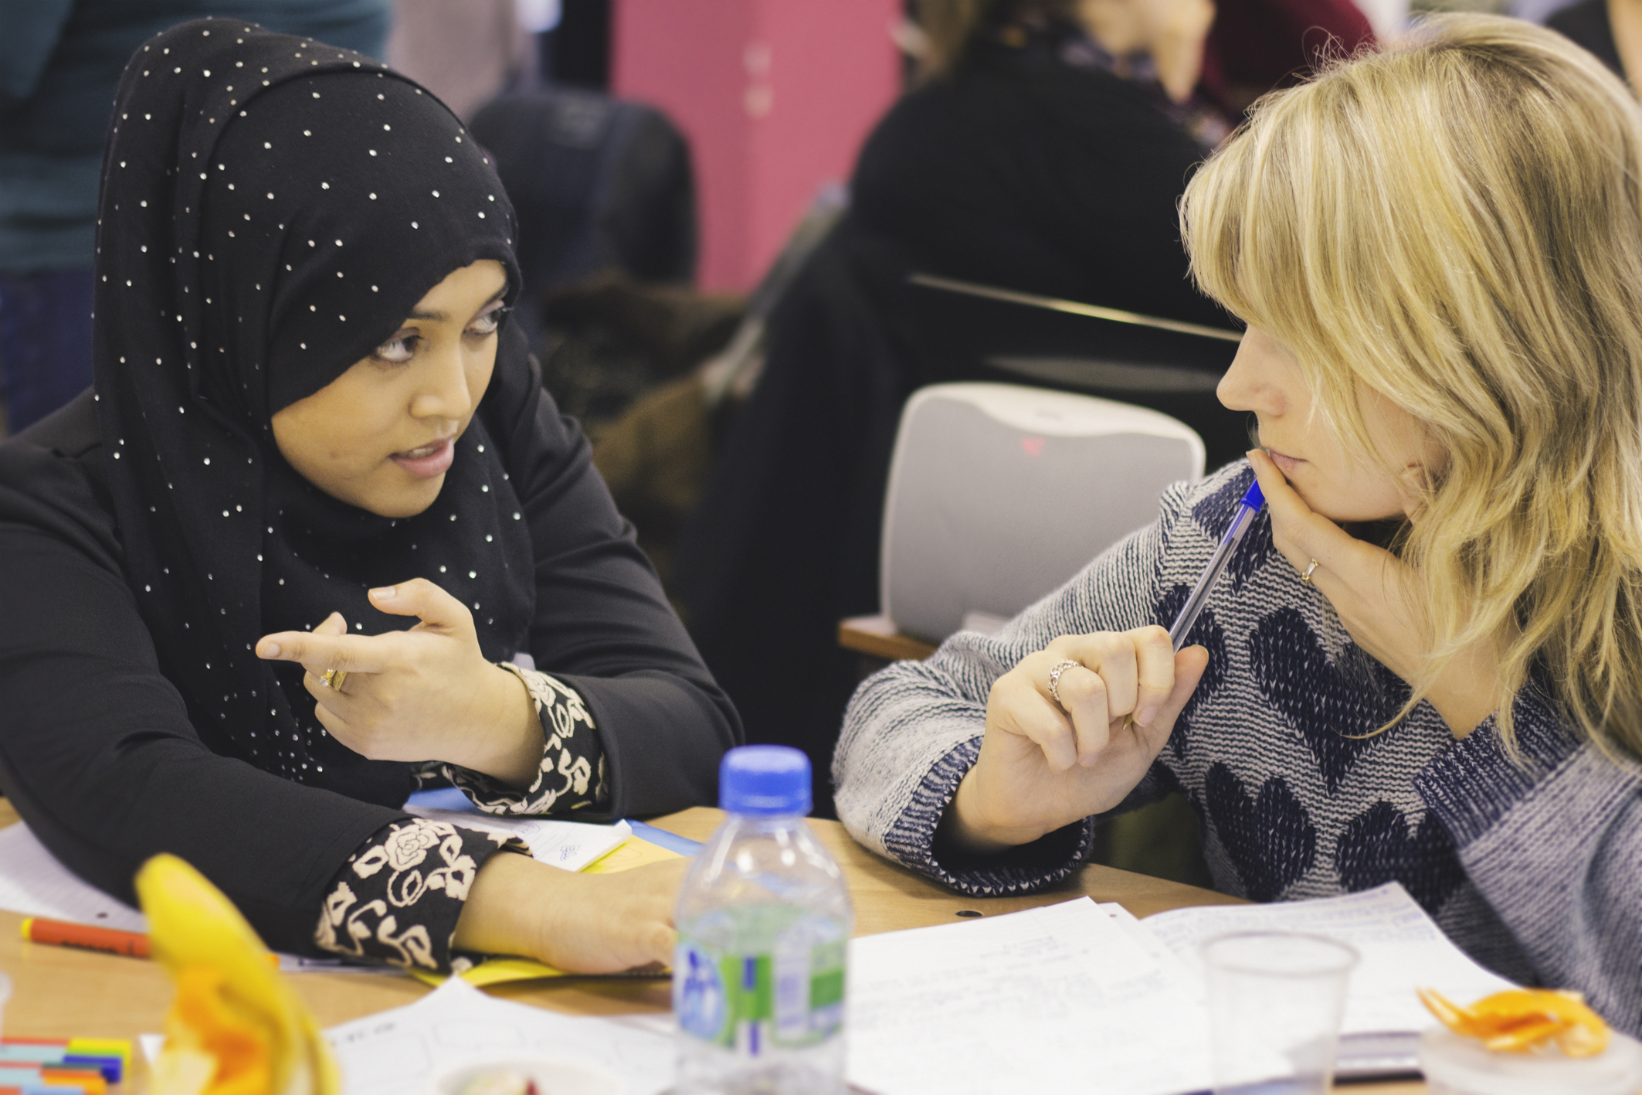
Who We Are
3FF works to build understanding and lasting relationships between people of all faiths and beliefs
Add image
Notes:
About 3FF
History
Vision – educating, equipping, humanising, encounters, building trust, building relationships
Core Programmes

Slide 13
Objectives
We believe that young people should feel confident communicating and collaborating with anybody, regardless of their faith, belief, culture or background. Our Schools Programmes help young people to:
Learn how different people understand and live their faiths and beliefs
Dispel common myths and stereotypes
Understand the diversity within and between different traditions
Become more able to ask and answer questions in a sensitive way
Learn to understand and share their own faiths and beliefs
Notes:
Aims
This interactive and immersive training session helps participants to explore the role of the facilitator in community engagement work. The training assumes participants have experience of basic facilitation so that the emphasis of the day is in sharpening and developing these skills for work with diverse groups from a range of faith and cultural backgrounds.
Objectives
By the end of this session training participants will:
Understand the role of a facilitator within interfaith and intercommunal settings
Understand the key principles to be taken into consideration when undertaking facilitation in interfaith and intercultural settings
Be better equipped to plan and prepare for interfaith and intercommunal encounters in their work
Understand how to create welcoming environments and inclusive spaces where those of all beliefs and cultures can thrive and navigate tensions
Understand the importance of sensitive and effective language in order to build trust and counter suspicion
Develop a range of skills and techniques to address difficult and challenging moments that occur in a facilitated session

Slide 14
School Linking
3FF’s School Linking programme provides opportunities for young people of different faiths and beliefs to meet and create long-lasting bonds of understanding and friendship.
Students on the Linking programme:
Take part in engaging and memorable link experiences throughout the academic year
Deepen knowledge and understanding of different beliefs by engaging directly with students from different backgrounds
Develop skills of communication, empathy and reflection
Teachers on the linking programme:
Build long-lasting links with local schools
Receive expert interfaith guidance on the provision of SMSC in their school
Network with other teachers and education professionals through our programme of Continued Professional Development.

Slide 15
Education Workshops
To succeed in today's complex and diverse world, young people need to be able to communicate sensitively and effectively with anyone, regardless of beliefs or background. Our award-winning workshops fulfil an essential role in preparing young people to succeed in the wider world.
Our activities are proven to help young people build religious literacy, empathy, and skills for dialogue and communication. Our workshops also support the RE, PSHE and citizenship curricula, as well as the provision of SMSC

Slide 16
Keep In Touch…
www.3ff.org.uk
rich@3ff.org.uk
Or follow us on social media…
Notes:
Additional training opportunities
Connect with us
Facebook (threefaithsforum)
Twitter (@threefaiths)
Twitter (@tamandawalker)

Slide 17
Primary resource adapted by Waverley Primary School

Slide 18
Feedback on Talking Mental Health
16 November 2017
Shahista Zamir
Middle Leader (PSHE)

Slide 19
Focus of the lesson:
Initially, ground rules were set to create a safe environment.
Objective: To understand the difference between a small, everyday feeling and a big feeling.
1. Pupils can use the appropriate language to talk about mental health and wellbeing.
2. Pupils can identify the trusted adults in my life and know how to ask them for help and support.
3. Pupils can compare feelings.
4. Each pupil has improved as a listener.

Slide 20
Definition of mental health clarified:
Mental Health is about our feelings, our thinking, our emotions and our moods – things you can’t really see, but that affect our lives in lots of ways.

Slide 21
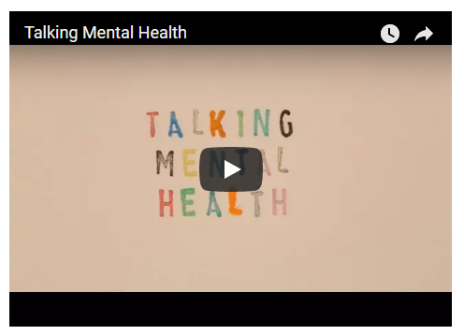
http://www.annafreud.org/what-we-do/schools-in-mind/youre-never-too-young-to-talk-mental-health/talking-mental-health-animation-teacher-toolkit/
Watch to [02:50].

Slide 22
Discussion
What did you notice in the animation?
*
*
*
‘Small everyday feelings’ – what are these?
Are there any other examples that you can give?

Slide 23
The feelings map
Discussion: ‘Small everyday feelings’ are feelings which change according to what is happening in our day.
Are there any other examples of things people do to cope with ‘small everyday feelings’?

Slide 24
What are small feelings?
Year 4
How do I deal
with big feelings?
*identify exactly what makes you feel this way
*act brave
*don’t avoid what makes you upset
*deep breaths
*brain holiday
*paint, write a letter
*exercise
*do what you like
*talk to someone who can help
*communicate
How do I deal
with small feelings?
*talk about them
*write them down
*draw pictures
*take a bath
*eat comfort food
*be with your friends, family and loved ones
What is mental health?
*when big feelings take over your life
*make you think or feel negative emotions about yourself or your life
*needs looking after or problems can happen
What are big feelings?
*always worrying
*feeling very anger
*being so scared all the time
*extreme sadness

Slide 25
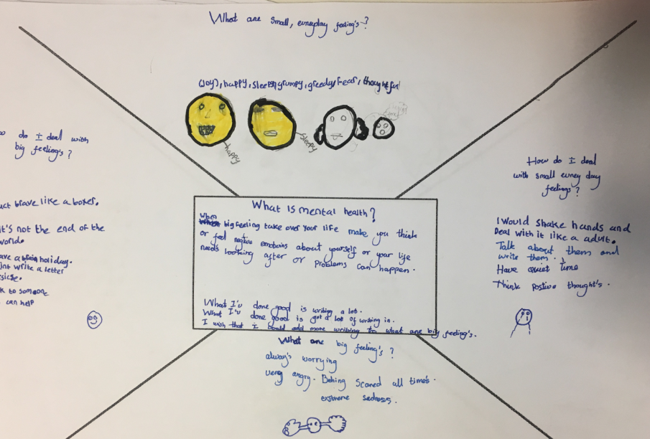

Slide 26
Year 5

Slide 27
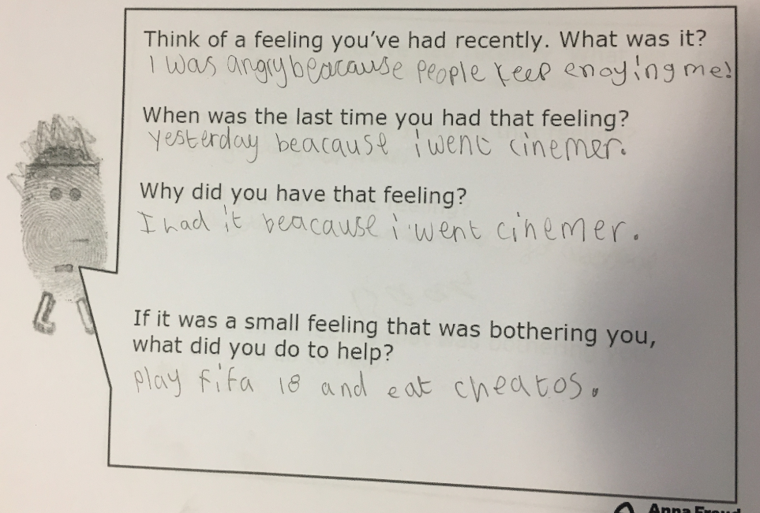

Slide 28
2. Talking
http://www.annafreud.org/what-we-do/schools-in-mind/youre-never-too-young-to-talk-mental-health/talking-mental-health-animation-teacher-toolkit/
Watch to [03:31].

Slide 29
Discuss: Sometimes our feelings get too big for us to manage on our own. What can we do when our feelings become too much/get too big?

Slide 30
Aim: There are ways for you to talk about your feelings and identify people to talk to.
After watching the clip, what is the key message of the clip?
2. What is happening for Jay?
3. What could Jay do?

Slide 31
Activity
Use the cut up sentence starters in pairs to roleplay talking to someone about a problem or a worry. One person to use the sentence starter to help them begin the conversation.
Talk about issues at school, for example, “I am worried that I can’t do my homework”, “I am worried that my friend doesn’t like me anymore, “I am worried about a test a school”.

Slide 32
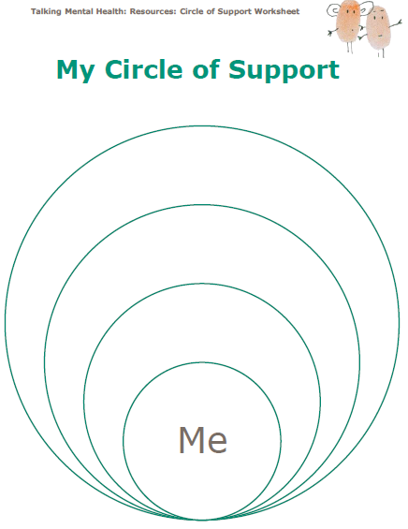
Activity
Complete your Circle of Support sheet.
Identify who the trusted people are in your life who you can talk to when you are feeling worried.
Write or draw them on the worksheet. On the sheet, place the people who you would speak to first, closest to you. This activity should be kept private. There is no need to discuss what you have put down afterwards.

Slide 33
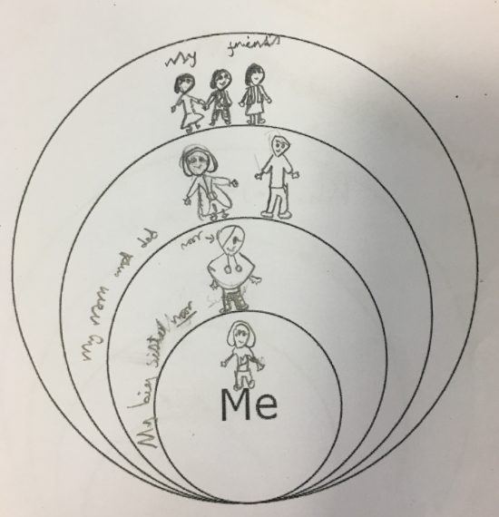
Year 4

Slide 34
3. Listening
http://www.annafreud.org/what-we-do/schools-in-mind/youre-never-too-young-to-talk-mental-health/talking-mental-health-animation-teacher-toolkit/
Who do we talk to and when do we decide to talk will be different for everyone.
Let’s see what Jay will do.

Slide 35
3. Listening
Jay needs someone to listen to her. How can we be good listeners when people want to tell us about how they are feeling?
Stand in two lines, with children facing a partner.
• Using the cards, you are to act out the instruction on the cards for 30 seconds at a time.
• Tell your partner after each one:
How did it feel?
Were you being listened to?
What was the other person doing that stopped them from being a good listener?
Using this information, draw or write down the rules of being a good listener using the good listener worksheet.

Slide 36
Plenary
What happened for Jay in the end?
“If your feelings are getting too big to cope with on your own, talking to someone you trust might really help.”
Let’s recap what we have learnt today about the following:
• What is mental health?
• Talking about mental health
• Being a good listener
• Who to talk to about our feelings

Slide 37
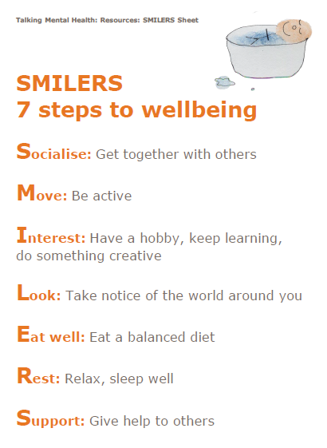
Benefits
Identification of potential safeguarding matters.
Further mental health lessons are being planned to meet the needs of the learners.
Children felt ‘listened to’.
Safer class environment.
Children’s emotional needs were explored and discussed.

Slide 38
Year 5 feedback
I could go around school for help.
I learnt how to be a good listener.
I’ve learnt the difference between mental health and physical health.
I liked the circle of trust and we didn’t have to share personal stuff.
I’ve learnt to share my feelings those who I trust.
I learnt how to cope with big feelings and small feelings.
I learnt how to express my feelings.
I like this lesson because now I know what to do when someone is talking [about their feelings].
The lesson helped me to show my feelings and how to deal with it if I’m upset.
I liked the video [clip].

Slide 39
Strengths
Well structured lesson plan.
Clarity with instructions: a list of resources needed at every stage of lesson and the duration of clip to show.
A topic which engaged and developed children’s understanding of the topic.
Finger print with real voices was abstract yet powerful.
Children commented on how they benefitted immensely from discussing this topic.
Children demonstrated greater understanding of different feelings which are felt by them.
Children were made to feel that it’s acceptable to have ranging feelings and explored strategies to cope.

Slide 40
Even better if...
I wish we could discuss things more.
I wish that this can happen everyday.
I wish we had more time.
I wish to learn more.
I want to explore where I can get help from outside of school for big feelings?
I want to know where to get help if I’m not at school, who should I go to?
I wish everyone was happy.

Slide 41
Suggestions
Video clip to include real faces to show what different emotions look like.
Video clip to show clips of cartoons or popular children’s shows to showcase everyday ‘little’ and ‘big’ feelings as well.
Differentiated resources (sentence prompts, images for low attaining children).
More guidance on support strategies outside of school, including a handout.
More guidance required on what can be done after the session for teachers.
Handout for children to take home for parents and carers.
Expectation of outcomes – Is there a scale (can these even be measurable)?

