Slide 1
EYFS and Primary curriculum planning

Slide 2
Delivering PSHE as part of a creative curriculum
Nelson Mandela Community School
Rochelle Jeffery / November 2016

Slide 3
Why is PSHE so important?
OFSTED’s changing priorities
Personal development, behaviour and welfare
(one of 4 key judgments)
Inspectors will evaluate the extent to which the school successfully promotes and supports pupils’:
employability skills so that they are well prepared for the next stage of their education, employment, self-employment or training
understanding of how to keep themselves safe from relevant risks such as abuse, sexual exploitation and extremism, including when using the internet and social media
knowledge of how to keep themselves healthy, both emotionally and physically, including through exercising and healthy eating
personal development, so that they are well prepared to respect others and contribute to wider society and life in Britain.
[Common Inspection Framework - June 2015]
Notes:
The key judgements are
• Effectiveness of leadership and management (including the curriculum and safeguarding)
• Outcomes for pupils
• Quality of teaching, learning and assessment
• Personal development, behaviour and welfare

Slide 4
Supporting evidence
"Are you teaching about the importance of tolerating other people and other cultures? Are you doing it through your RE lessons? Are you doing it through your PSHE programmes?
You can tell very quickly whether a school is doing that or not and if they’re not doing that, they’re going to fail an Ofsted inspection.”
[Sir Michael Wilshaw
Chief Inspector]
An example from the descriptor for grade 1:
Pupils can explain accurately and confidently how to keep themselves healthy. They make informed choices about healthy eating, fitness and their emotional and mental well-being. They have an age-appropriate understanding of healthy relationships and are confident in staying safe from abuse and exploitation.
Notes:
Discuss – we’re not doing it to pass an ofsted inspection – we’re doing it because we care about the children.
We want them to feel and be safe, this includes equipping them with life skills and making sure they feel happy and positive about who they are.

Slide 5
‘It is difficult to see how safety and safeguarding can be good if PSHE education provision is poor.
If pupils are kept ignorant of their human, physical and sexual rights; or how to protect themselves and others, or know where to go to for help, they are not being adequately safeguarded.’
Janet Palmer HMI
Notes:
Discuss – we’re not doing it to pass an ofsted inspection – we’re doing it because we care about the children.
We want them to feel and be safe, this includes equipping them with life skills and making sure they feel happy and positive about who they are.

Slide 6
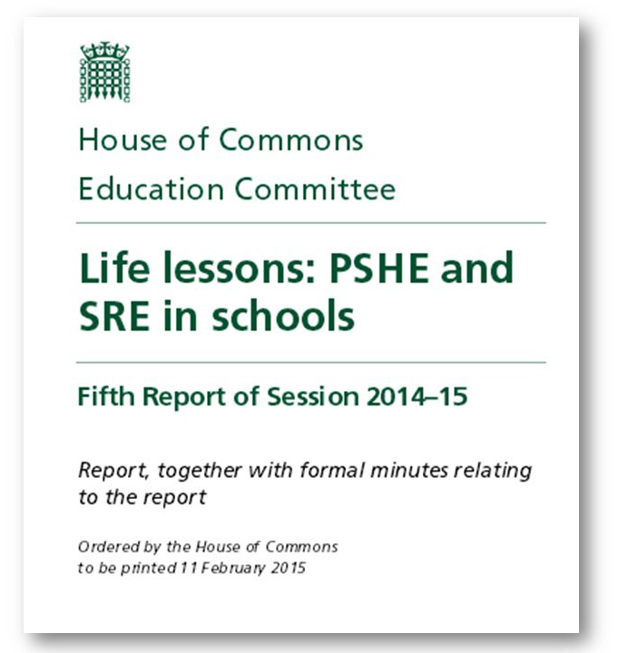
PSHE and the political landscape
CHILDREN’S RIGHTS
Article 17 – the right to information to promote well-being and health
Article 29 – the state must prepare children for a responsible life
Article 12 – the right to express their views
Article 34 – the right to protection from all forms of harm
Notes:
House of commons reported last year that PSHE should be made statutory – change of government put it on hold. DFE still ‘considering all options’. Still a non-statutory subject!!!
We are Duty bearers for Children’s rights.

Slide 7
Curriculum
Map
British Values
SMSC
Children’s Rights
Safe-guarding
PSHE
PSHE alongside
other key aspects of the
curriculum
Notes:
PSHE is an important subject and supports learning of other areas, such as values, rights and safeguarding.
We ensure all this areas are included in our curriculum map, alongside statutory curriculum areas.

Slide 9
Delivering our PSHE education
In our school the PSHE curriculum is delivered in a variety of ways;
As a whole school, through assemblies, but also through a strong school culture, whose values are integrated into each and every school day.
For two terms in each academic year, through twice weekly PATHS lessons. (Promoting Alternative THinking Strategies; or PATHS as it is more widely known; is a social and emotional learning (SEL) programme for primary school children. It is an early intervention prevention programme which builds social and emotional literacy, leading to benefits such as improved self-control, greater ability to solve problems and increased educational attainment.)
For one term in each academic year, through discrete weekly lessons which cover curriculum content that is not met by PATHS.
Through cross-curricular links with other subjects such as Science, Geography and RE.
Through annual focus weeks where pupils learn about subjects such as Safety, Money, Internet Safety and Road Safety.
Notes:
Through making sure we cover the PSHE curriculum and build progress into it through mapping
Staff to look at PSHE curriculum and mapping.

Slide 10
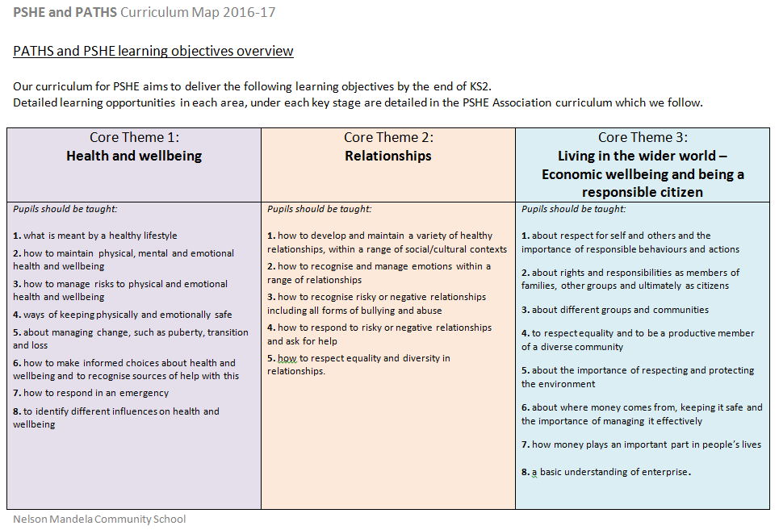
Notes:
Core themes - Using the PSHE association curriculum for guidance

Slide 11
Notes:
Curriculum map so teachers know what they should be teaching and when.

Slide 12
Notes:
More detailed medium term planning for trickier areas.

Slide 13
Ensuring PSHE is outstanding
A member of the SLT who is responsible for PSHE
Making sure it is valued within the school curriculum
Including PSHE as a focus for whole staff Inset
Supported by a PSHE team – distributed leadership
Monitoring, including collecting and moderating evidence
Involving parents (parent workshops)
Using expertise –PSHE association, NSPCC, Educate & Celebrate, PFEG, BHES.

Slide 14
During the next 15 years…

