Slide 1
2018 Director of Public Health Annual Report – ‘Fulfilling Lives for Under Fives’
Public Launch Event 12th November
Birmingham City Council – Public Health
12th November 2018
Twitter: #BDPHReport

Slide 2
Public Launch 12th Nov
Welcome & Introduction
Councillor Paulette Hamilton
Cabinet Member of Health and Social Care

Slide 3
Programme
Background & introduction
Summary of report contents and key recommendations
Poster Based Discussions
Questions to Panel Members
Close

Slide 4
Summary of report and key recommendations Becky Pollard Interim Director of Public Health

Slide 5
Background and Introduction
The Health and Social Care Act 2012 set out a statutory requirement for all DsPH to produce an annual independent report of the health of their population – & for the local authority to publish it
This year the focus is on the health of under five year olds
Call to action

Slide 6
Introduction
Report provides an honest evaluation of:
How well Birmingham is performing currently
What we should be doing (best practice)
What we are doing (any gaps?)
Recommendations for future action

Slide 7
Context
Health is everyone’s business, and we all have a part to play in promoting a best start in life.
Foundations of good health through out life start even before birth.
If we are to be successful in improving life chances for families and young children, we must work together and focus our collective efforts at all levels.

Slide 8
Chapter 1 - Demography

Slide 9
Demography
Birmingham has the largest population under five year olds of any English local authority
85,820 children making up 7.6% of the total population
Highest number of births per year of all the local authorities in England – remaining fairly constant over past 10 years
17,000 births in 2007 – 17,500 in 2016
Largest number of births in Central and East of the city
60% under fives from BAME groups in 2011
6.7% households with dependent children live in overcrowded conditions (compared to 3.2% nationally)
355 under fives are Looked After by the local authority

Slide 10
Chapter 2 – Conception, Pregnancy and Neonatal

Slide 11
Conception, Pregnancy and Neonatal
Birmingham has many poor maternity outcomes – still births, low birth weight, neonatal death and infant mortality
Infant Mortality Rate (IMR) higher than England rate – 7.9/1,000 in B’Ham compared to 3.9/1,000 in England
Highest IMRs in Central areas of city (Hodge Hill and Ladywood)

Slide 12
Conception, Pregnancy and Neonatal
Main causes of infant deaths are from immaturity related conditions, congenital anomalies & intrapartum events
Fewer women smoke during pregnancy than nationally
Under 18 conception rates have fallen significantly - now similar to England rate
Maternal mental health – 30% of women who gave birth had adjustment disorders and distress (4,900)

Slide 13
What we should and are doing
Ensure local delivery of the NHS Saving Babies’ Lives Care Bundle for Reducing Stillbirth
Service improvements led by the Sustainability Transformation Partnership Local Maternity System should target those women with additional needs
Birmingham Forward Steps to establish systematic approach to support women’s nutrition & physical activity needs during the postnatal period

Slide 14
Chapter 3 – Early years health and care

Slide 15
Early years health and care
71% women started breast feeding (74% for England)
At 8 weeks this drops to 51% still breastfeeding (43% for England)
24.7% 4 year olds were overweight or obese (22.6% for England) – wide variation across city
Obesity rates are higher in more deprived communities
Higher A&E attendances in 0-5 year olds compared to England
Hospital admissions due to unintended & deliberate injuries in 0-4 year olds is lower in B’ham than England average

Slide 16
Early years health and care
36.2% of 2-4 year olds received the flu vaccination (compared to 38.1% for England)
Uptake rates vary hugely across GP practices (between 3.6-85.7% for 2 year olds)
MMR uptake rates for 2 doses at 5 years old is 82.9% for B’ham – 87.6% for England (national target 95%) – again wide variations
87.5% 3 year olds are free from dental decay (88.4% England)

Slide 17
What we should and are doing
Increase uptake of Healthy Start and vitamins vouchers
Improve data quality, specifically breastfeeding
Develop better support offer for breastfeeding, nutrition and physical activity to mothers
Develop a whole system approach to obesity
Carry out an oral health needs assessment
Increase vaccination uptake rates and reduce variations
Adopt NICE / PHE oral health recommendations

Slide 18
Chapter 4 – Early years education and development

Slide 19
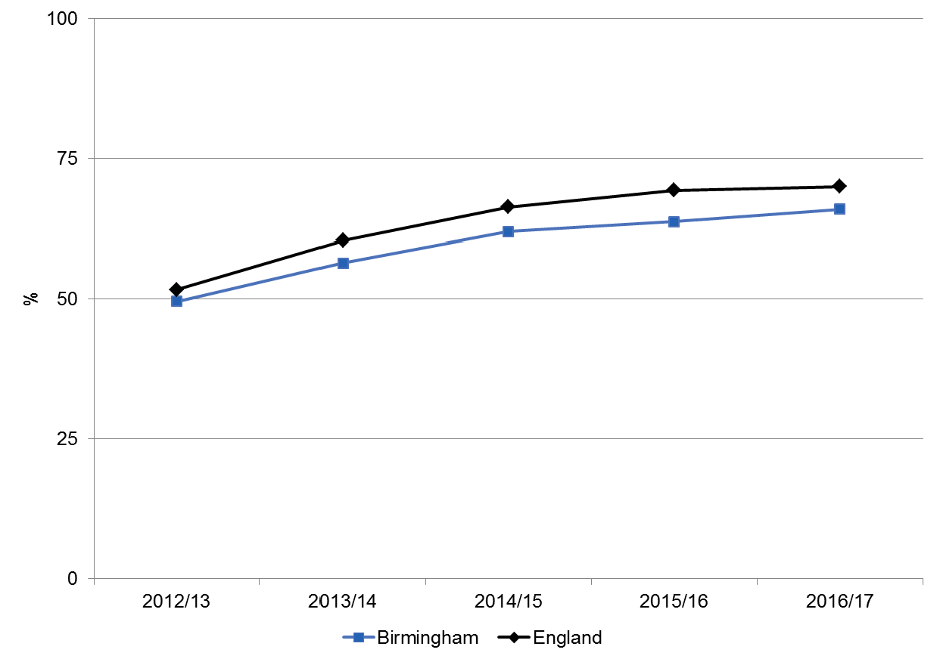
Early Years Education and development School readiness - % of children achieving a good level of development at end of reception

Slide 20
Early Years Education and development
In 2017/18 , 67% of 2-2.5 years olds received their Ages and Stages Questionnaire 3 assessment (non validated data from Birmingham Forward Steps)
In spring 2018, 62% (5,519) of eligible 2 year olds took up an entitlement of free early education (compared to 72% in England)
Take up of a free offer for all 3 and 4 year olds was 90% (20,717) in B’hm compared to 94% across England
Children receiving special educational needs & disability support has increased each year since 2013/14 (2067 in 2017/18)

Slide 21
What we should and are doing
Birmingham Forward Steps to develop locality links with Early Years Education providers to increase uptake of free education offers and ASQ-3 assessments
Improve data quality of Ages and Stages Questionnaire (ASQ-3) collected at the 2-2.5 year health visitor assessment

Slide 22
Chapter 5 - Family and social environment

Slide 23
Family and social environment
More than 1 in 4 children (27%) children in B’ham lives in poverty (England 16.7%)
2,961 city households with dependent children or a pregnant mother accepted as homeless
30.5% of children in B’ham live in income deprived households – this varies widely across the city
Rates of unemployment benefit claimants mirrors income deprivation

Slide 24
What we should and are doing
Build measures to reduce family poverty into economic developments across the city – share learning from use of 106 funding in Longbridge
Develop opportunities to prevent and reduce the impact of Adverse Childhood Experiences – schools, NHS, mental and social care services
Focus the JSNA on supporting and evaluating the B’Ham Homelessness Prevention Strategy needs assessment

Slide 25
5 Overarching Recommendations

Slide 26
It is recommended that:
Commissioners and providers of Early Years services within Birmingham take account of the demographic makeup, variations in health outcomes and distribution of the under five year olds population across the city (specifically in Central and Eastern areas) and target efforts and resources accordingly.
Commissioners and providers have in place robust data collection systems to monitor health needs and outcomes for under five year olds and their families, the Ages and Stages Questionnaire and breastfeeding rates.
Local STPs across the city encourage commissioners and service providers to strengthen the prevention offer from preconception through to early years for the citizens of Birmingham, particularly through the Local Maternity System & Birmingham Forward Steps.

Slide 27
Overarching recommendations (cont.)
4. Inclusive growth and economic development programmes across the city and those led by the West Midlands Combined Authority, maximise opportunities to promote the wellbeing of young children and their families, particularly those in greatest need.
5. The Health and Wellbeing Board strengthens strategic partnership working and ensures robust governance arrangements are in place between statutory and non- statutory bodies to monitor and promote the health and wellbeing of under five year olds.

Slide 28
Chapter Leads:
Demographics: Ralph Smith, Service Manager, Public Health, Birmingham
Conception, Pregnancy and Neonatal: Dr Dennis Wilkes, Assistant Director of Public Health, Birmingham City Council
Early Years Health and Care: Fiona Grant and Chris Baggott, Service Managers, Public Health, Birmingham City Council
Early Years Education and Development: Fiona Grant, Service Manager, Public Health, Birmingham City Council
Family and social environment: Duncan Vernon, Acting Assistant Director of Public Health, Birmingham City Council

Slide 29
2018 Director of Public Health Annual Report – Fulfilling Lives for Under Fives
Poster Discussions

Slide 30
Director of Public Health’s Annual Report – Early Years (0-5 Years)
Questions - Panel

Slide 31
Thank You
Twitter: @HealthyBrum
https://www.birmingham.gov.uk/publichealth

