Slide 1



20mph in Birmingham
Notes:
Introduce the session, stating why you / your group you wanted the session to happen.
Explain that this is a self-guided presentation but that BCC are keen to hear feedback and particularly keen to hear your group's ideas about how we can encourage more people to slow down!

Slide 2
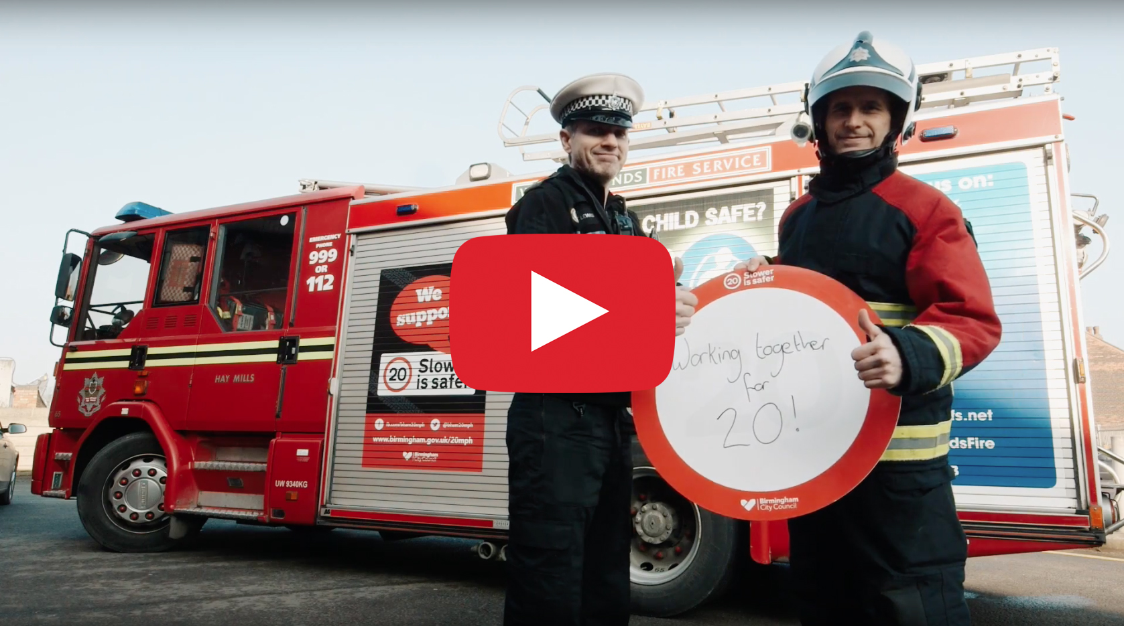

Hello…
We’d like to start by showing you some of the things our communities have been doing to support 20mph in Birmingham.
(Play video by clicking the play button on the picture).
Notes:
A short video featuring some of the activities we have delivered with our partners.
We included it because it shows how important community engagement is to the success of the scheme.
Success = getting drivers to embrace the new speed limits and slow down.

Slide 3

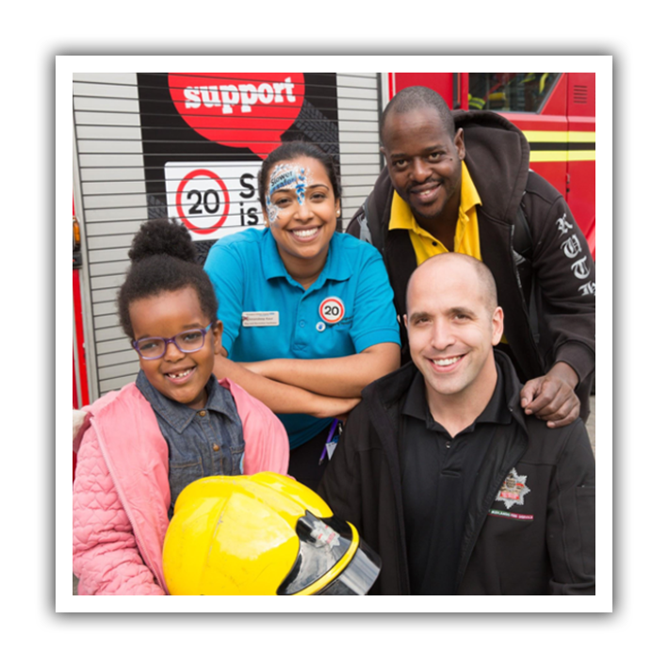
20mph is a people powered change
It’s not traffic signs but hearts and minds that will make the change
Notes:
If you want more background to 20mph in Birmingham you will find this in the earlier pages of this toolkit!

Slide 4
Let’s start with the
nuts and bolts
Not all areas of the city will down 20mph - we are trialling it in parts of the city where there is high public support and higher than average collision rates.
Majority of ‘A’ roads will remain as they are.
It’s costing £2.75 million to bring 20mph to our first four areas.
Notes:
If you want more background to 20mph in Birmingham you will find this in the earlier pages of this toolkit!

Slide 5
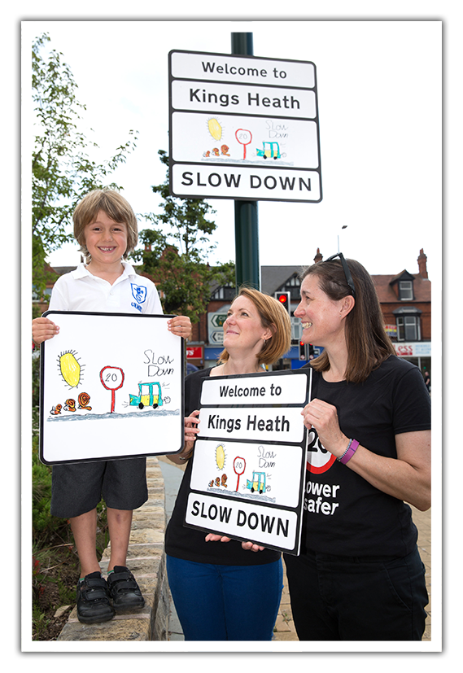
Nuts and bolts
continued…
A 20mph scheme is different from a 20mph ‘zone’. Schemes cover large areas and do not require speed bumps or other traffic calming measures.
This is why a programme of engagement, designed to change people’s attitudes and behaviours is so important.
Notes:
If you want more background to 20mph in Birmingham you will find this in the earlier pages of this toolkit!

Slide 6
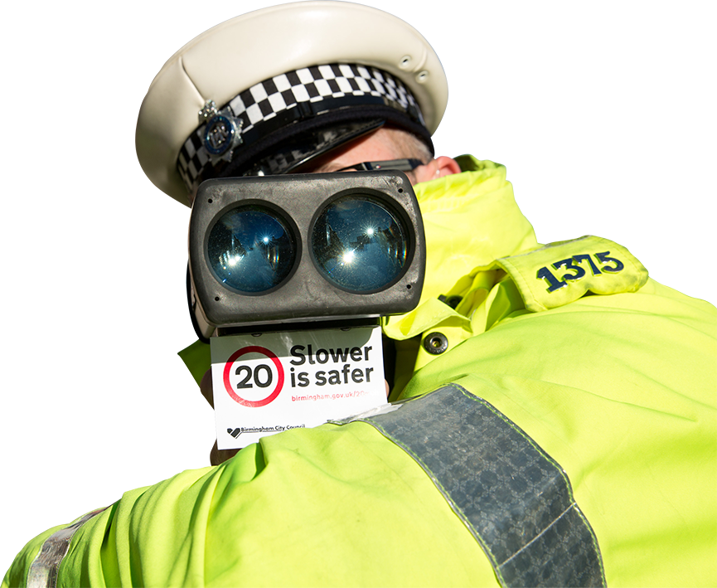
What areas are included?
Notes:
If you want more background to 20mph in Birmingham you will find this in the earlier pages of this toolkit!

Slide 7
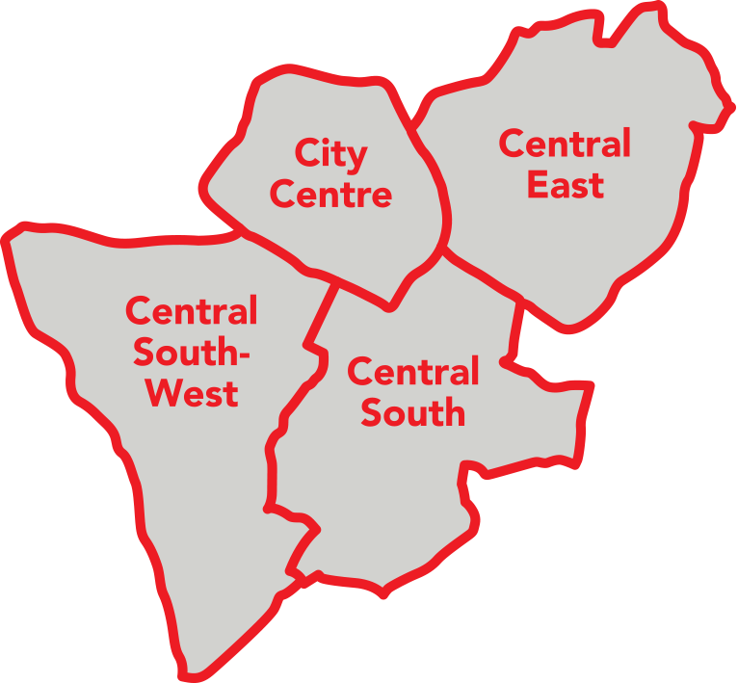
Pilot areas
Current areas include:
The entire city centre within the ring road.
Central South-West: Covering the majority of Edgbaston and Selly Oak and parts of Harborne and Bourneville wards.
Central South: Sparkbrook, Pickwick Park, Balsall Heath, Cannon Hill, Kings Heath, Moseley, Park Hill and Sparkhill.
Central East: Ward End, Saltley, Bordesley, Little Bromwich, Bordesley Green and Small Heath.
Notes:
This shows the current pilot areas (as of 2018)
The decision on whether to expand 20mph beyond the initial pilot areas will be taken on the basis of the following;
Reduction in speeds in pilot areas.
Sufficient budget to roll out the scheme to other areas of the city.

Slide 8
Some things that may surprise you…
Notes:
These slides are here to indicate the scale of the problem.
Road Traffic Collisions (RTCs) remain one of the biggest causes of death. in the UK but globally, Coronary Heart disease holds the number 1 spot!

Slide 9
The odds…
Many people are scared of flying.
But the odds of dying in a plane crash are
11 million to 1
Notes:
These slides are here to indicate the scale of the problem.
RTCs remain one of the biggest causes of death. in the UK but globally, Coronary Heart disease holds the number 1 spot!

Slide 10
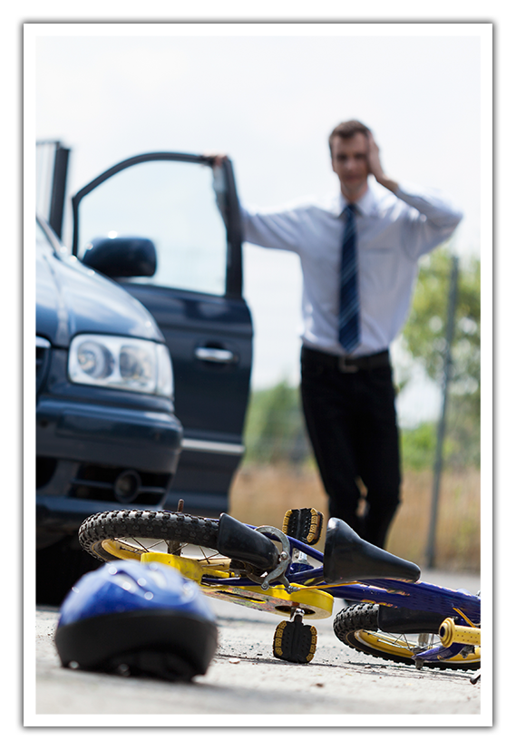
Road traffic collisions
Road traffic collisions (RTC’s) are far more common than you’d think.
But the odds of dying in a collision are
8,000 to 1
RTC’s are the biggest killer worldwide of children under 15*. * United Nations
Notes:
These slides are here to indicate the scale of the problem.
RTCs remain one of the biggest causes of death. in the UK but globally, Coronary Heart disease holds the number 1 spot!

Slide 11

In Birmingham…
One person is killed or seriously injured everyday on Birmingham’s roads.
One child is seriously injured on our roads everyday and,
one child a week is killed or seriously injured.
Notes:
These slides are here to indicate the scale of the problem.
RTCs remain one of the biggest causes of death. in the UK but globally, Coronary Heart disease holds the number 1 spot!

Slide 12

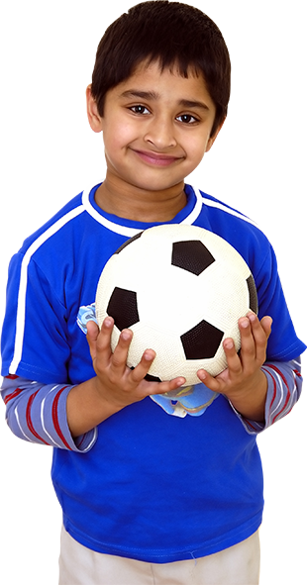

Think of it another way…
Every summer holiday children all over Birmingham look forward to playing with their friends and having a few weeks off school.
This year, six of those children won’t be joining their classmates in September.
Notes:
These slides are here to indicate the scale of the problem.
RTCs remain one of the biggest causes of death. in the UK but globally, Coronary Heart disease holds the number 1 spot!

Slide 13

Why DOESN’T this make the headlines?

Slide 14

Is it because we have ACCEPTED injury and death on the road as a cost of modern living?
Is that OK?

Slide 15
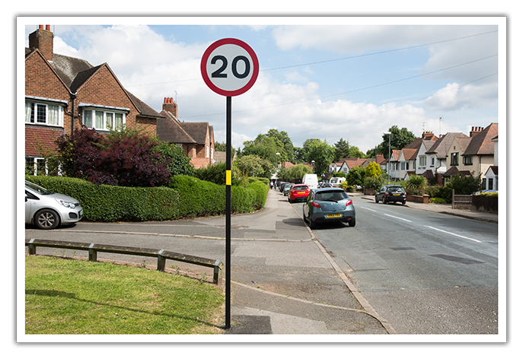
The good news is – we can change this

Slide 16
How can we change it?
By recognising that; as drivers we make mistakes – every time we get in the car.
By slowing down! At lower speeds we have more time to deal with the consequences of those mistakes and the mistakes made by other road users.
By recognising that a small change made by many people creates a much greater impact than a big change made by a few extreme ‘problem drivers’.

Slide 17

20mph won’t stop people being injured on our roads…
BUT it will reduce the numbers of collisions.
AND when somebody is hit by a vehicle driving at 20mph or below, they stand a far greater chance of getting up and walking away.

Slide 18
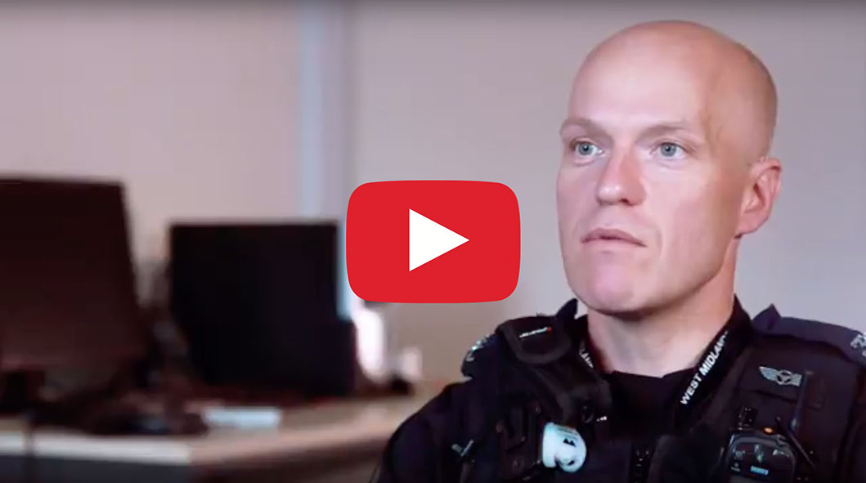
Jago’s story
We’d like to show you a short video.
When watching this, try to think about how many people would have been involved in this true story.
(Play video by clicking the play button on the picture).
Birmingham City Council

Slide 19
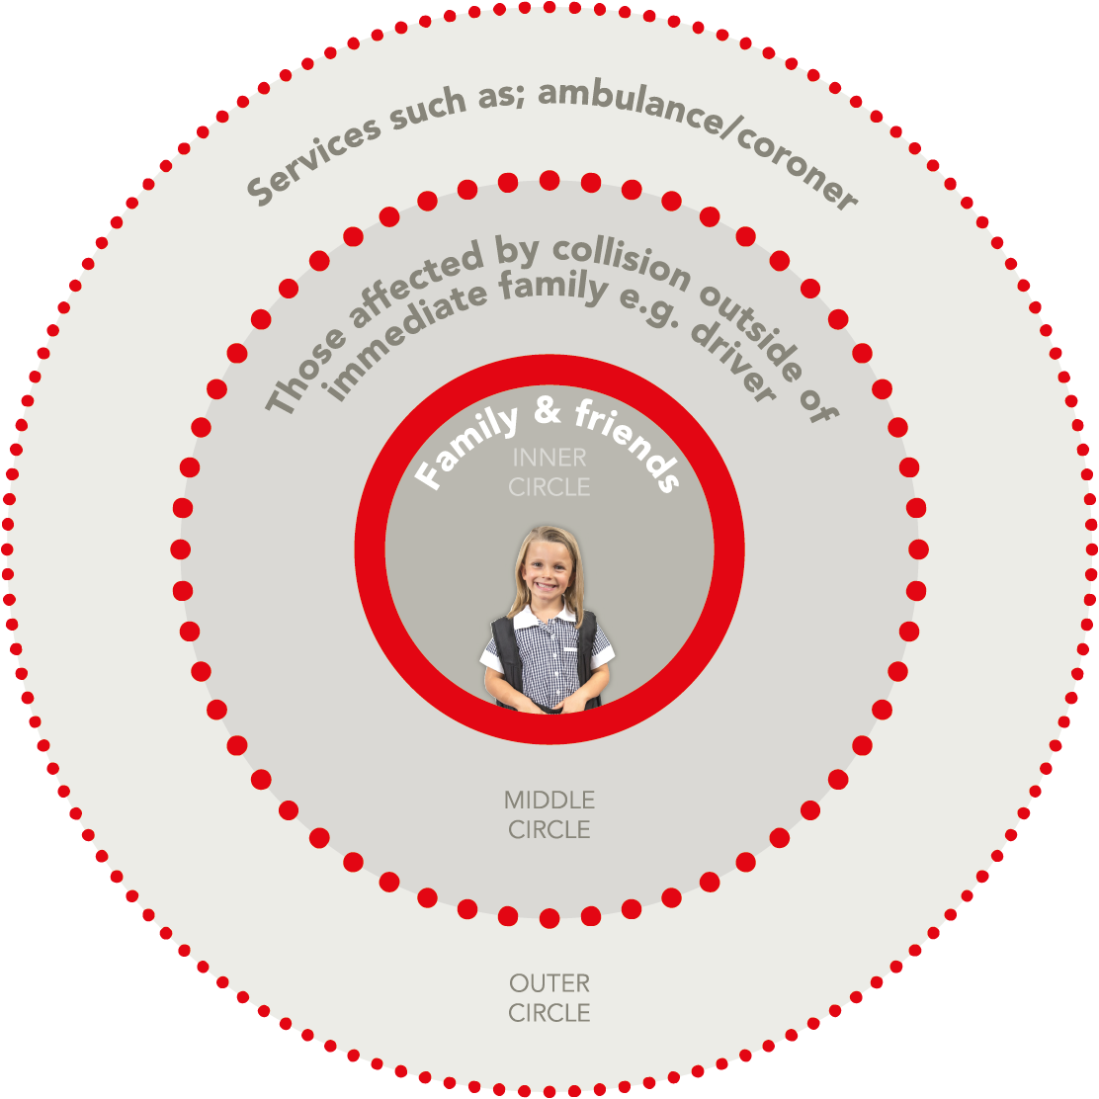
The ripple effect of a crash
How many people do you think were affected in Jago’s story?
Were you surprised at the cost of a fatality?
Notes:
Here is a great opportunity to have a discussion
Encourage people to share their reaction.

Slide 20
Different ways to count the cost of doing nothing…
Notes:
Different types of costs.

Slide 21
The economic cost
RTC’s in Birmingham cost the local economy an estimated
£176 million a year
A single fatality costs the tax-payer approximately 2.5 million pounds, so stopping just one fatality is an equivalent saving to the amount the council is investing!
(Source DfT)
Notes:
This figure was calculated using: DfT table RAS6000: Average value of prevention per reported casualty and per reported road collision; and STATS 19 collision data for Birmingham. Figure is an average annual cost for 2010-2013.

Slide 22
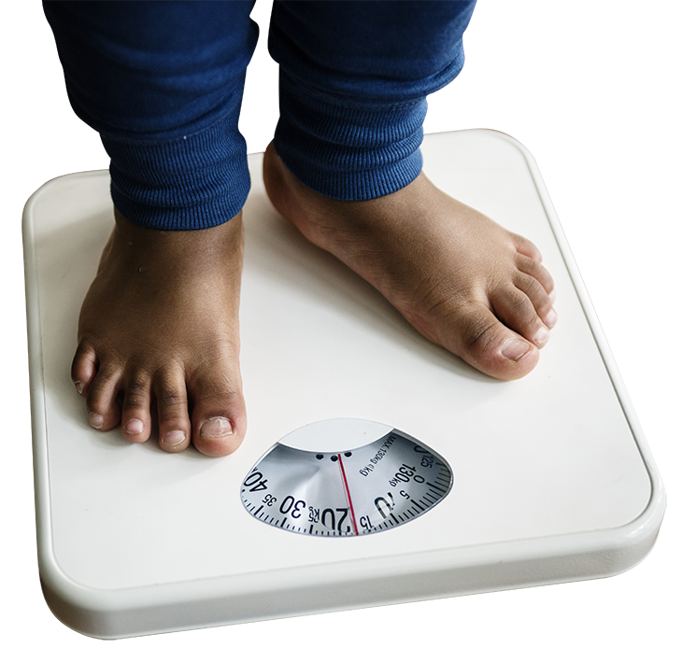
The cost to our health
By the time they leave primary school
40% of Birmingham’s
children are overweight
or obese.
Parents tell us that one of the key reasons their children don’t walk and cycle to school is the speed of traffic on our roads.
Notes:
Different types of costs.

Slide 23
The cost to our environment
Around 900 deaths per year in Birmingham are linked to air pollution.
Reducing speeds reduces vehicle emissions.

Slide 24
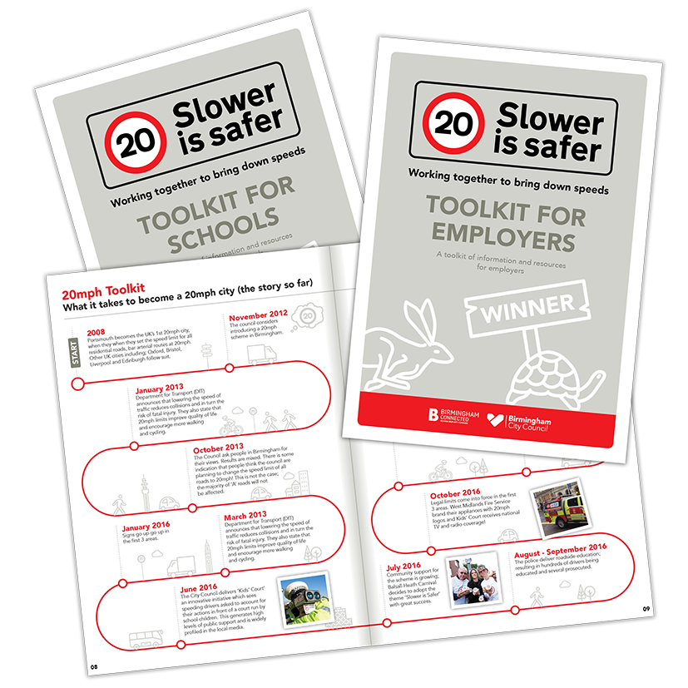
'Slower is Safer’ Toolkits
Birmingham City Council have produced a range of toolkits to help you promote the 20mph ‘Slower is Safer’ campaign.
Download a copy today to become part of the change.
www.birmingham.gov.uk/20mph
Notes:
Encourage people to download the toolkit.

Slide 25
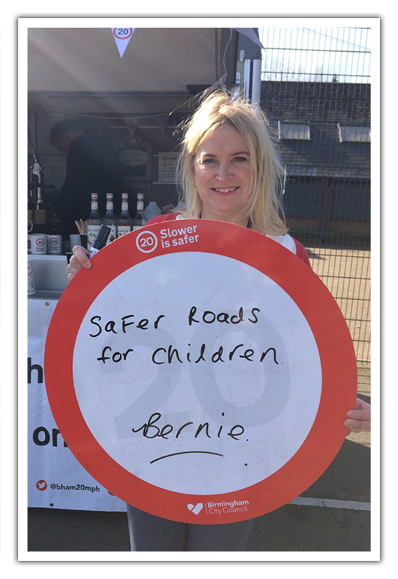
We want to hear you!
What else can be done?
Share your suggestions with us.
Notes:
Ask people to suggest different ways to slow down traffic, then please email us your suggestions!

Slide 26
Want to know more?
Twitter: @bham20mph
Facebook: @bhamconnected
Visit our website:
www.birmingham.gov.uk/20mph
Request a ‘Slower is Safer’ toolkit, email:
connected@birmingham.gov.uk

