Slide 1
THE NEW GENERAL DATA PROTECTION REGULATIONS (GDPR)
THE NEW GENERAL DATA
PROTECTION REGULATIONS (GDPR)
Malkiat Thiarai
Head of Corporate Information Management
Birmingham City Council

Slide 2
Welcome and Domestics
Welcome
Fire Evacuation
Toilets
Smoking

Slide 3
Overview of Session
Presentation from Malkiat Thiarai
Questions
Feedback and general questions
What do I need to actually do and who needs to be involved?
What are the implications of me not adhering to the new regulations?
Key Messages

Slide 4
General Data Protection Regulations
Background to the Regulations
Timescale for change
GDPR aims
Key changes
Impact on Health and Social Care
Impact on SMEs
Procurement Implications

Slide 5
Background
UK Data Protection Act 1998 derives from EU Data Protection Directive 95/46/EC
Data Protection Act now almost 20 years old
Amendments and related law have been enacted, but fundamental review required
Potential changes discussed at EU level for 4 years
Reform consists of 2 instruments:
General Data Protection Regulations (GDPR)
Data Protection Directive (for police & criminal justice sector)

Slide 6
Timescales
GDPR approved by European Parliament on
14 April 2016
Entered into force on 25 May 2016
Will apply in UK (potentially with changes) from
May 2018

Slide 7
GDPR Aims
To give citizens back control over their personal data
To simplify the regulatory environment for business
To create a modern and harmonised data protection framework across the EU
Reform seen as ‘key enabler’ of Digital Single Market & EU Agenda on Security

Slide 8
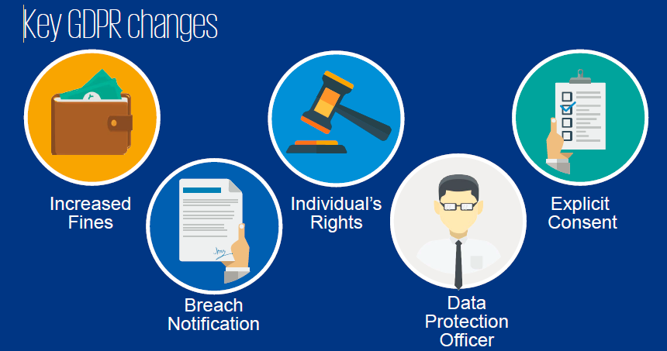
Key GDPR changes

Slide 9
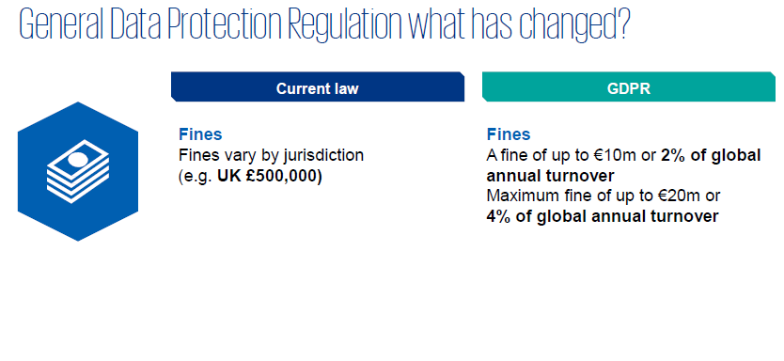
GDPR what has changed

Slide 10
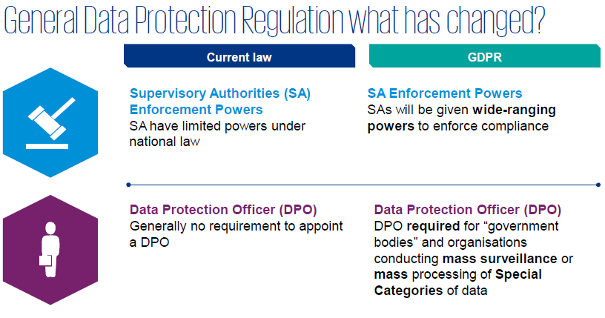
GDPR what has changed?

Slide 11
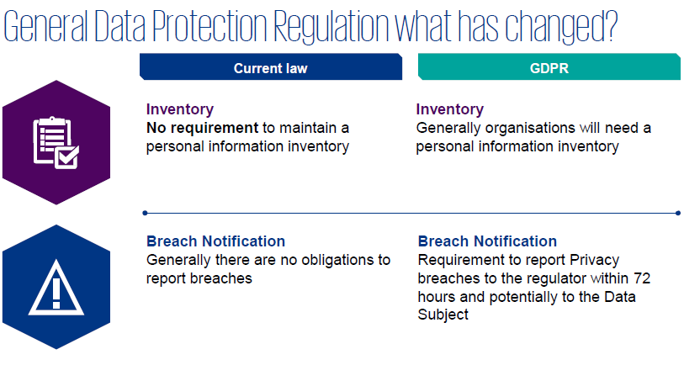
GDPR what has changed?

Slide 12
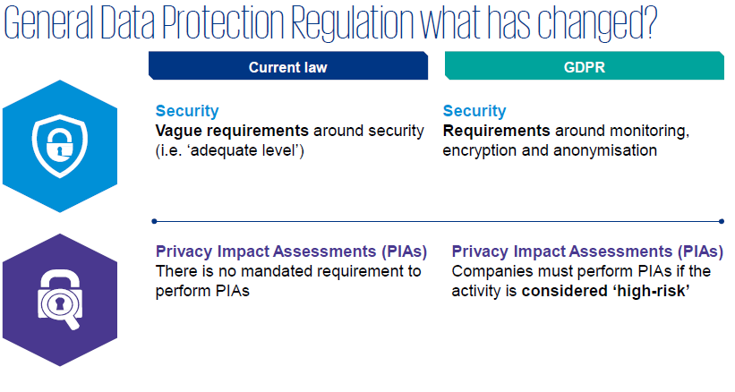
GDPR what has changed?

Slide 13
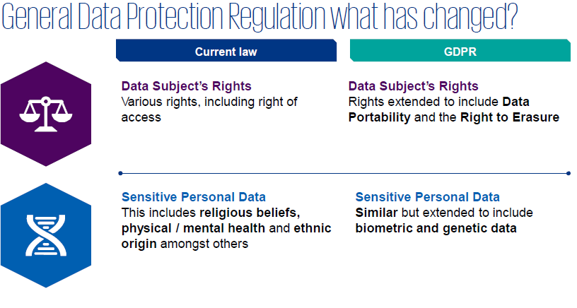
GDPR what has changed

Slide 14
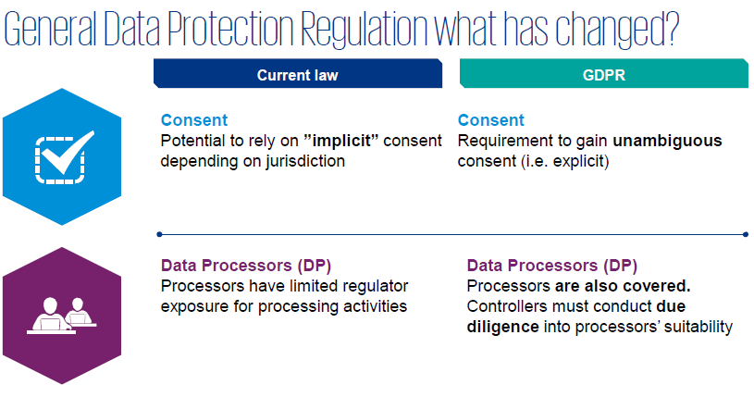
GDPR what has changed

Slide 15
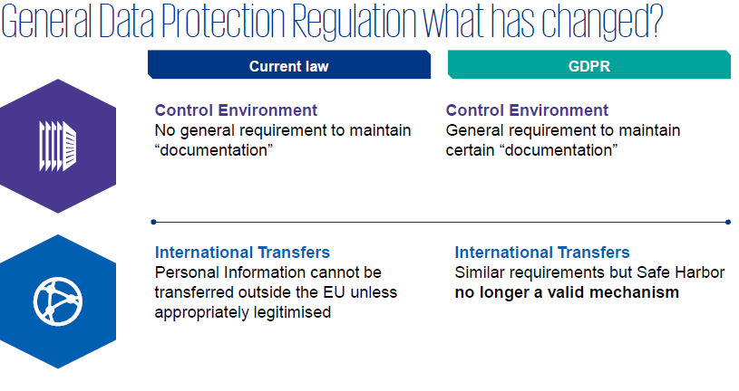
GDPR what has changed?

Slide 16
GDPR compliance in health and social care
GDPR Articles 9 and 10:
The GDPR requires special conditions to be met for processing “special categories” of personal data and criminal convictions data.
Articles 9 and 10 of the GDPR prohibit the processing of such data unless the special conditions, set out in Articles 9(2) and 10 respectively, are met.

Slide 17
What are the conditions for processing special category data? The conditions are listed in Article 9(2) of the GDPR: the data subject has given explicit consent processing is necessary for the purposes of carrying out the obligations and exercising specific rights of the controller or of the data subject (c) processing is necessary to protect the vital interests of the data subject (d) processing is carried out in the course of its legitimate activities with appropriate safeguards (e) processing relates to personal data which are manifestly made public by the data subject (f) processing is necessary for the establishment, exercise or defence of legal claims or whenever courts are acting in their judicial capacity (g) processing is necessary for reasons of substantial public interest (h) processing is necessary for the purposes of preventive or occupational medicine, the provision of health or social care or treatment or the management of health or social care systems and services (i) processing is necessary for reasons of public interest in the area of public health, (j) processing is necessary for archiving purposes in the public interest, scientific or historical research purposes

Slide 18
What’s different about special category data? Special category data is more sensitive, and so needs more protection. For example, information about an individual’s: •race; •ethnic origin; •politics; •religion; •trade union membership; •genetics; •biometrics (where used for ID purposes); •health; •sex life; or •sexual orientation.

Slide 19
Impact on SMEs
All UK businesses collecting data on EU
customers will be affected, including SMES.
GDPR will strengthen the protection of personal information.
Regardless of size, all companies doing business in the EU will be required to collect, store and use personal information more securely.

Slide 20
The GDPR provides the following rights for individuals: 1.The right to be informed 2.The right of access 3.The right to rectification 4.The right to erasure 5.The right to restrict processing 6.The right to data portability 7.The right to object 8.Rights in relation to automated decision making and profiling.

Slide 21
GDPR and Procurement Implications
Consider taking the following steps now:
Map the flows of personal data
Identify existing contracts that involve the processing of personal data
Consider the organisations’ approach to risk in existing and new contracts in light of the GDPR.
Carry out adequate due diligence to check their GDPR compliance

Slide 22
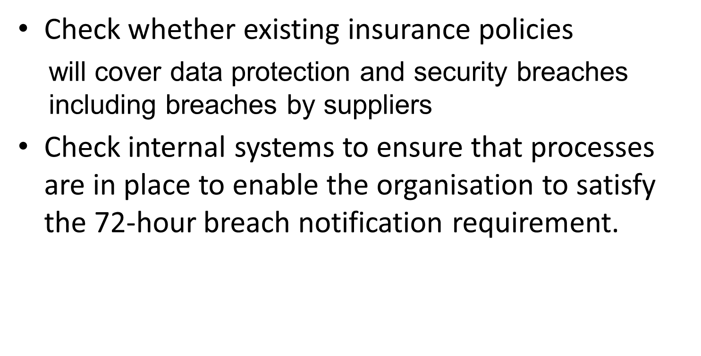
Check insurance policies

Slide 23
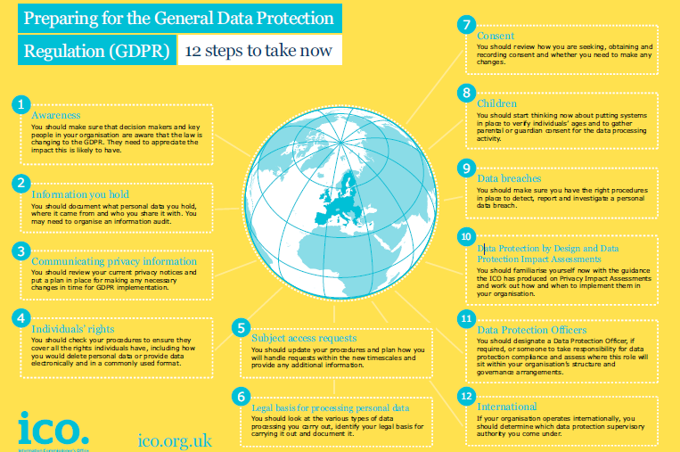
12 steps to take now

Slide 24
Questions

